Slide 1
Unit 5: Climates of the world
- Landscapes -

Slide 2
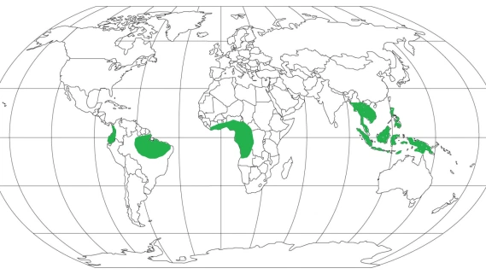
Rainforest or Jungle (Equatorial Climate).

Slide 3
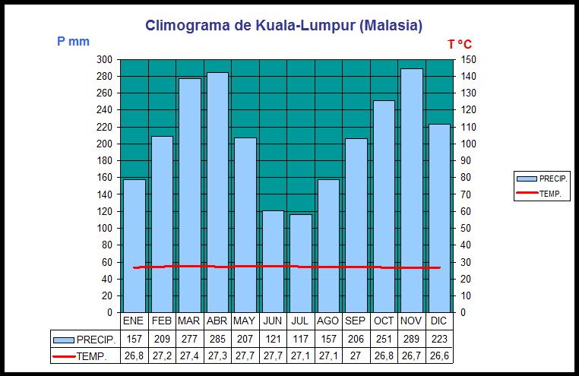
Rainforest or Jungle (Equatorial Climate).

Slide 4
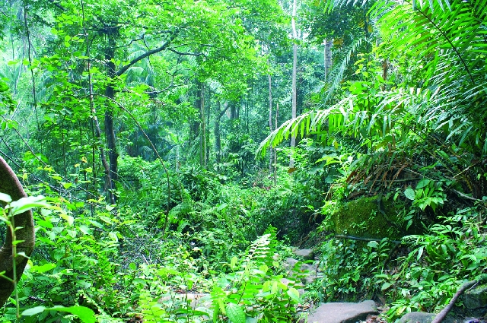
Rainforest or Jungle (Equatorial Climate).

Slide 5
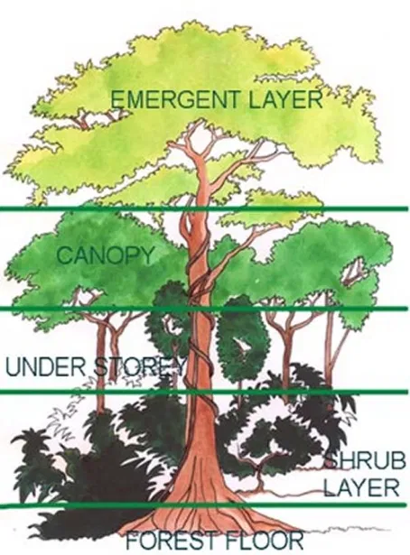
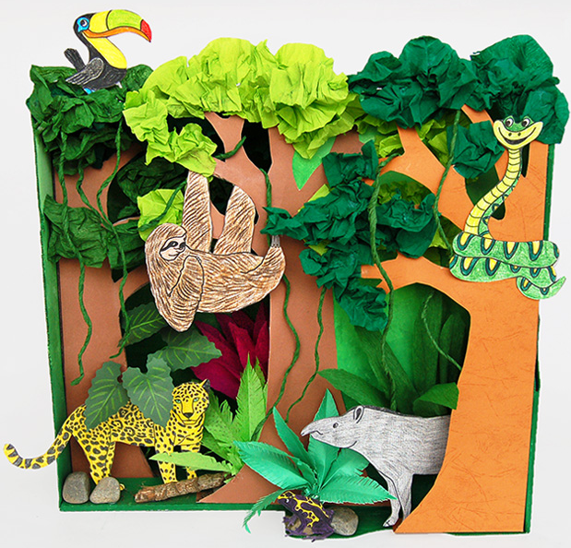
Rainforest or Jungle (Equatorial Climate).

Slide 6
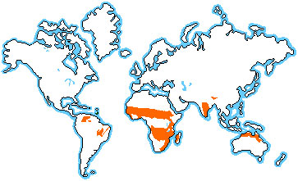
Savannah (Tropical or Savannah Climate).

Slide 7
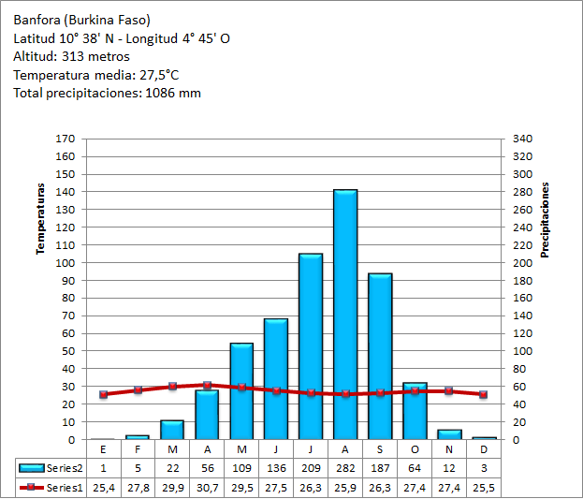
Savannah (Tropical or Savannah Climate).

Slide 8
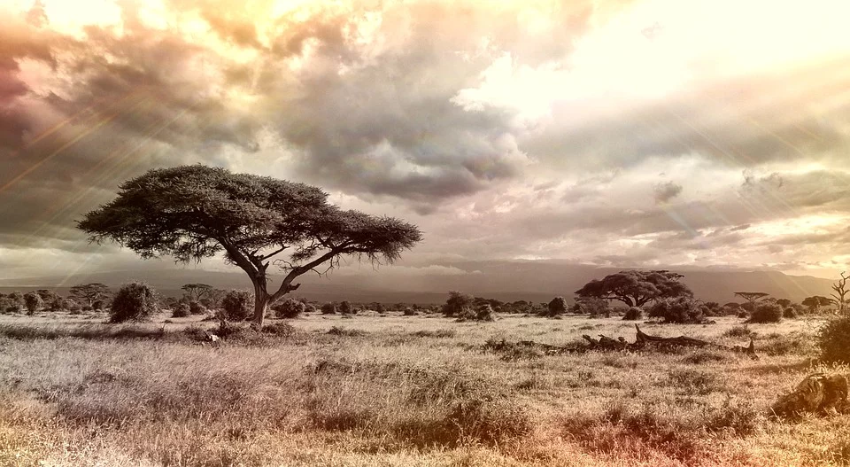
Savannah (Tropical or Savannah Climate).

Slide 9
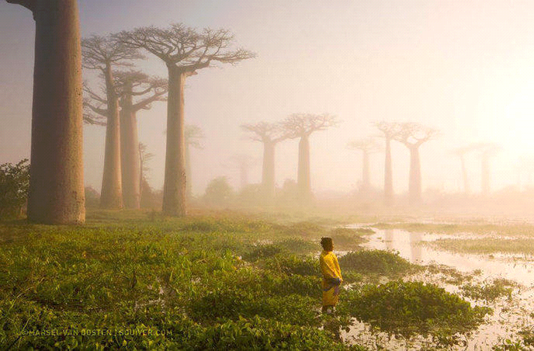
Savannah (Tropical or Savannah Climate).

Slide 10
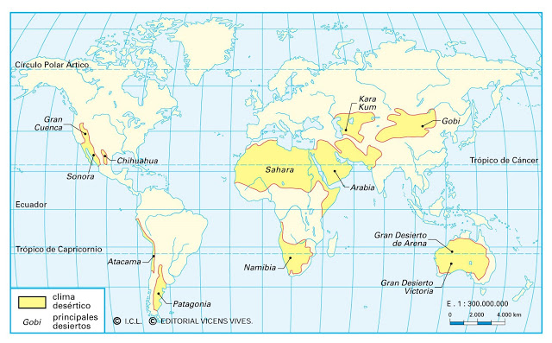
Hot desert Climate

Slide 11
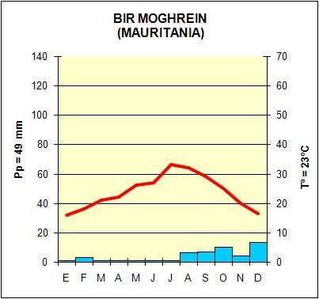
Hot Desert Climate

Slide 12
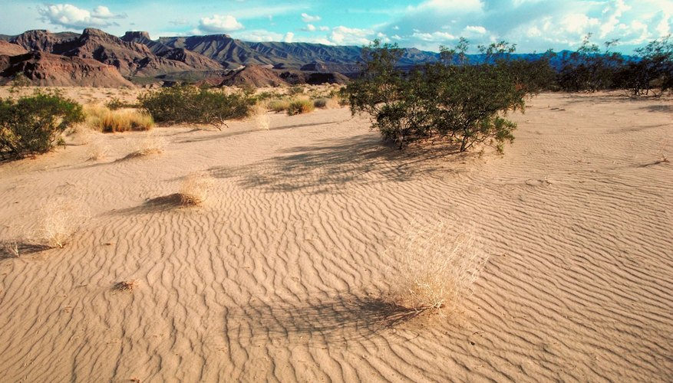
Hot desert Climate

Slide 13
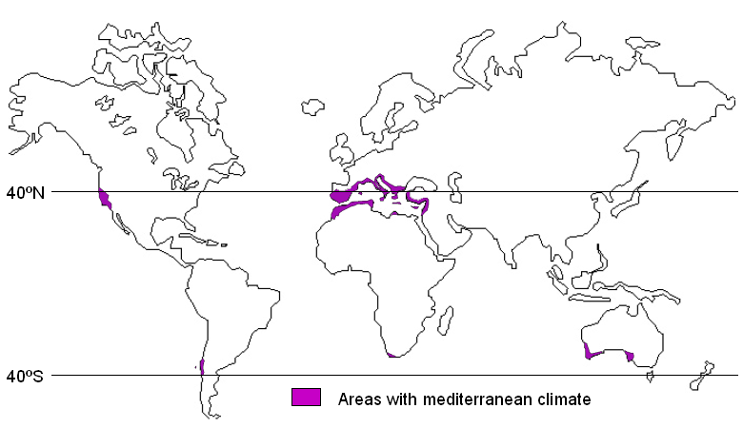
Mediterranean Climate

Slide 14
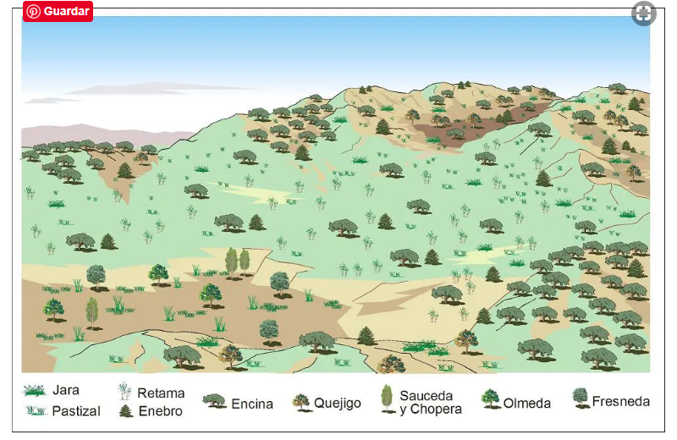
Mediterranean Landscape

Slide 15
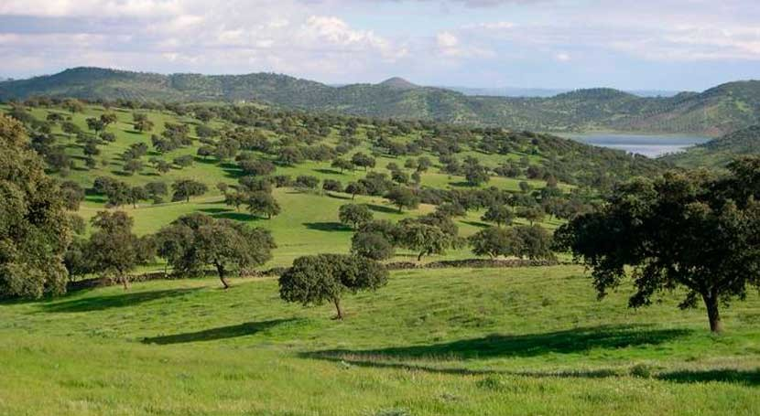
Mediterranean Forest

Slide 16
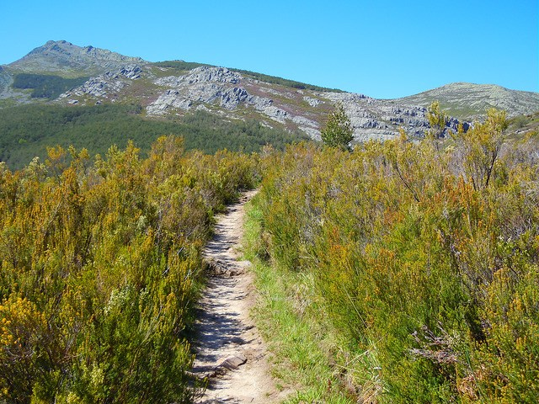
Maquis and Garrigue (Shrubland - Matorrales) (Mediterranean Climate)

Slide 17
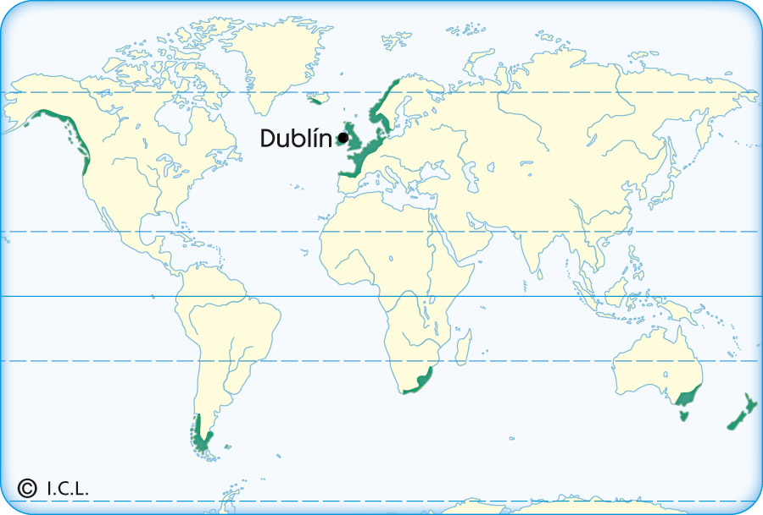
Oceanic Climate

Slide 18
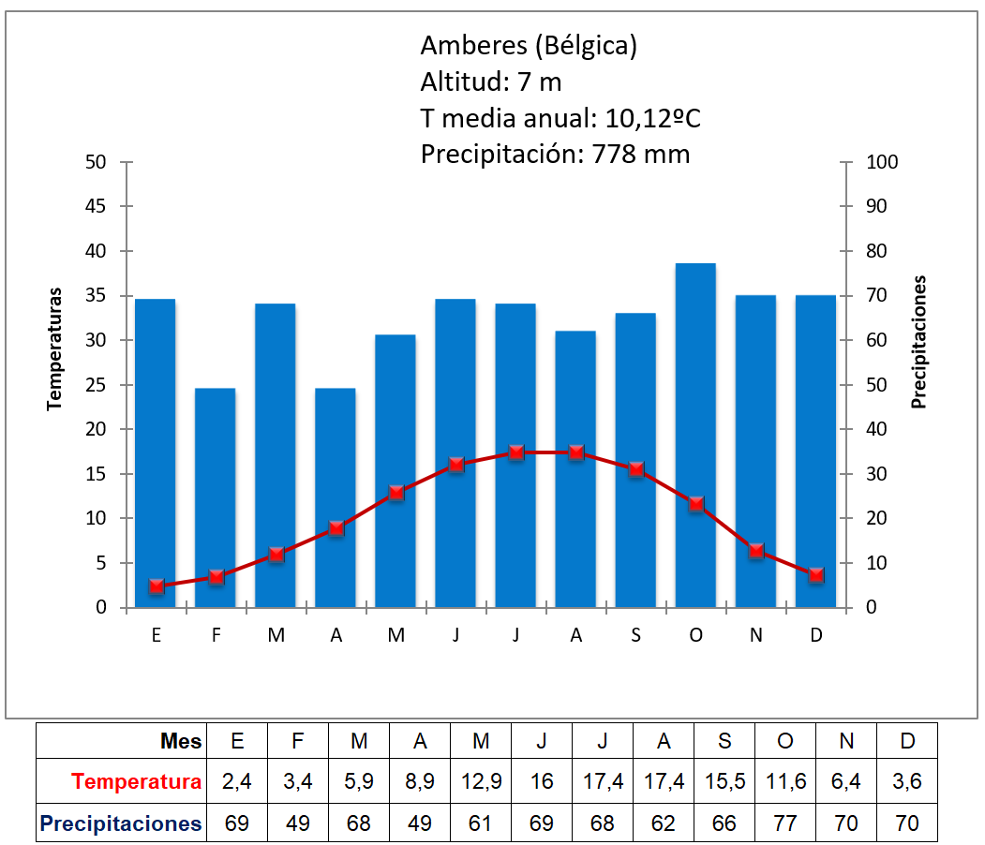
Oceanic Climate

Slide 19
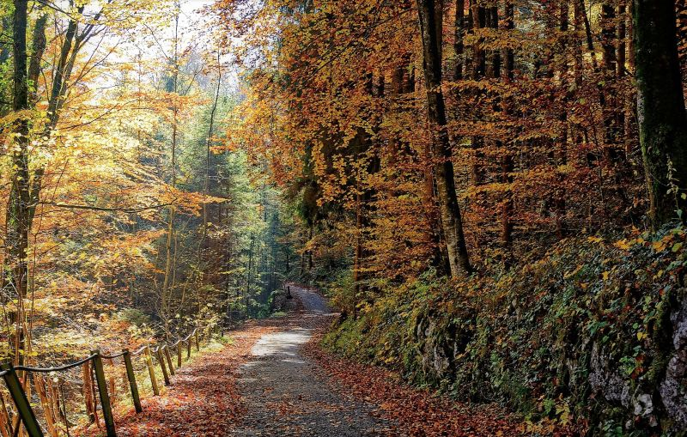
Deciduous Forest (Oceanic Climate)

Slide 20
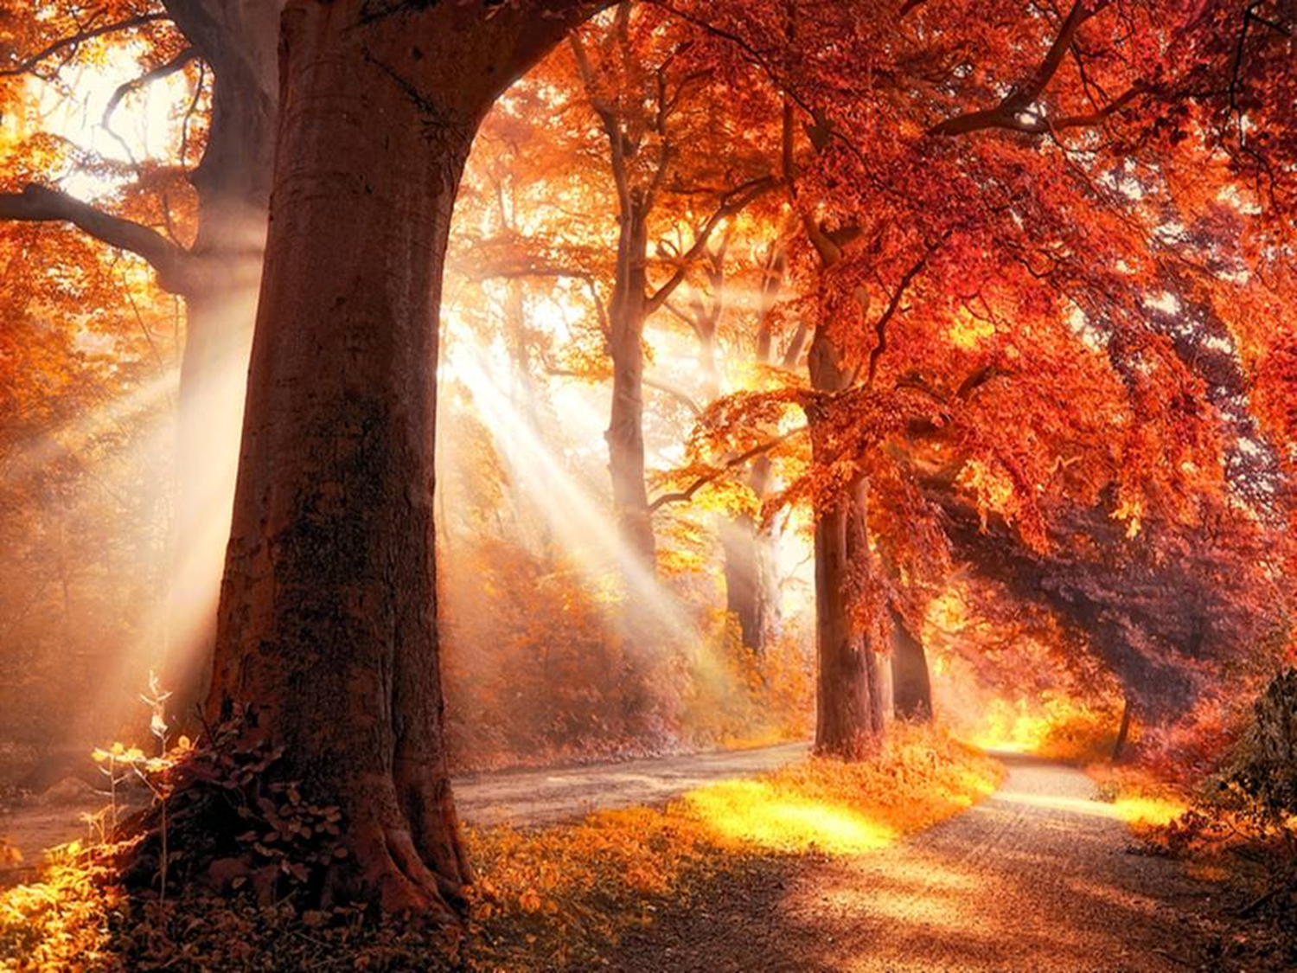

Slide 21
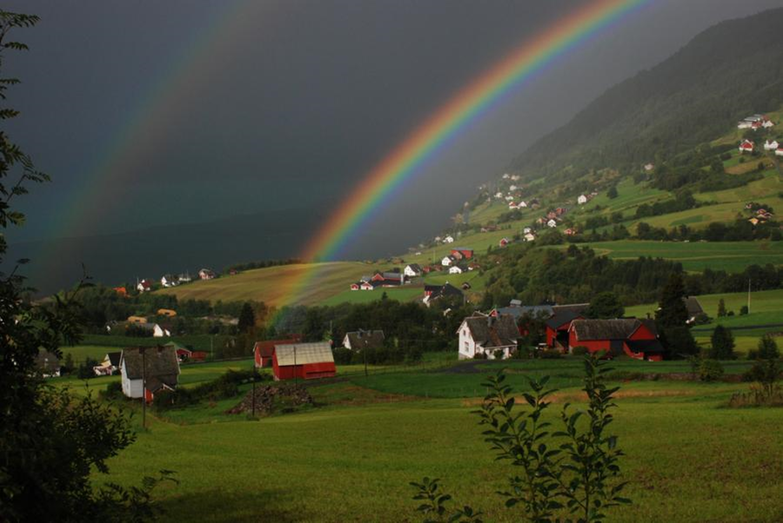
Moors and meadows (páramos y praderas)
(Oceanic Climate)

Slide 22
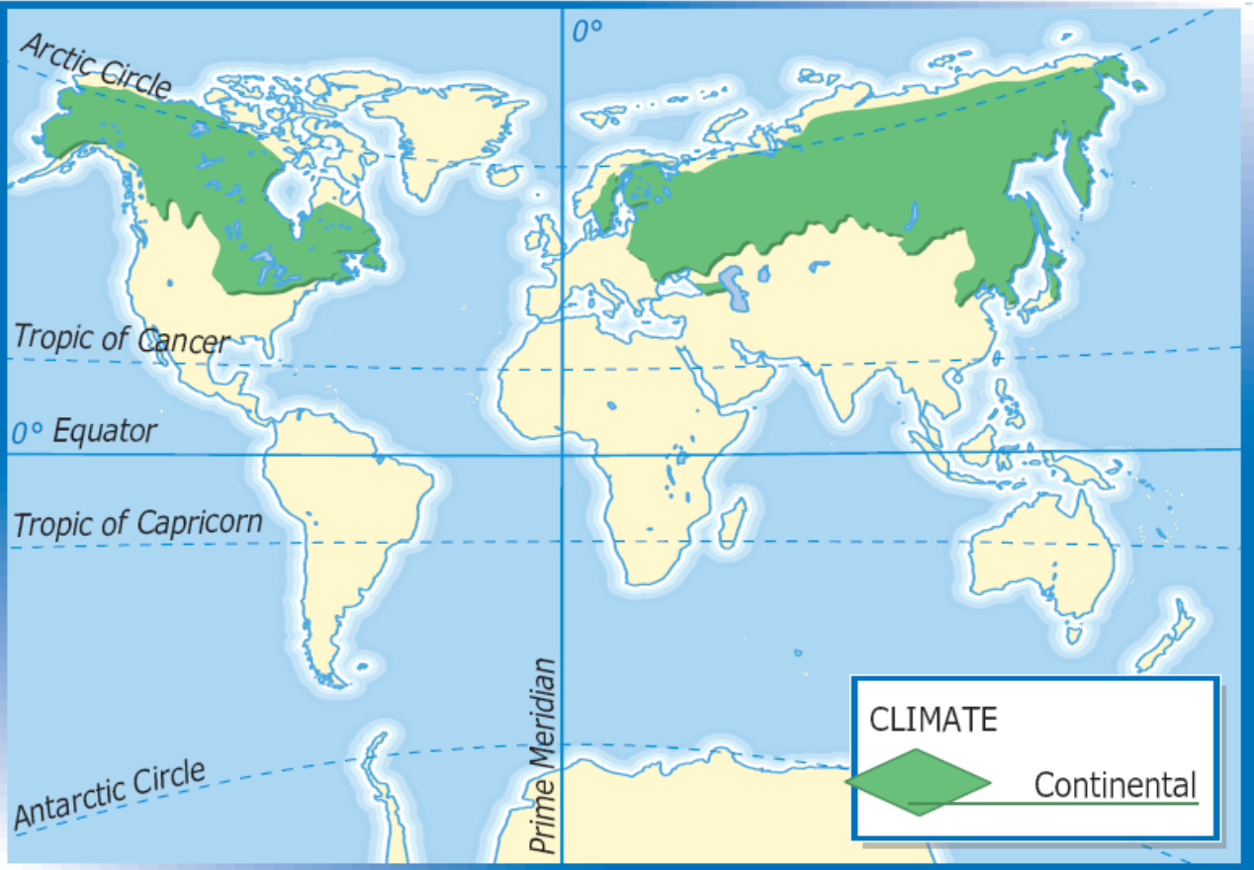
Continental Climate

Slide 23
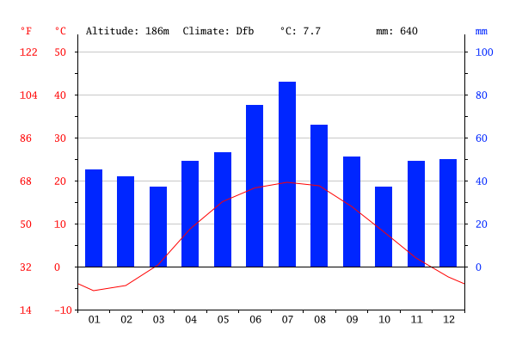
Continental Climate

Slide 24
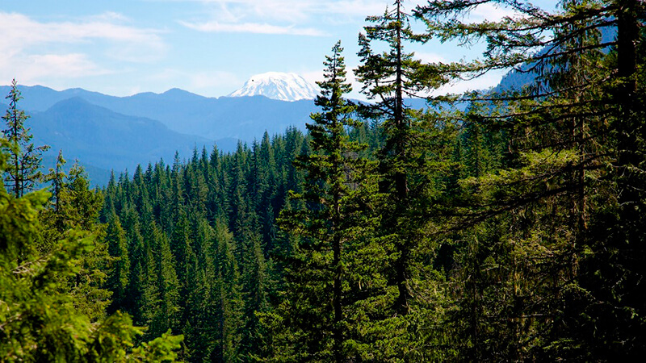
Taiga (Continental Climate)

Slide 25
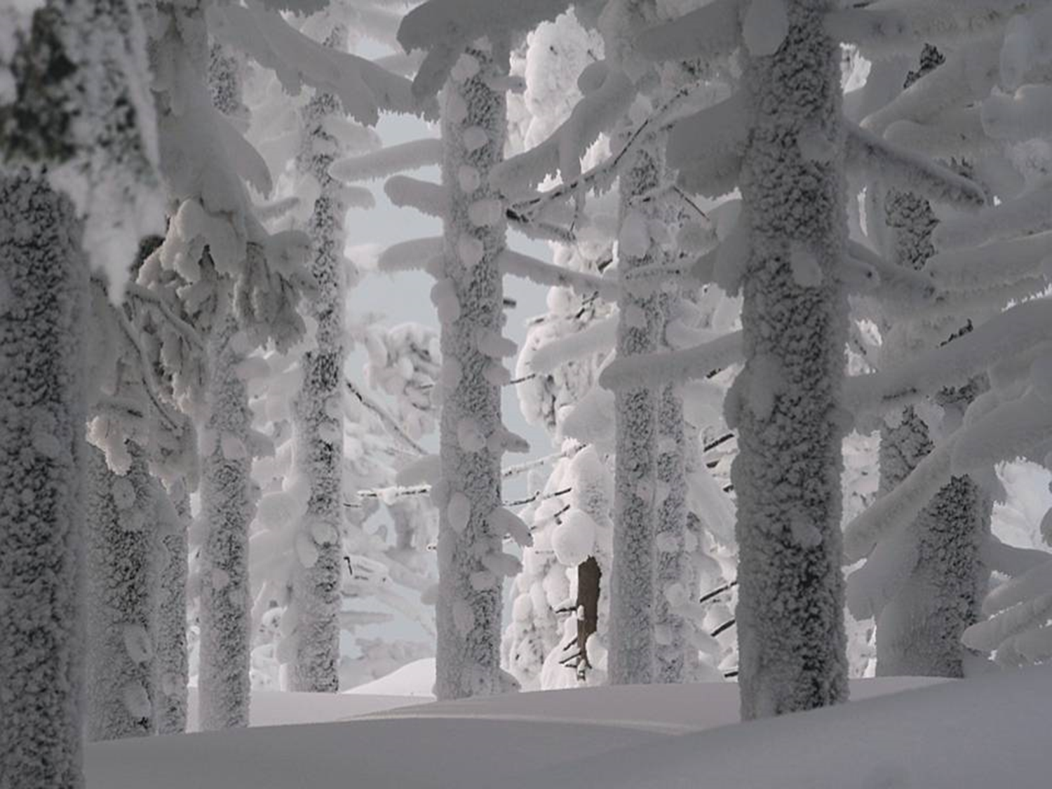

Slide 26
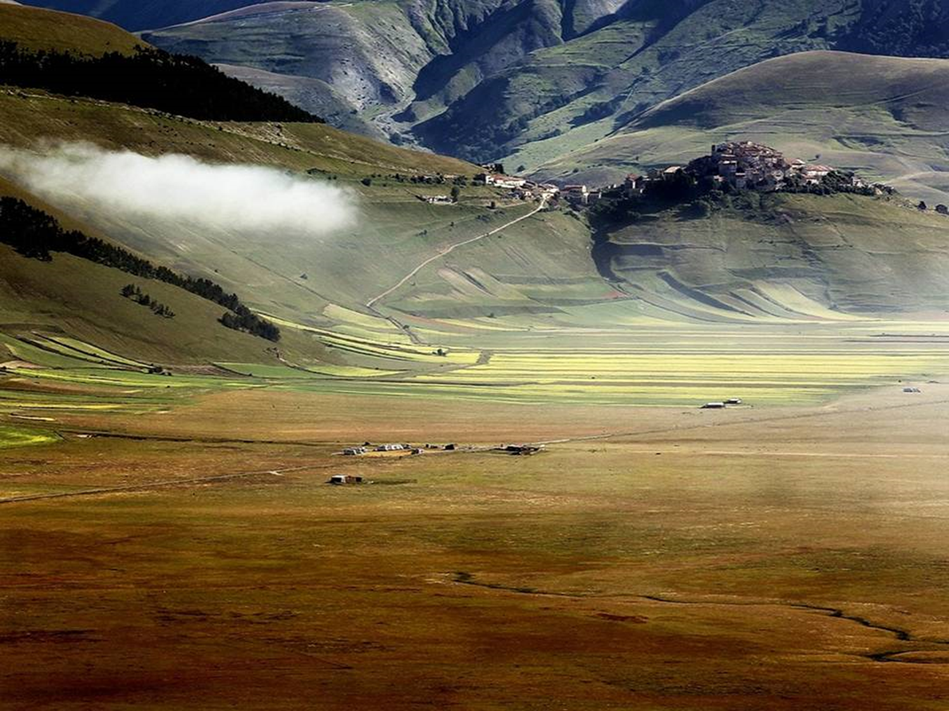
Steppes and prairies (Continental Climate)

Slide 27
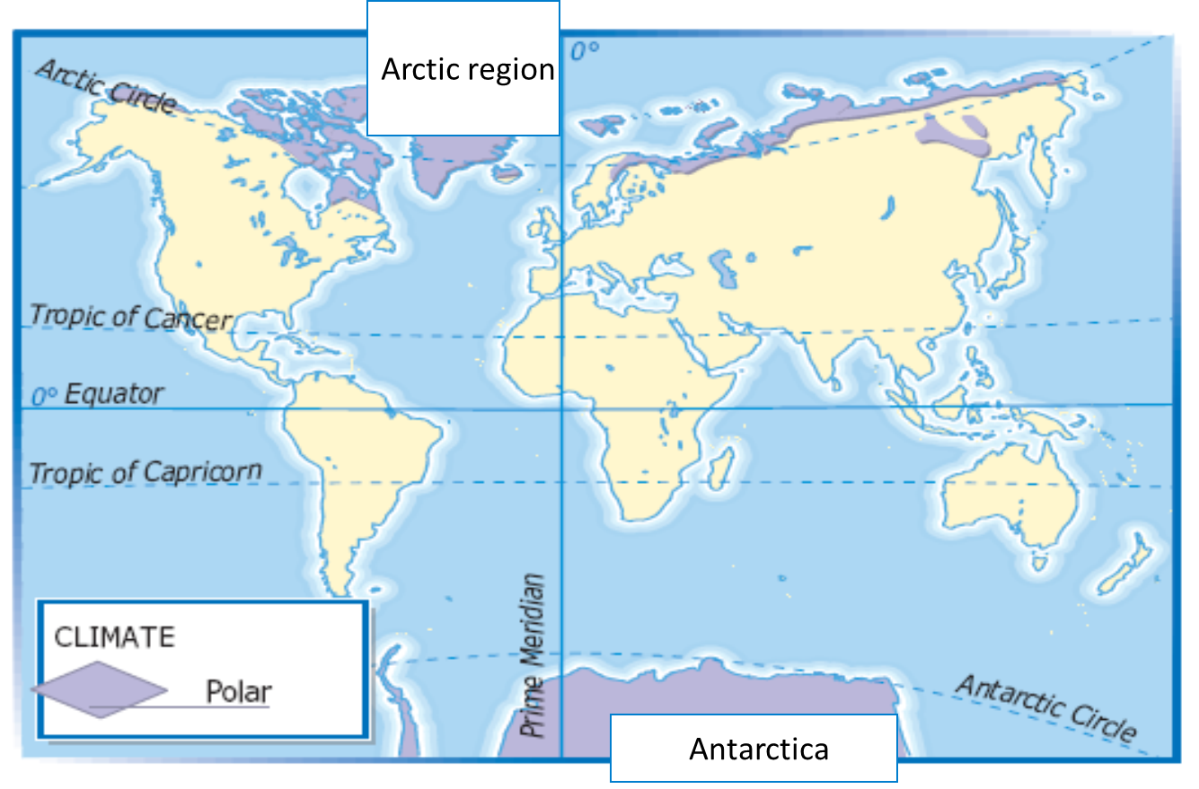
Polar Climate

Slide 28
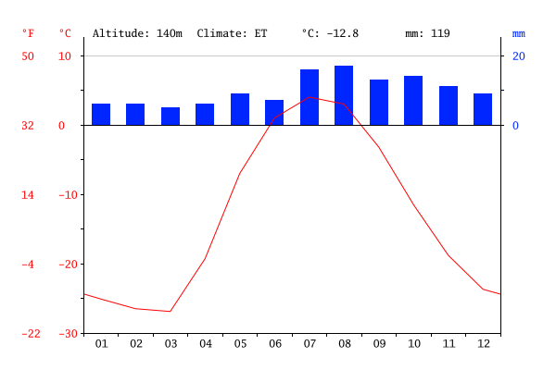
Polar Climate

Slide 29
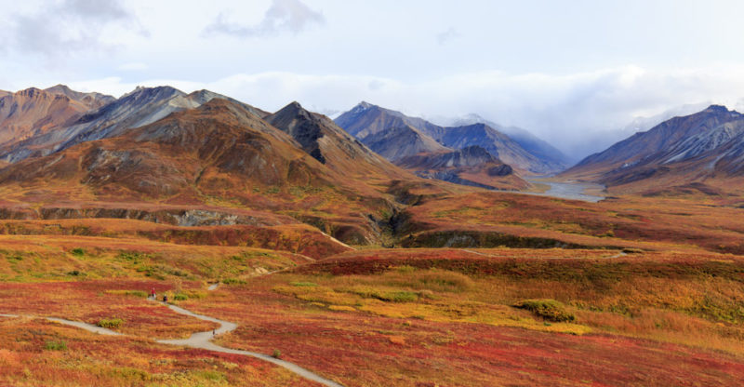
Tundra (Polar Climate)

Slide 30
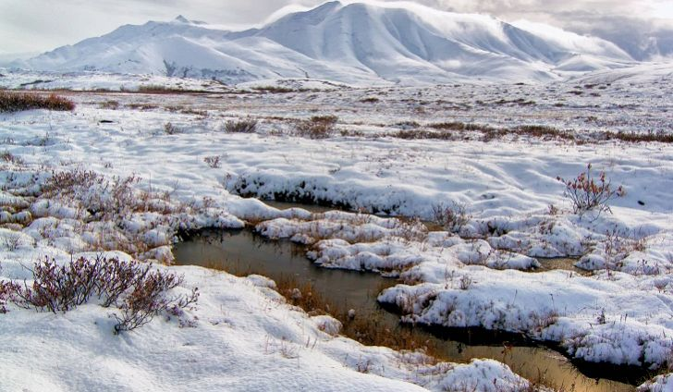
Tundra (Polar Climate)

Slide 31
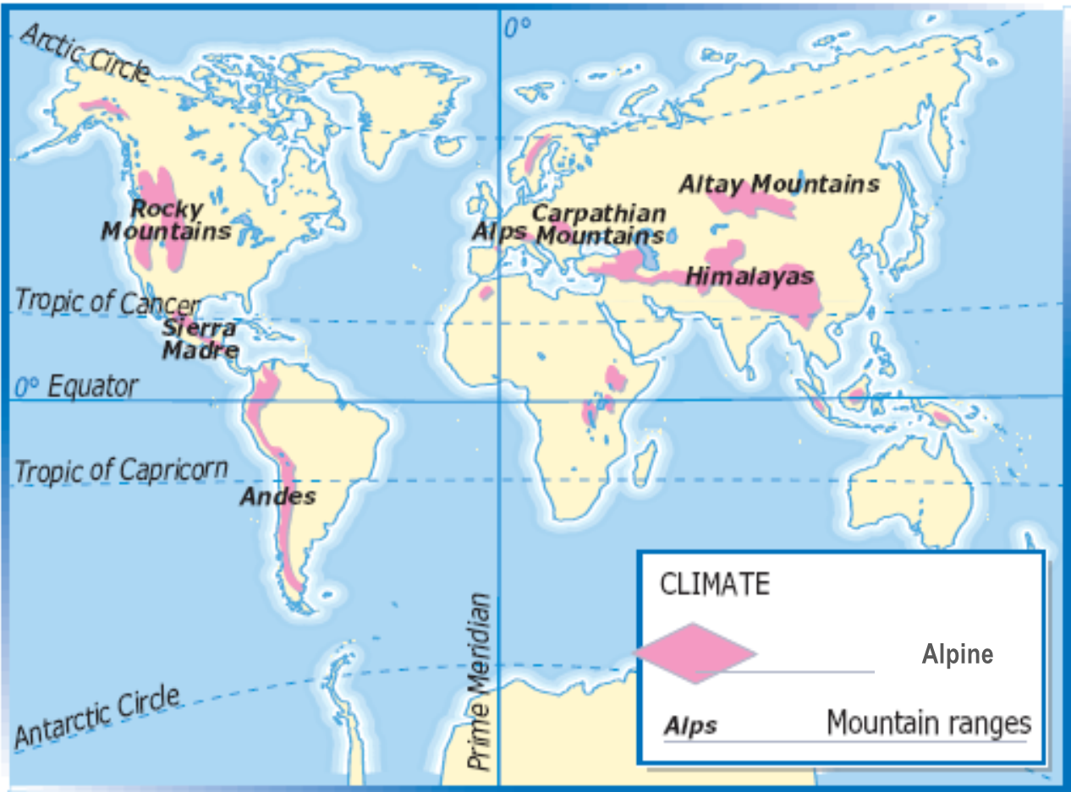
Mountain Climate

Slide 32
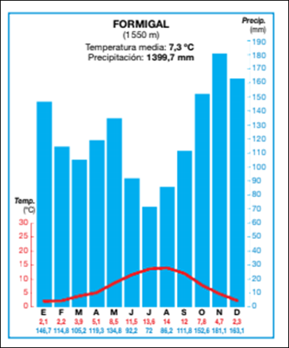
Mountain Climate

Slide 33
Mountain Climate
Vegetation changes with altitude because of the changes in temperature and precipitation.
It is called: Altitudinal Zonation (Cliserie)
The vegetation on sunny slopes is different from the vegetation on shady slopes
Vegetation is more abundant windward, than leeward.
The levels are:
Local trees
Deciduous trees
Evergreen trees (Taiga)
Shrubs or bushes
Grass or meadows
Moss and lichens (Tundra)
Snow zone

Slide 34
