Slide 1
Unit 5: Climates of the World

Slide 2
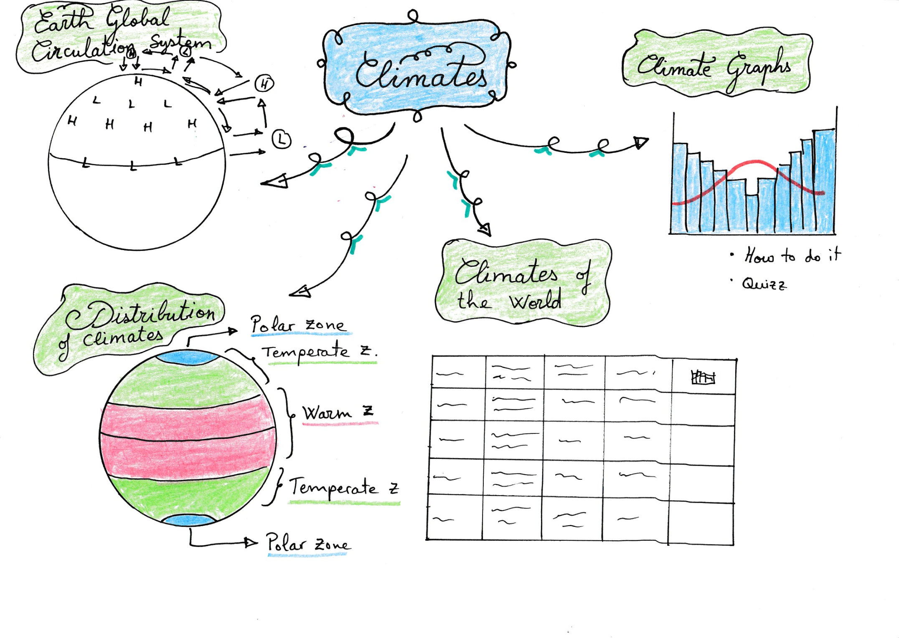

Slide 3
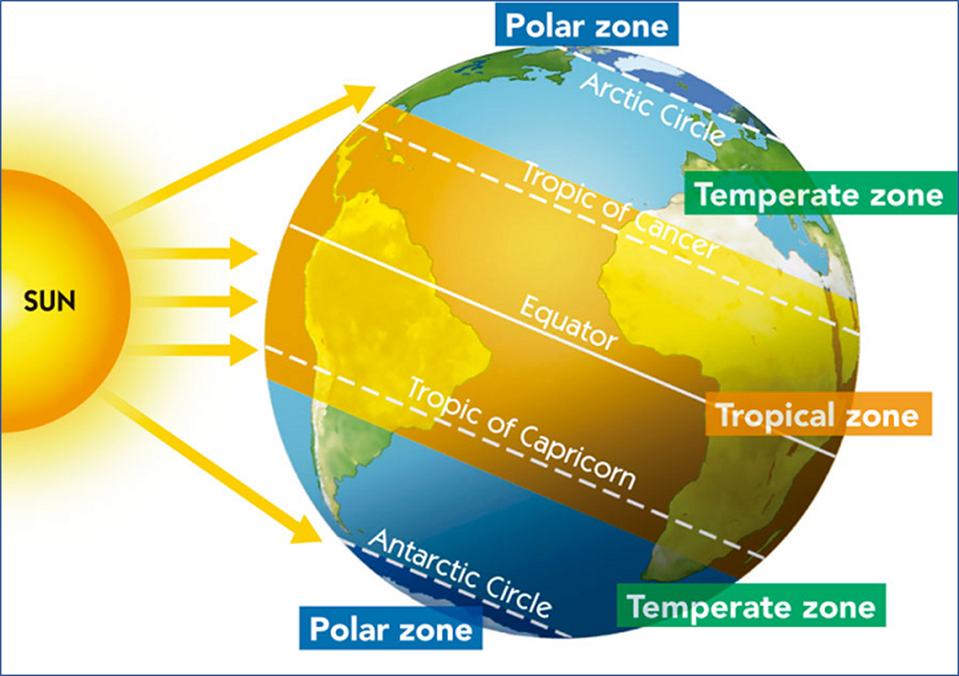
1) What are the Climates of the World?
Warm zone
Equatorial Climate
Tropical Climate
Hot desert Climate
Temperate zone
Mediterranean Climate
Oceanic Climate
Continental Climate
Cold Zone
Polar Climate
Mountain Climate

Slide 4
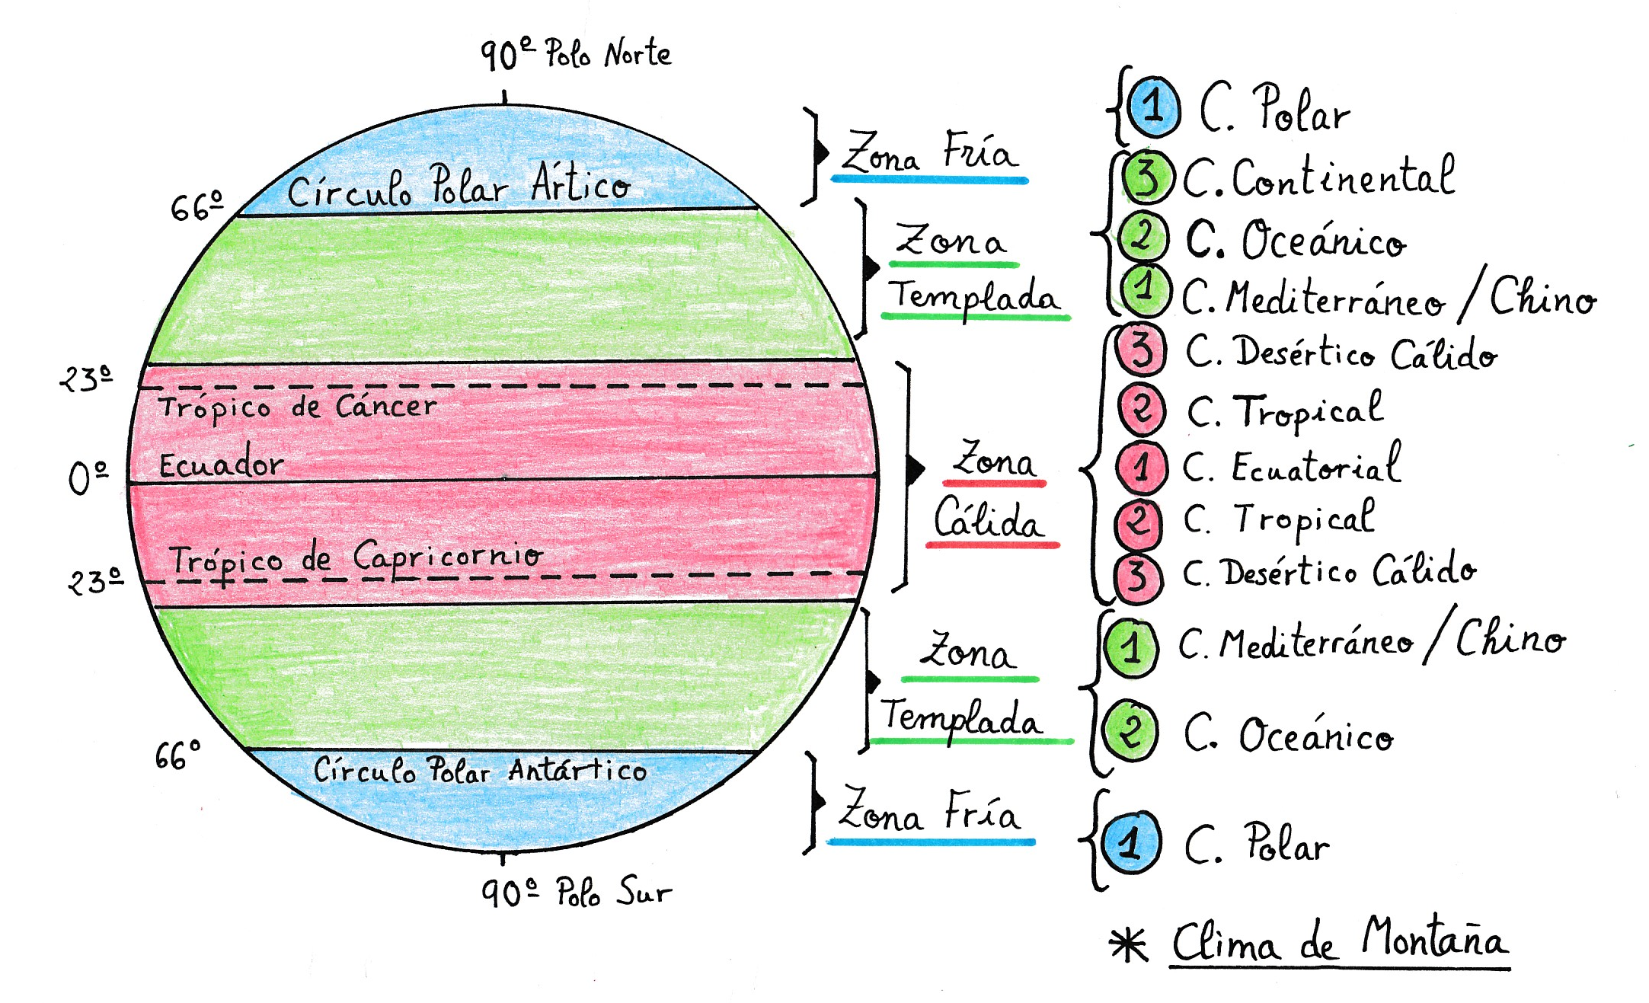
2) How are the Climates of the world distributed?

Slide 5
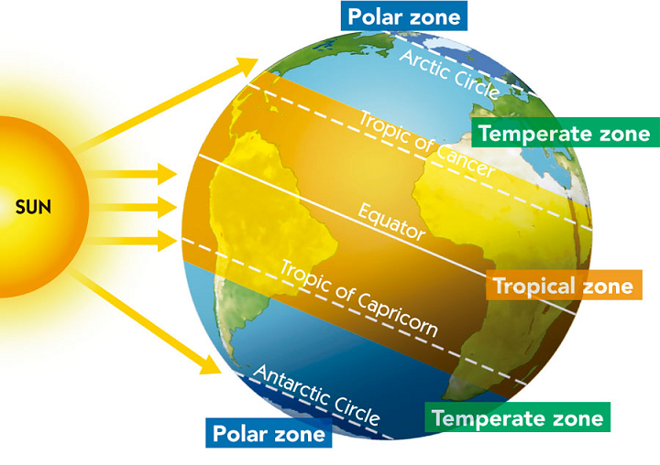
2) How are the Climates of the world distributed?
Polar Climate
Continental Climate
Oceanic Climate
Mediterranean Climate
Hot desert Climate
Tropical Climate
Equatorial Climate
Tropical Climate
Hot desert Climate
Mediterranean Climate
Oceanic Climate
Continental Climate
Mountain Climate
Polar Climate

Slide 6
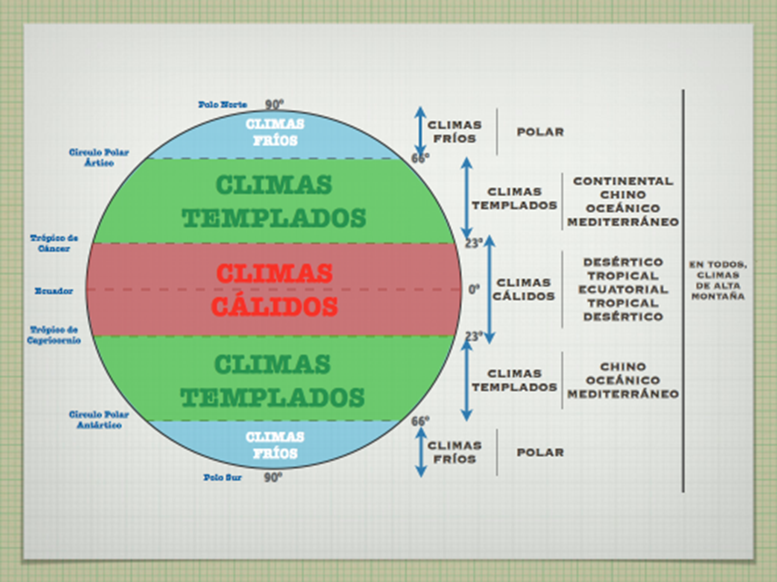

Slide 7
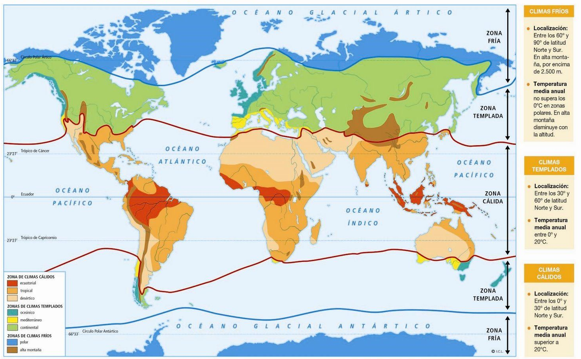

Slide 8
