Slide 1
Unit 4:
Weather and Climate

Slide 2
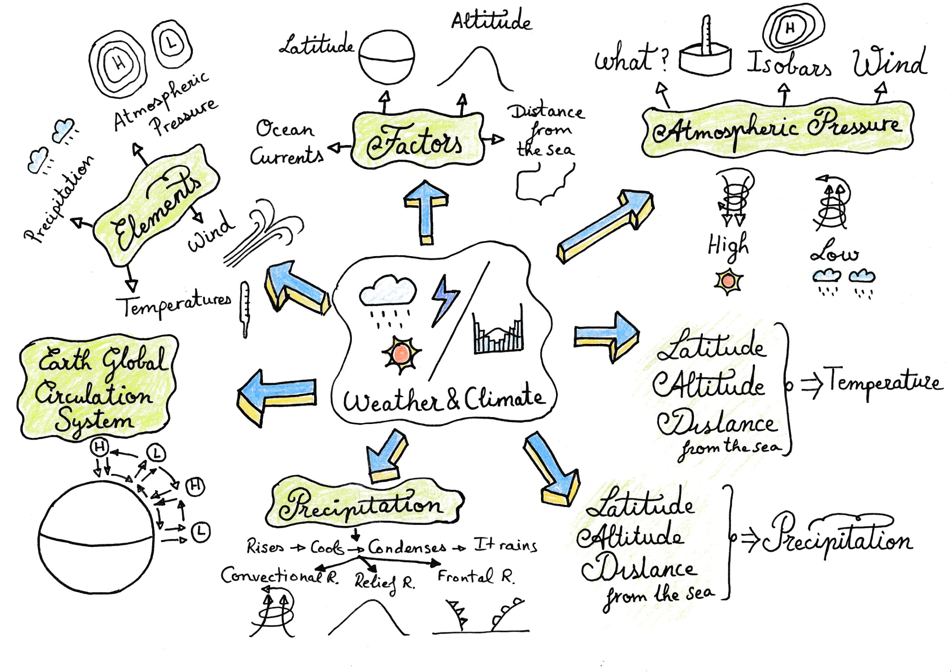

Slide 3
What is the difference between weather and climate?
Weather refers to the atmospheric conditions (temperature, precipitation, wind…) in a specific place and in a specific moment.
While climate refers to the atmospheric conditions in a region for a long period of time (20 – 30 years).

Slide 4
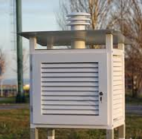

Slide 5
2) Explain the greenhouse effect (efecto invernadero).
The greenhouse effect is caused by the emission of certain gases from industry, cars and aerosols (carbon dioxide).
Due to this emissions the layer of gases that surround the Earth is becoming thicker.
This causes that the sunrays that reach the Earth are trapped and cannot escape increasing the temperatures of the Earth.

Slide 6
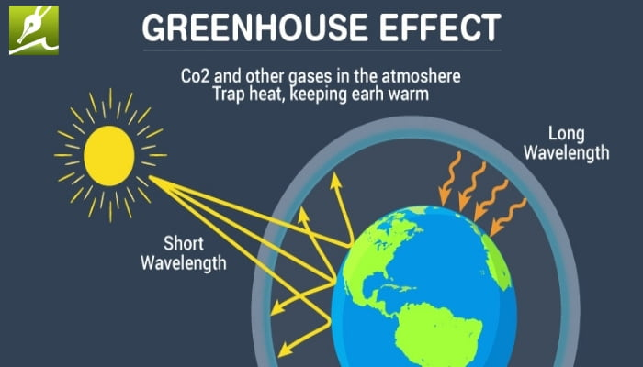

Slide 7
3) What are the elements of the climate?
The elements or components of the climate are:
Temperatures
Precipitation
Wind
Atmospheric Pressure

Slide 8
4) What are the factors of the Climate?
The factors of the climate can modify a climate and they are:
Latitude
Altitude
Distance from the sea
Ocean currents

Slide 9
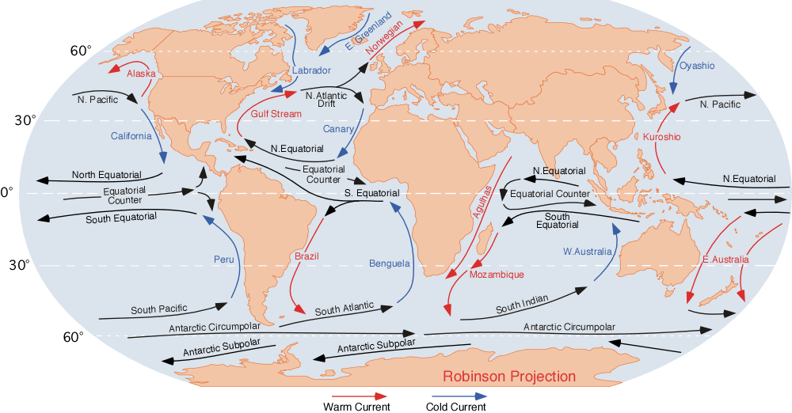

Slide 10
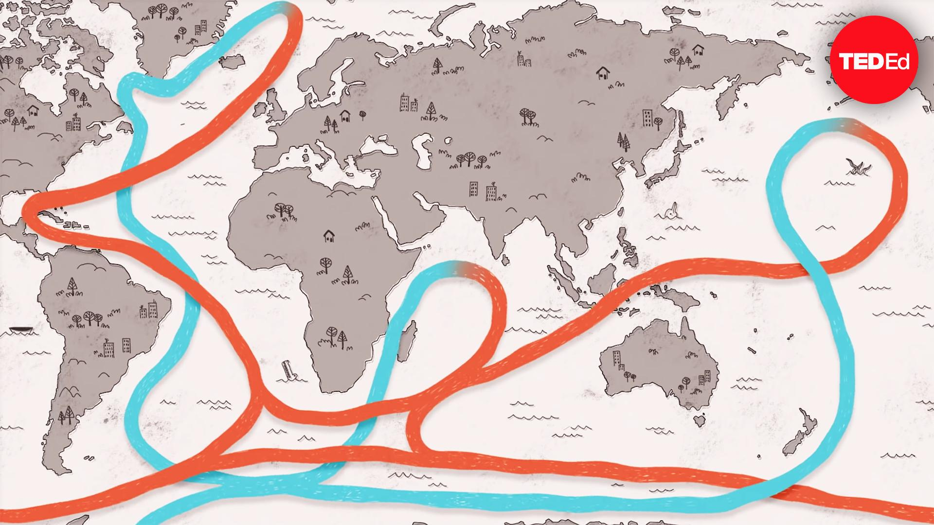

Slide 11
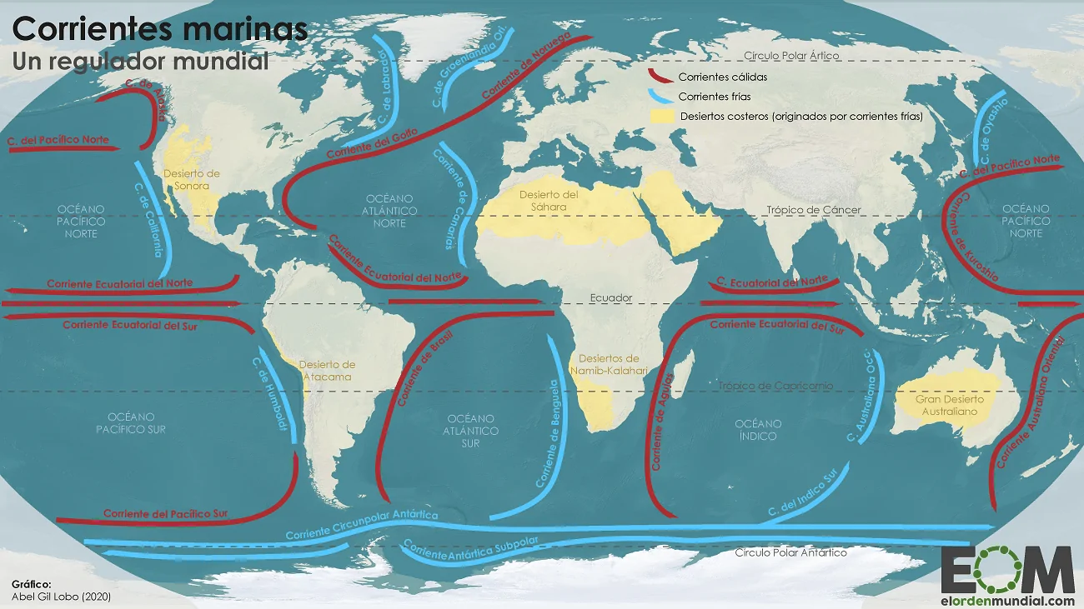

Slide 12
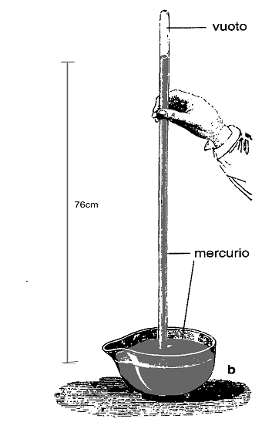
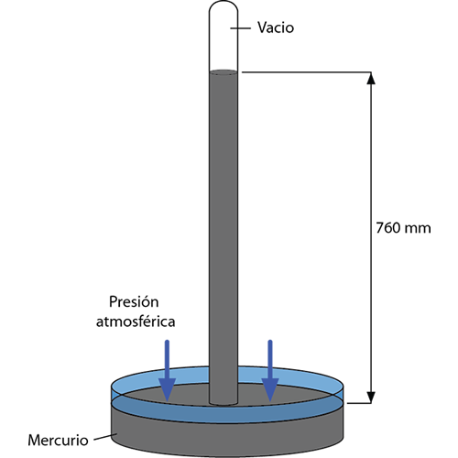
5) What is atmospheric pressure and what two types do we have?
Torricelli, 1647

Slide 13
5) What is atmospheric pressure and what two types do we have?
Atmospheric pressure is the weight that the atmosphere exerts over us.
We have two types that are high pressure and low pressure.

Slide 14
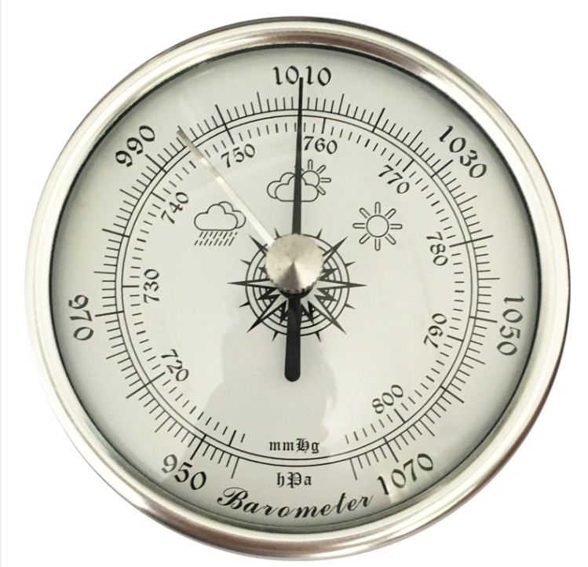
6) How is the atmospheric pressure measured?
It is measured with a barometer and the unit is the milibars or hectopascals (mb or hPa).

Slide 15
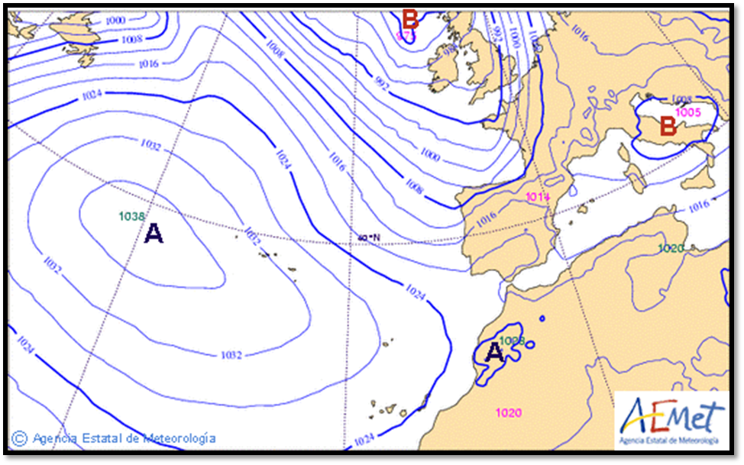
7) What is an Isobar?
An isobar is a line that joins points with the same atmospheric pressure.

Slide 16
Explain what is High Pressure, how it is represented and how is the weather caused by it.
High Pressure or Anticyclone (Alta presión o Anticiclón) is when the air exerts a high pressure (the air is heavy).
It is represented with an H (with an A in Spanish).
It causes stable weather (sunny and dry) and hot and cold weather.

Slide 17
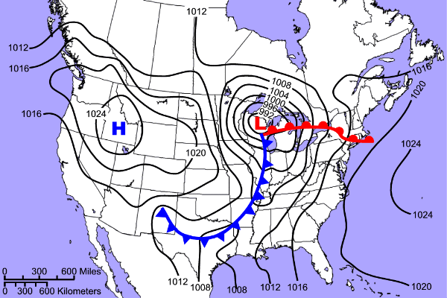
> 1013: High Pressure
< 1013: Low Pressure

Slide 18
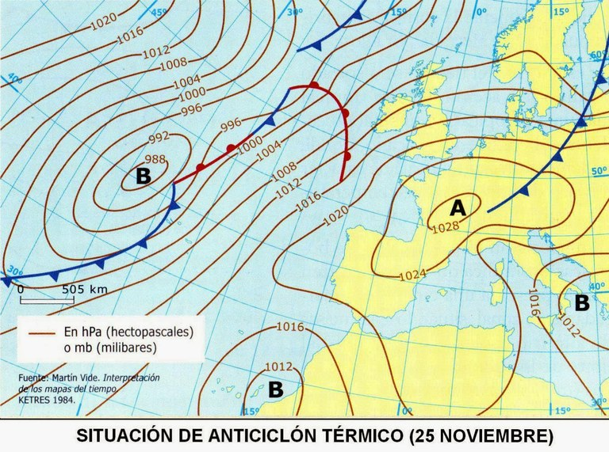

Slide 19
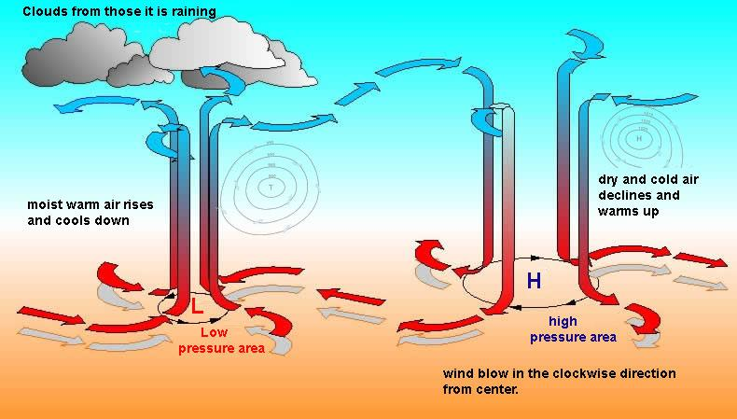

Slide 20
Explain what is Low Pressure, how it is represented and how is the weather caused by it.
Low Pressure or Depression (Baja presión o Borrasca) is when the air exerts a low pressure (the air is light).
It is represented with a L (with a B in Spanish).
It causes unstable weather (cloudy and wet, it may cause rain).

Slide 21
10) What is wind?
Wind is the movement of masses of air from the high pressure areas to the low pressure areas.
Extra information:
It usually carries with it the characteristics of the region of origin (cold or hot temperatures, humidity or dryness, sand...)
High pressure areas move clockwise
Low pressure areas move counter clockwise
You can see it in this web: www.ventusky.com

Slide 22
Factors
Latitude
Altitude
Distance from the sea
Elements
Temperatures
Precipitation

Slide 23
How do Latitude, Altitude and Distance from the Sea affect temperature?
Latitude: temperatures are warmer in the equator than in the poles.
Altitude: Temperatures decrease with altitude (0,6º C per 100 m).
Distance from the sea:
Near the coast temperatures are milder or softer (not so cold in winter and not so hot in summer).
Far from the coast (in the inland) temperatures are more extreme. (Winters are colder and summers are hotter).

Slide 24
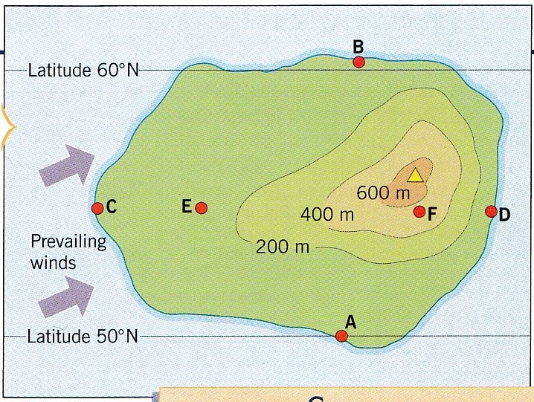
Activity
Answer to the following questions:
A-B. Which one is warmer and why?
C-E. Which one has more extreme temperatures and why?
D-F. Which one has colder temperatures and why?
D-F. If the point D has 20ºC of temperaturas and the altitude of the yellow triangle is 800 meters, what is the temperature of the yellow triangle?

Slide 25
How do Latitude, Altitude and Distance from the Sea affect Precipitation?
Latitude: depending on the latitude precipitation vary.
In the equator it rains a lot. (Equatorial climate)
In the tropics it doesn’t rain much. (Desert climate)
Altitude: it rains more in the mountains.
Distance from the sea: it rains more near the coast because there is more humidity.

Slide 26
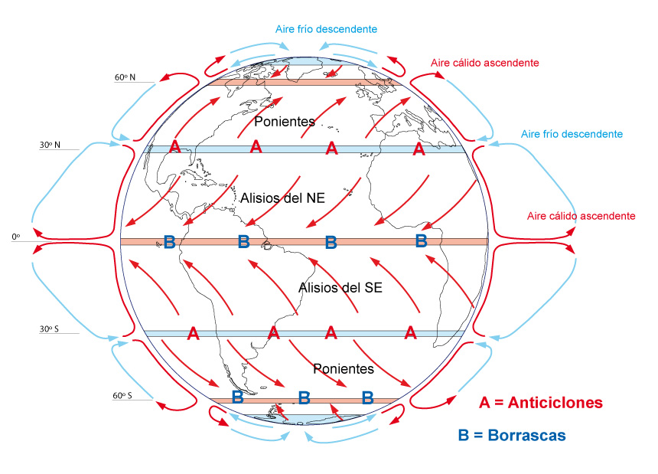
Latitude

Slide 27
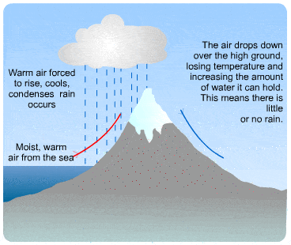
Altitude

Slide 28
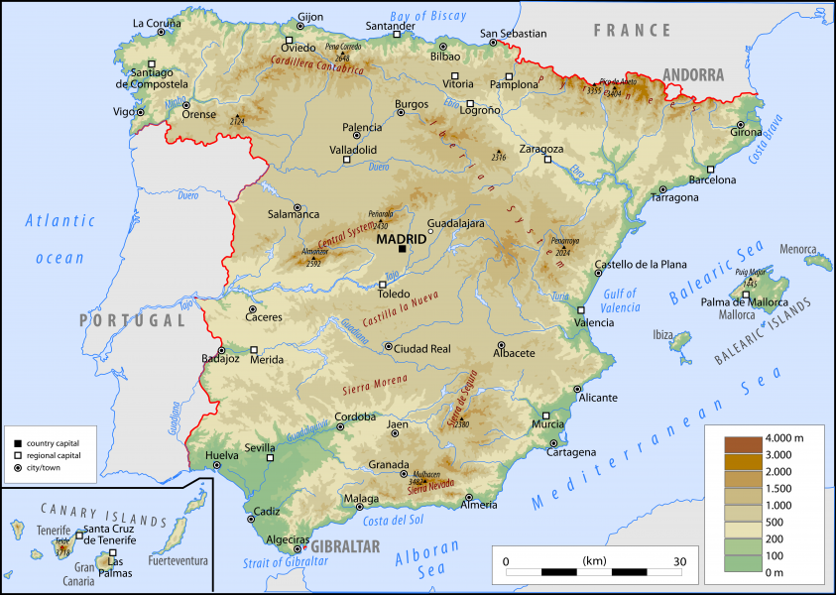
Distance from the sea

Slide 29
THE MASSES OF AIR:
RISE => COOL => CONDENSE => IT RAINS
What three types of precipitations do we have?
The three types of precipitation are:
Convectional rainfall
Relief rainfall
Frontal rainfall

Slide 30
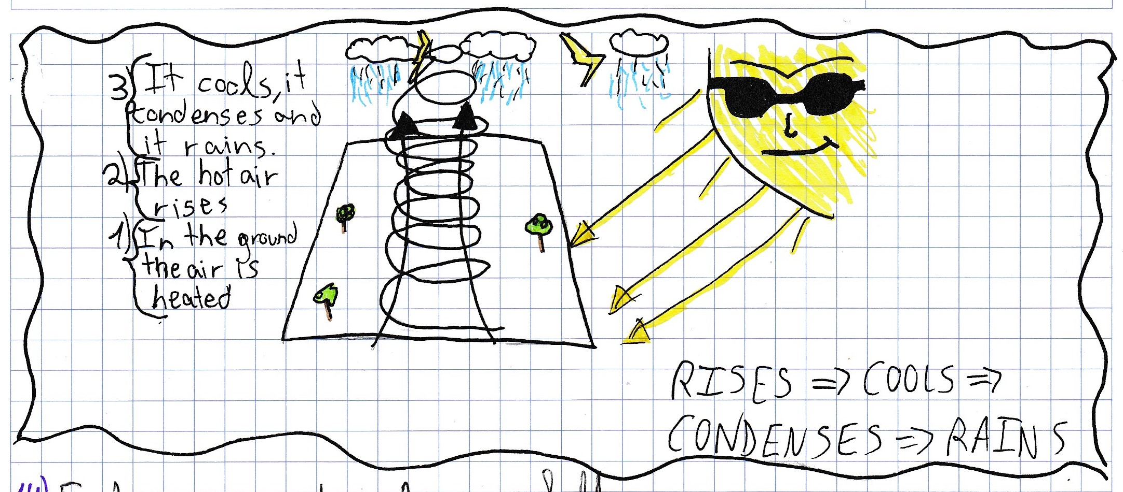
Explain convectional rainfall
In the convectional rainfall the ground is being heated by the sun; the hot air is lighter, it rises up, it gets cooler, it condenses and it rains.

Slide 32
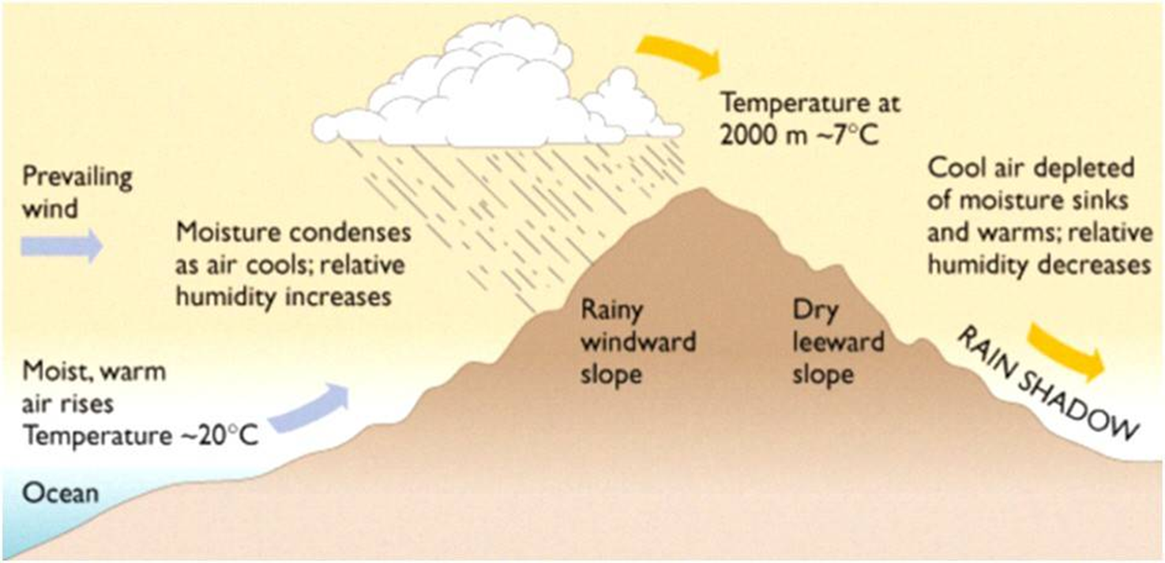
Explain Relief rainfall
In the relief rainfall the masses of air are forced to rise up by a mountain. The air rises up, it gets cooler, it condenses and it rains.
Notes:
32

Slide 33
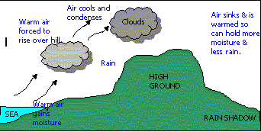

Slide 34
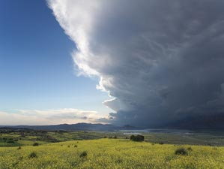
Frontal rainfall. What is a front?
A front is the boundary between two masses of air of different characteristics (one warm and one cold).
How does frontal rainfall work?
The warm mass of air goes up forced by the cold mass of air. When the warm mass of air rises up it gets cooler, it condenses and it rains.

Slide 35
What two types of fronts do we have?
There are two types of fronts, cold front and warm front.
Cold front is when the mass of air that is pushing is cold.
Warm front is when the mass of air that is pushing is warm.

Slide 36
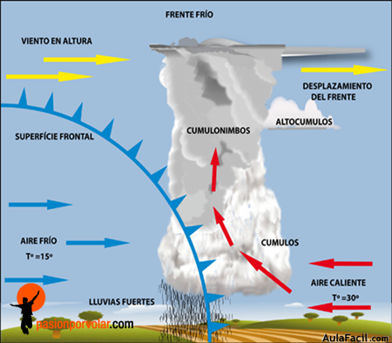
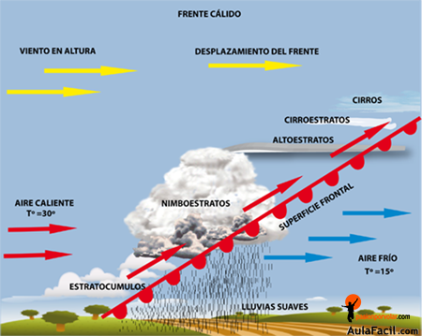
Cold Front
Warm Front

Slide 37
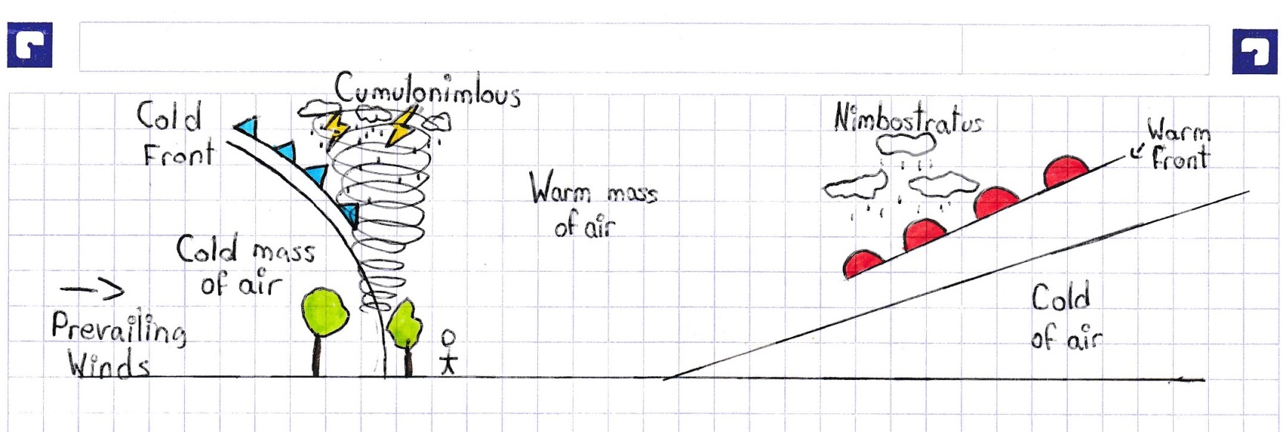
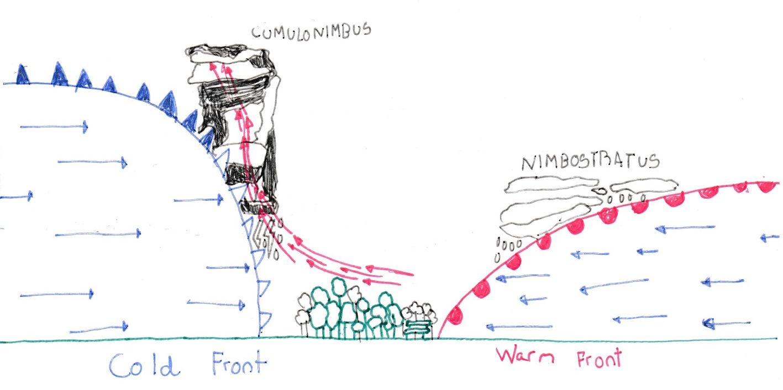

Slide 38
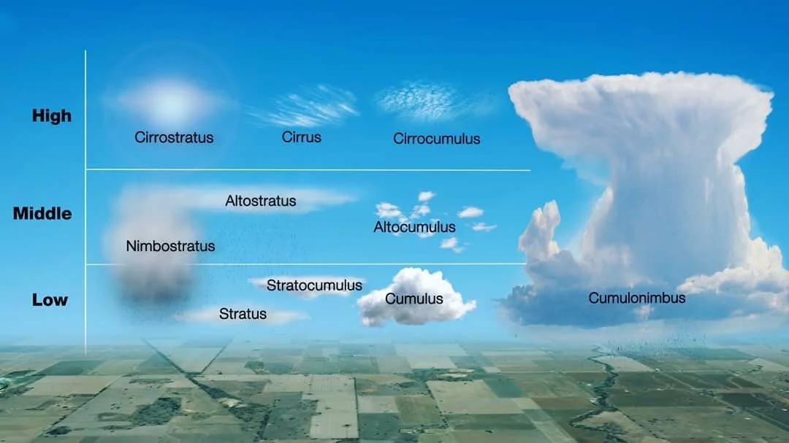

Slide 39
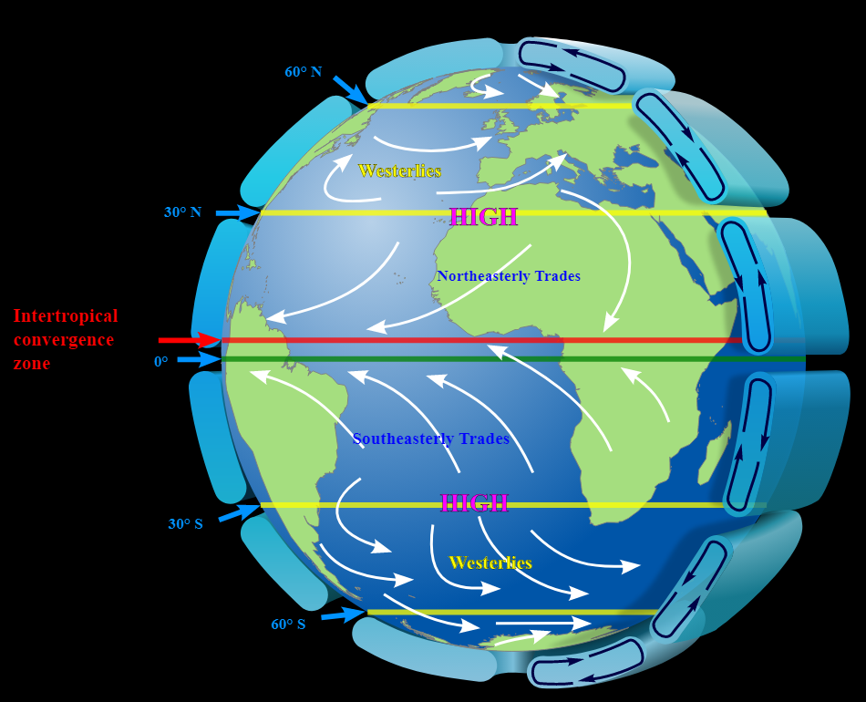
Earth Global Circulation System

Slide 40
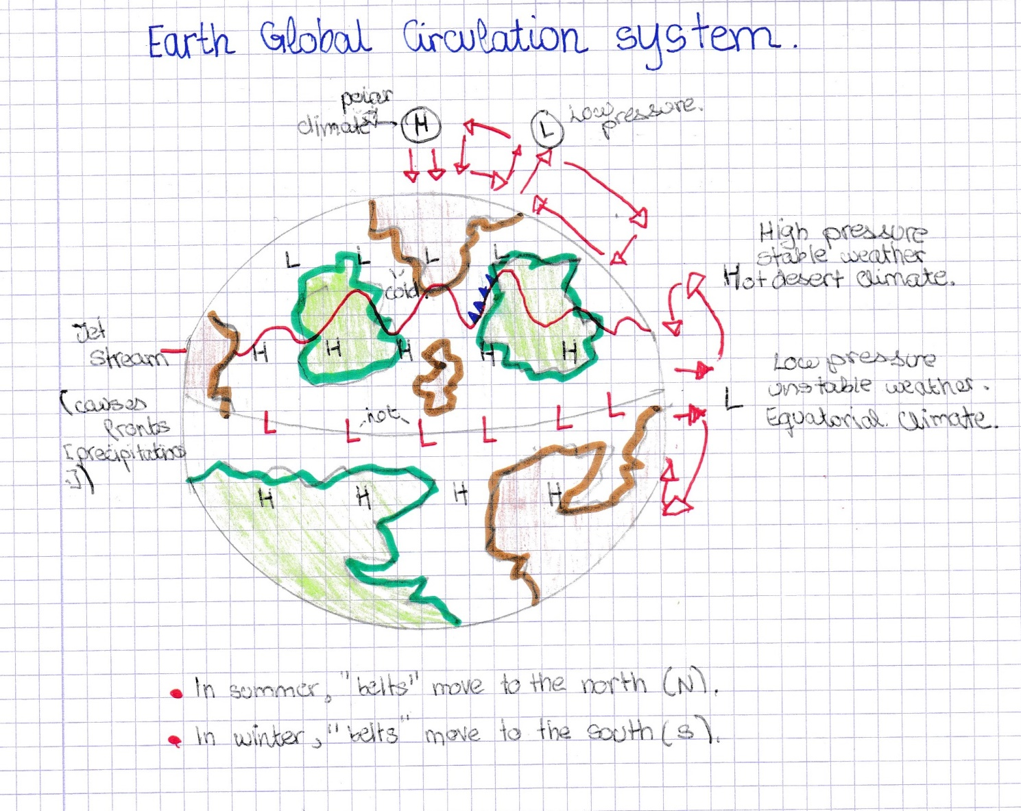

Slide 41
