Slide 1
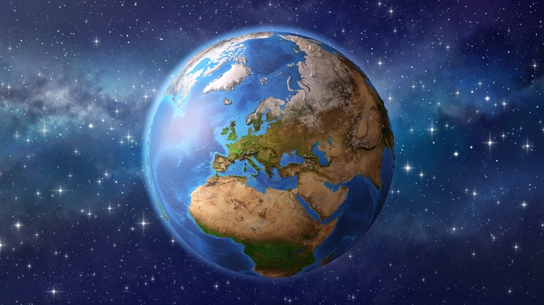
Unit 1: The Earth

Slide 2
1. Write a definition about the rotation of the Earth (include how long it takes and its consequences).
It is the movement of the Earth around its own axis (220 km/sec).
This movement takes (slightly less than ) 24 hours and causes the succession of days and nights.

Slide 3
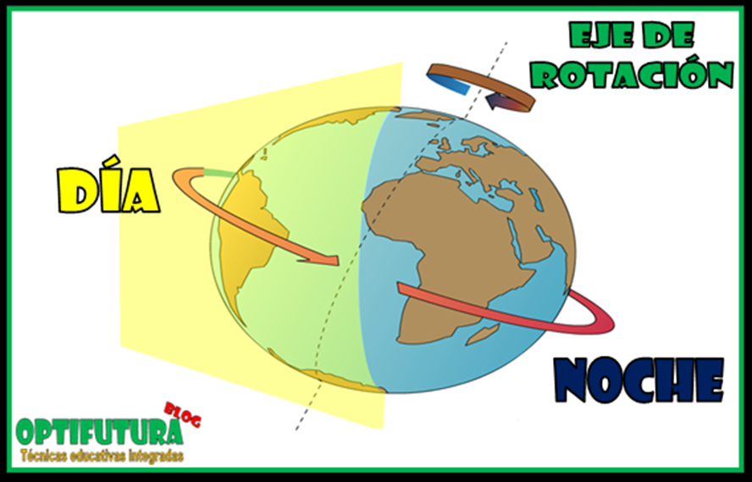

Slide 5
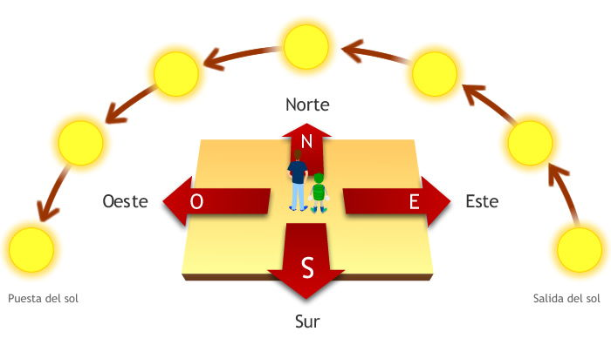
Cardinal Points
2. Where does the sun rise?
The sun rises in the east.
3. Where does the sun set?
The sun sets in the west.

Slide 6
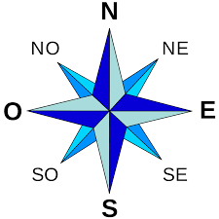
North (Norte, Septentrional, Boreal)
West (Oeste, Occidente, Poniente)
East (Este, Oriente, Levante)
South (Sur, Meridional, Austral)

Slide 7
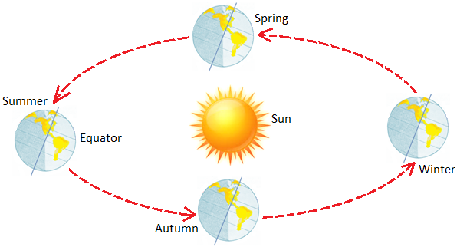
4. Write a definition of the revolution of the Earth. (Include how long it takes and its consequences).
It is the movement of the Earth around the Sun. It takes 365 days, 6 hours and 9 minutes. It causes the succession of four different seasons.

Slide 8
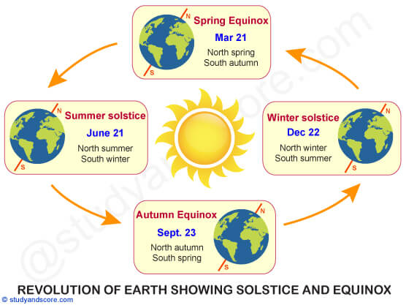

Slide 9
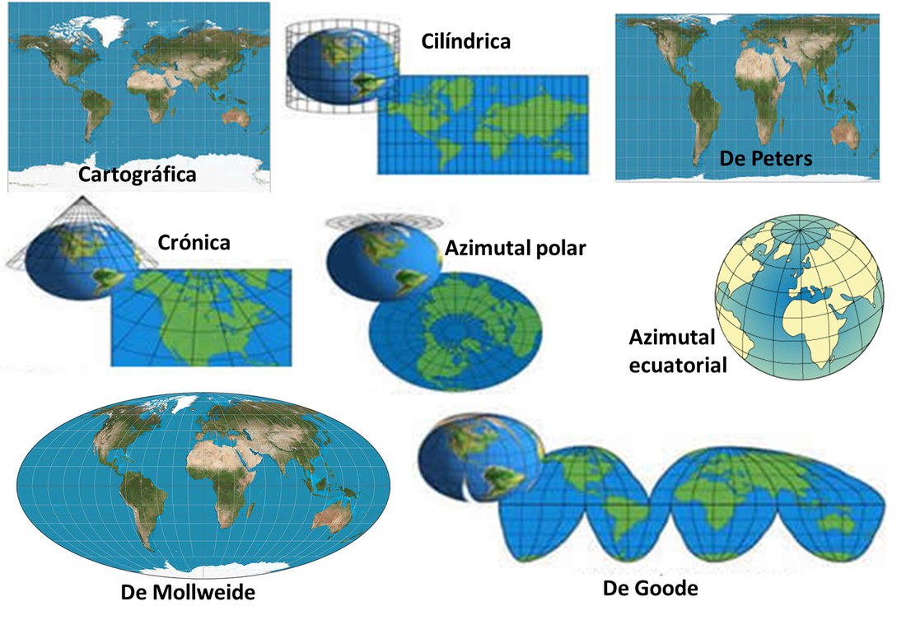
Representing the Earth

Slide 10
5. What are the parallels and what are the most famous parallels?
The parallels are imaginary lines that encircle the Earth horizontally.
Some famous parallels are:
The equator
Tropic of Cancer
Tropic of Capricorn
Arctic circle
Antarctic circle

Slide 11
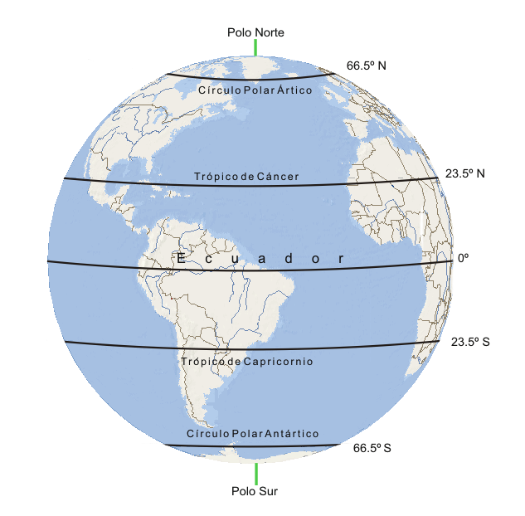

Slide 12
6. What are the meridians and which one is the most famous meridian?
The meridians are imaginary lines that encircle the Earth vertically.
The most famous meridian is the Greenwich meridian.

Slide 13
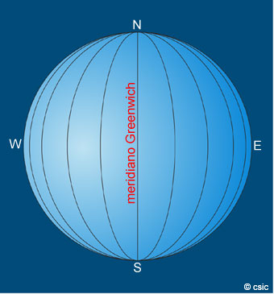

Slide 14
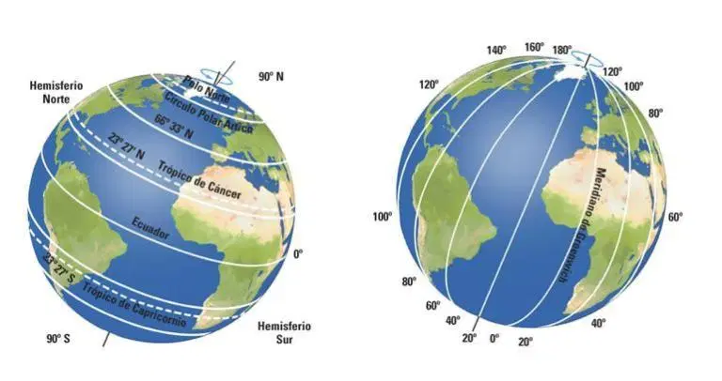

Slide 15
7. What is Latitude and how do we measure it?
Latitude is the distance from any point on the Earth to the equator.
It is measured in degrees, minutes and seconds and it goes from 0º (in the equator) to 90º north or south (in the Poles).

Slide 16
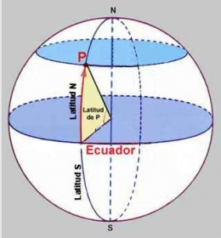
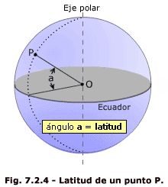

Slide 17
8. What is Longitude and how do we measure it?
Longitude is the distance from any point on the Earth to the Greenwich meridian.
It is measured in degrees, minutes and seconds and it goes from 0º (in the Greenwich meridian) to 180º East or West.

Slide 18
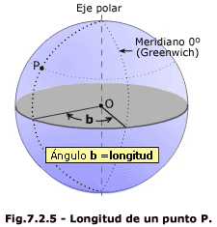

Slide 19
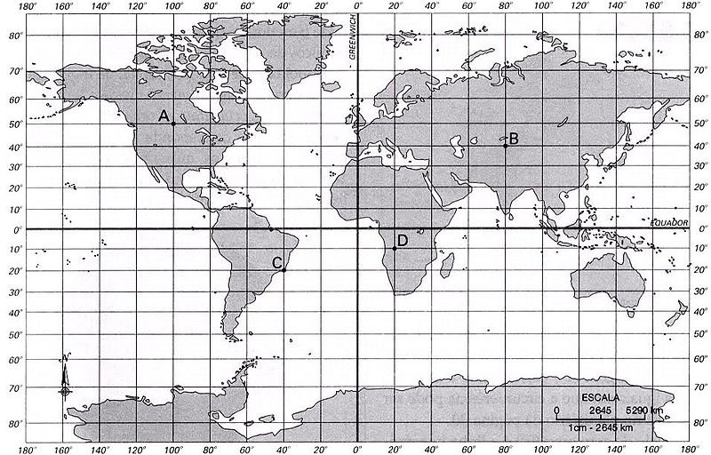
The geographical coordinates

