Slide 1
Unit 7: Ancient Egypt

Slide 2
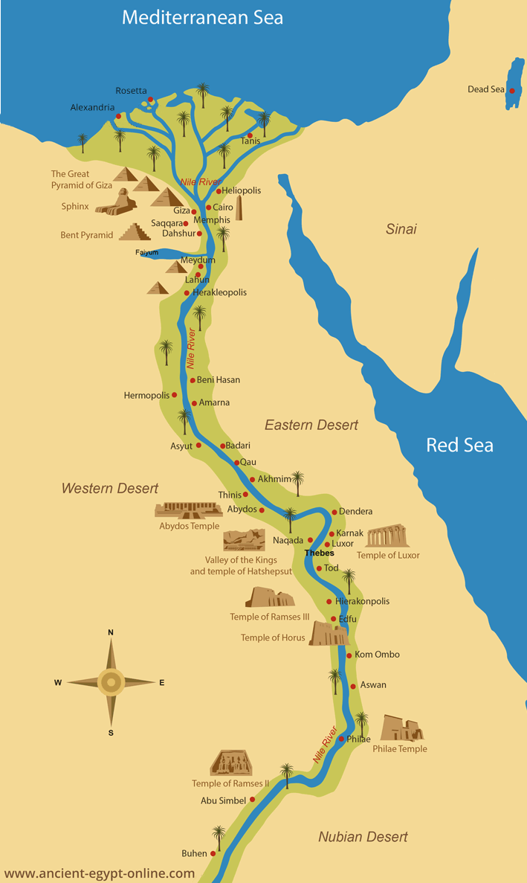
Extra Information:
Ancient Egypt exists thanks to river Nile. The Nile carried fertile soil from the mountains of Ethiopia and the inundations took place always in spring when the ice of the mountains melted.
These two aspects guaranteed a good harvest every year.

Slide 3
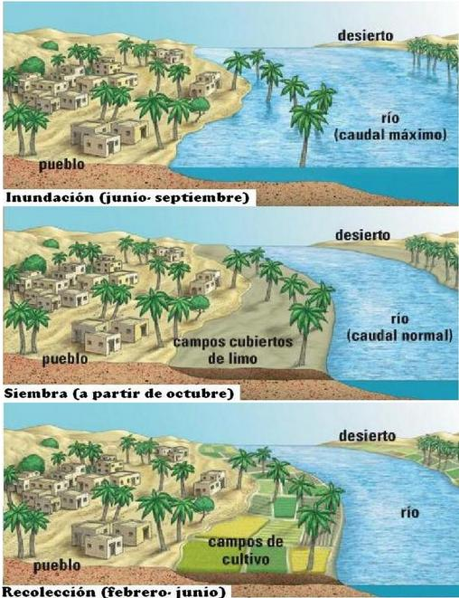

Slide 4
What is the name of the river of Egypt and what were their main uses?
The river of Egypt is the Nile, and its main uses were irrigation (for agriculture), fishing and transport.
What is the name of the two main areas of Egypt , what two areas do they represent and why do they receive that name?
The two main areas are the Lower Egypt and the Upper Egypt. The Lower Egypt represents the delta of the Nile River and the Upper Egypt represents southern part of the Nile River.
They receive that name because of the relief.

Slide 5
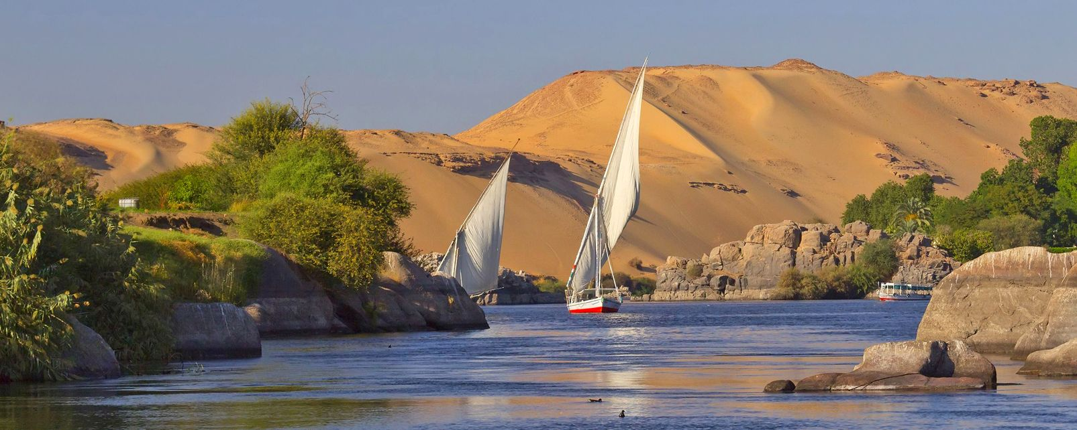
Extra information:
Obviously Upper Egypt is higher (because it’s in the mountains), and Lower Egypt is lower because is in the delta in the sea level, that is 0 metres.

Slide 6
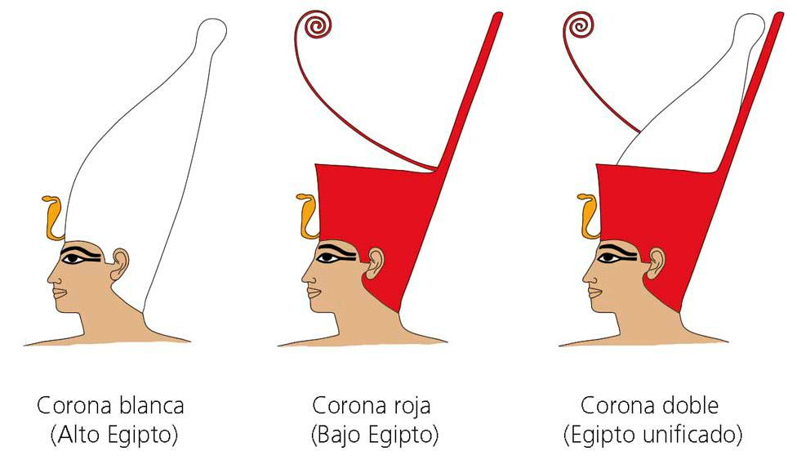
What were the pharaohs and who was the first pharaoh?
Pharaohs were the kings of Ancient Egypt. They had absolute power, they owned all the land and they were considered gods.
The first pharaoh was Narmer, who unified the Upper Egypt and the Lower Egypt around 3000 B.C.

Slide 7
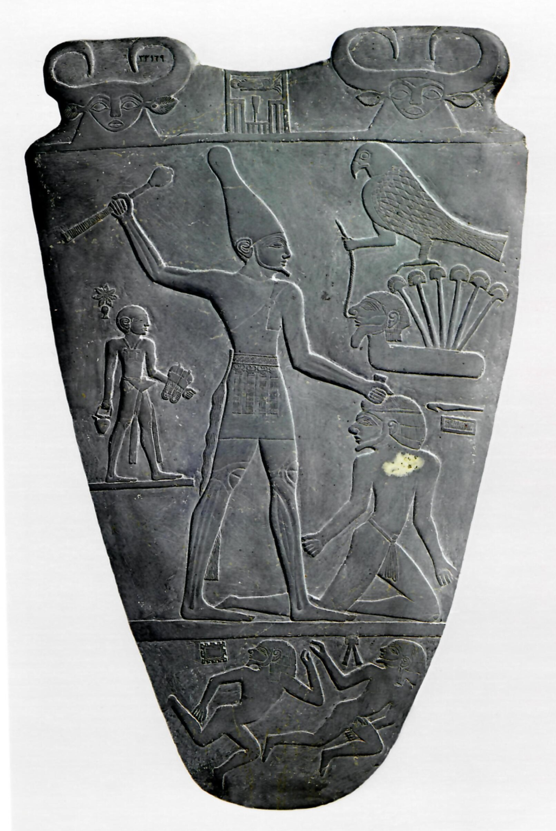
Narmer Palette
Extra Information:
Narmer was a very important pharaoh. He was the first pharaoh that ruled in Upper and Lower Egypt and he was the founder of the first dynasty of Egypt.
He ruled in Upper Egypt and later conquered Lower Egypt; in this way he unified both regions of Egypt.

Slide 8
Draw a social pyramid of Ancient Egypt that includes the following social groups. (In the next slide you can see some examples).
Pharaoh
Nobles and Priests
Soldiers
Scribes
Traders and artisans
Peasants (90% of the population)
Slaves

Slide 9
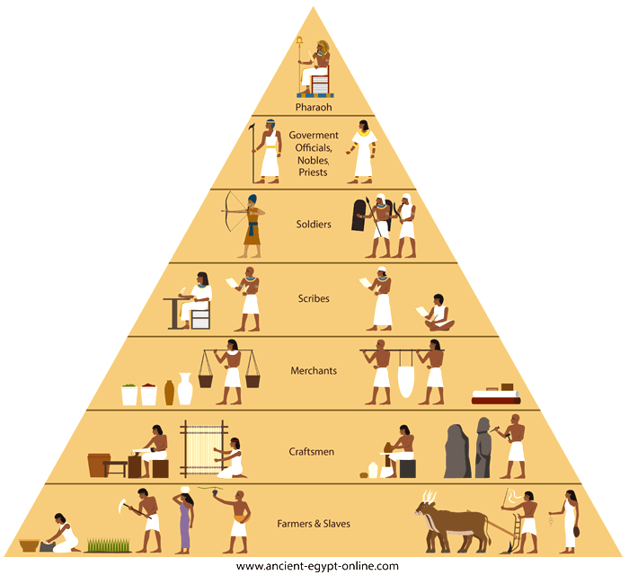

Slide 10
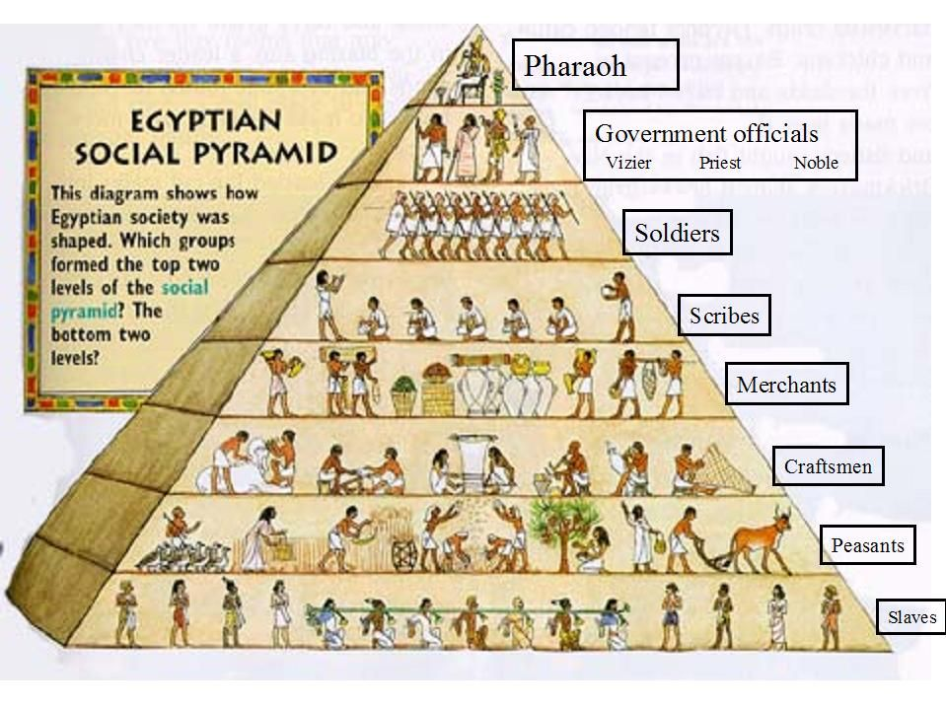

Slide 11
Historical Phases:
What were the three Ages or periods of Ancient Egypt?
The three periods were:
Old kingdom
Middle kingdom
New kingdom
Note: It’s not necessary to study the dates.

Slide 12
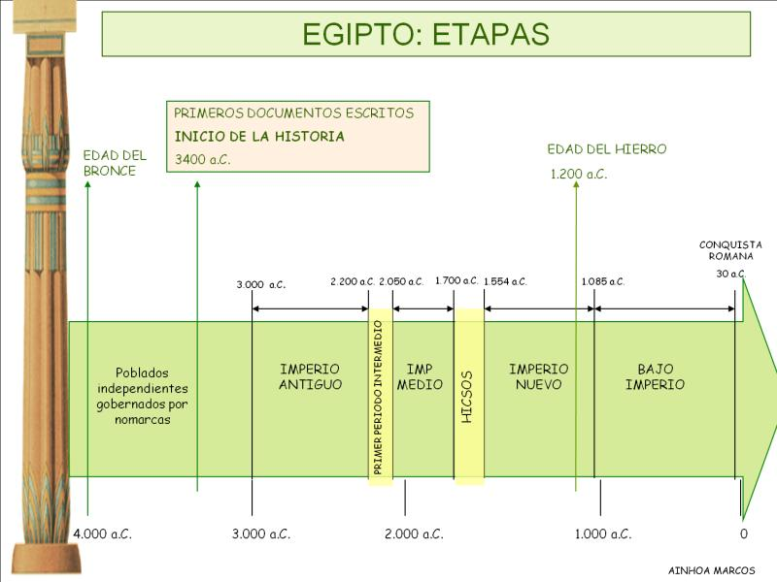

Slide 13
Egyptian Art
Egyptian Art
Architecture
Painting
Sculpture
General Characteristics
Parts of a temple
Characteristics
Characteristics

Slide 14
Egyptian Art
What were the characteristics of Architecture in Ancient Egypt?
The characteristics were:
Use of big blocks of stone (grandes sillares de piedra).
Monumental architecture. (Because it’s huge).
The use of a horizontal architecture. (Use of lintels (vigas)).
Construction of temples, palaces and tombs.
Types of tombs: mastabas, pyramids and hypogea, (hypogeum in singular).

Slide 15
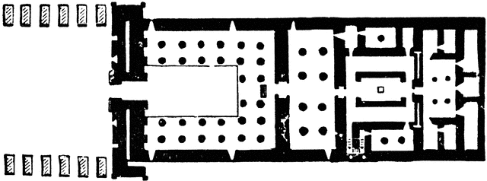
Draw the floor plan of an Egyptian temple with its main parts. (Copy the floor plan –planta- that is at the bottom)
Avenue of sphinxes
Obelisks
Pylons (pilonos)
Patio
Hypostyle hall (sala columnada)
Barque chamber
Sanctuary

Slide 16
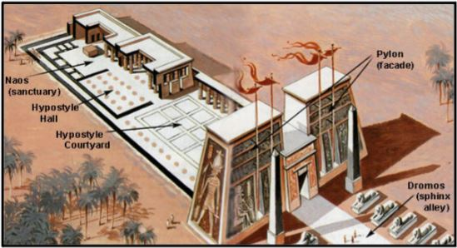
Parts of an Egyptian Temple

Slide 17
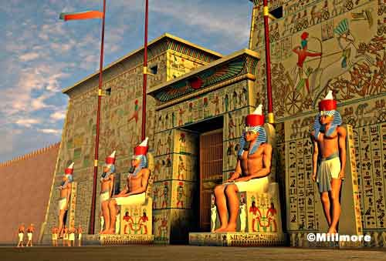
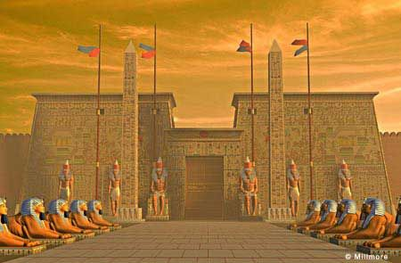
Reconstructions of Egyptian Temples

Slide 18
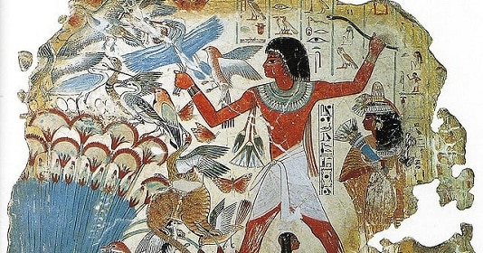
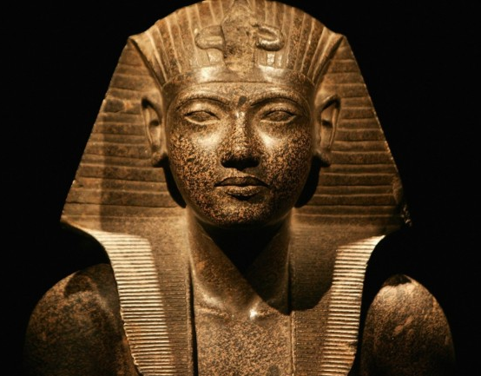
Tell me some characteristics of Egyptian painting and sculpture.
Lack of perspective (in painting).
Frontal and profile representation (in painting): chest and eye are seen from the front, but the head, arms and legs are seen in profile.
Lack of shading. (No hay sombreado).
Human figures are static.
Idealization.

Slide 19
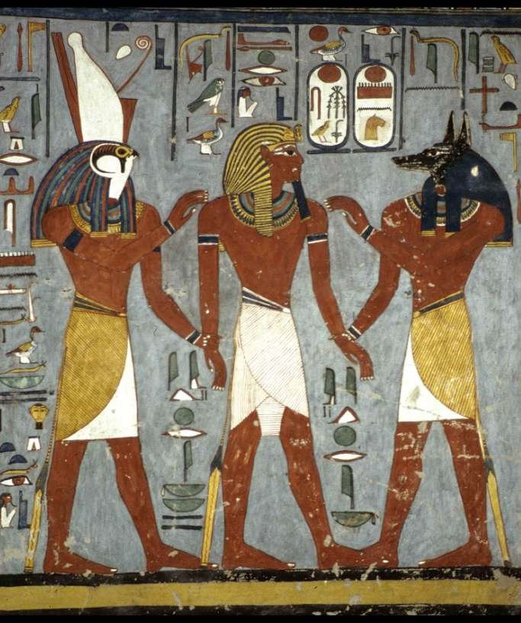
Extra activity:
Try to identify the characteristics of Egyptian painting:
Frontal and profile representation.
No shading
Lack of perspective
Static figures
Idealization

Slide 20
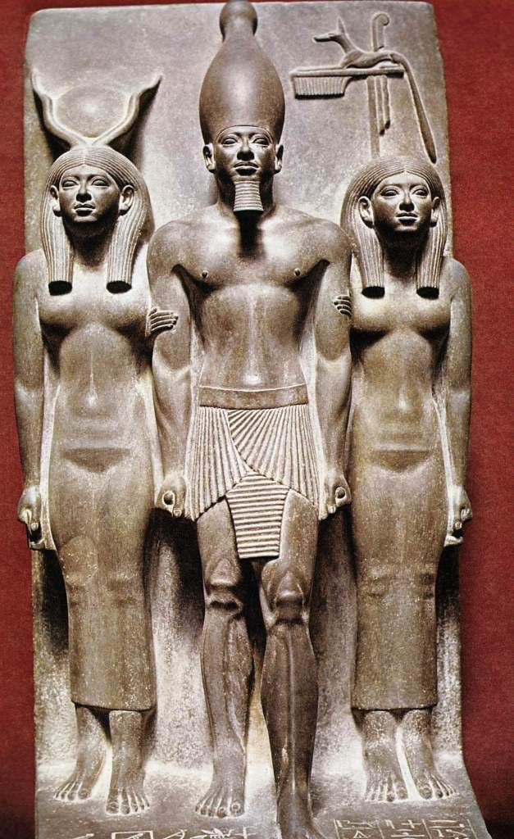
Extra activity:
Try to identify the characteristics Egyptian sculpture:
Static figures
Idealisation

