Slide 1
Unit 7: Mesopotamia

Slide 2
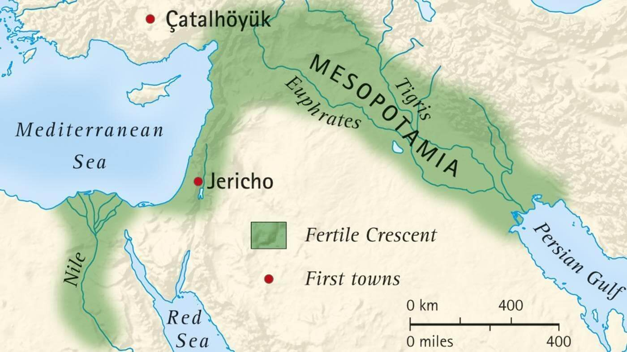
Extra Information:
Mesopotamia is a term that comes from the Greek meaning “land between two rivers”. It corresponds to nowadays Iraq.

Slide 3
1) When and where did the first civilisations of Mesopotamia appear?
The first civilisations appeared in the 4th millennium B.C. in Sumer (Lower Mesopotamia), in the fertile plains between Tigris and Euphrates rivers.
2) Tell me the name of some of these new city-states.
Some new city states were Ur, Uruk, Lagash and Eridu

Slide 4
Extra information:
A city-state is a type of political organisation. It includes the city and the surrounding territory.
They are completely independent and they are not part of bigger nation or country.
Extra information:
The first civilisations appeared in the Bronze Age in Mesopotamia and Egypt. Other civilisations appeared in China (2600 B.C.), in India (2500 B.C.) and Central and South America (Olmeca and Chavin cultures) 1600 B.C.

Slide 5
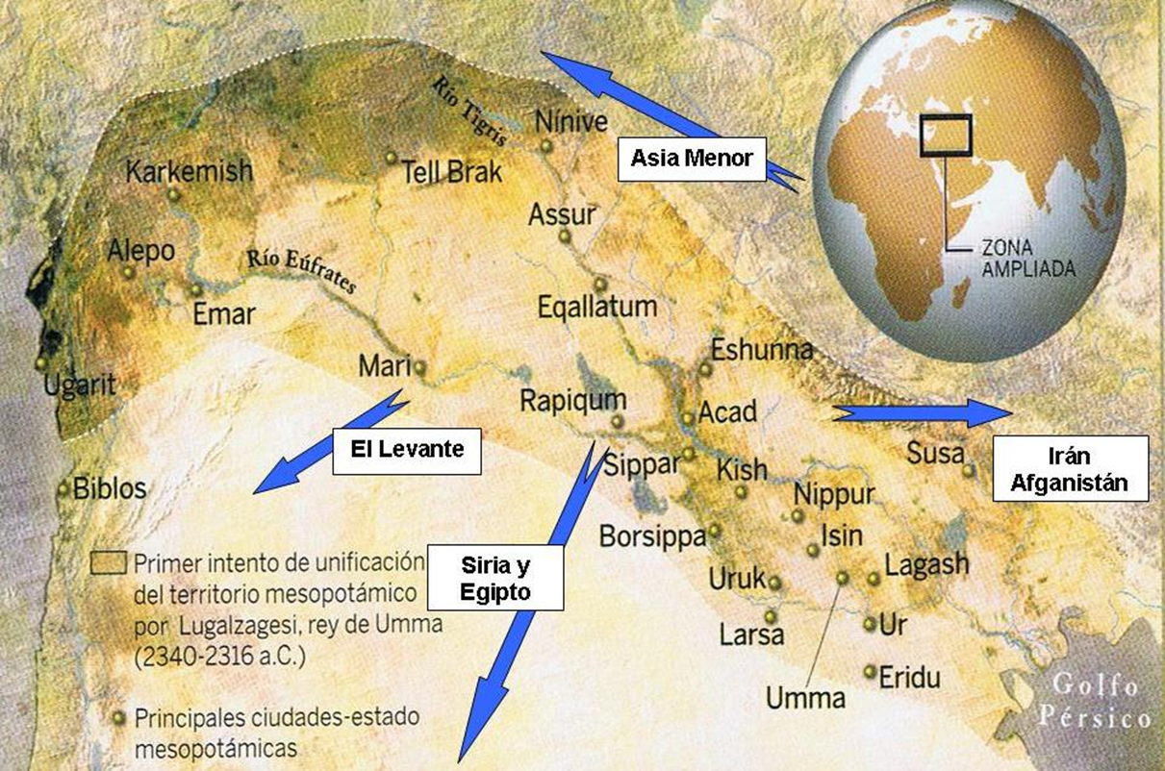
Some Mesopotamian city-states

Slide 6
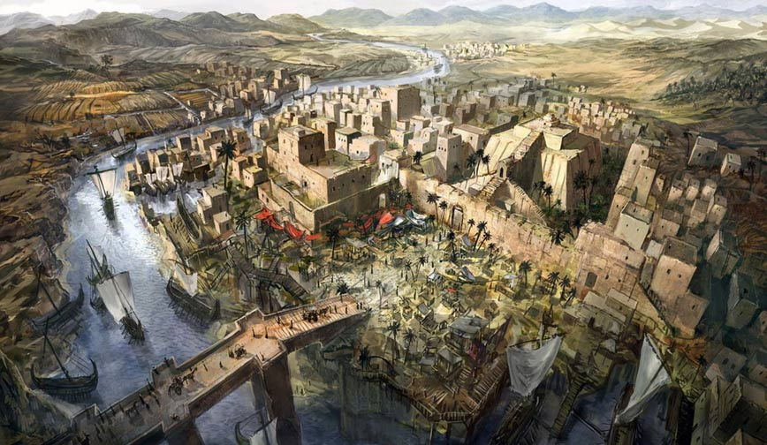
Reconstruction of a Mesopotamian city-state.

Slide 7
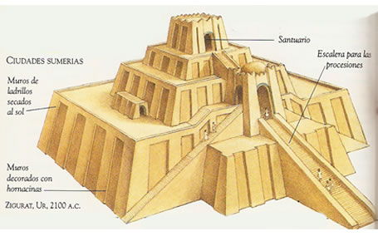
3) Tell me some characteristics of these new city-states.
The use of irrigation systems.
They had specialised jobs.
There was also a temple with a tower called ziggurat controlled by priests.
Ziggurat

Slide 8
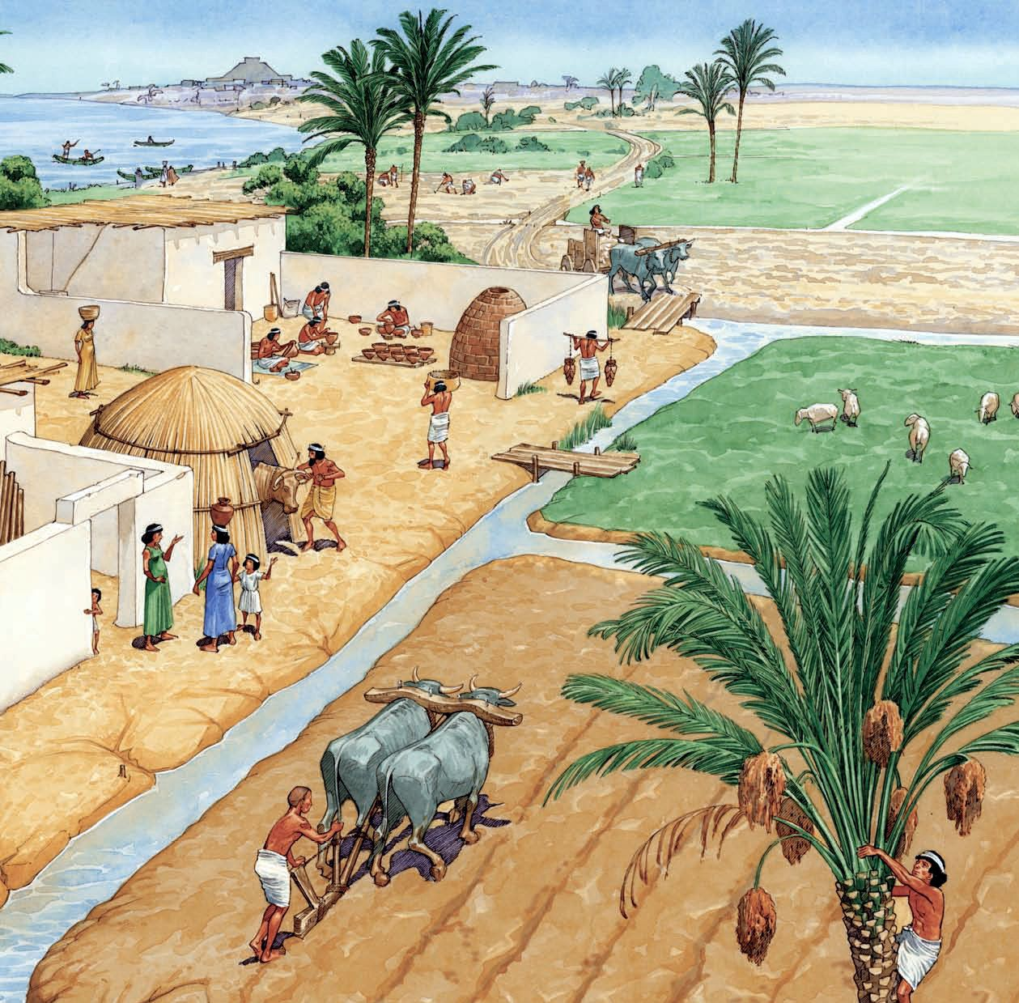
Irrigation system

Slide 9
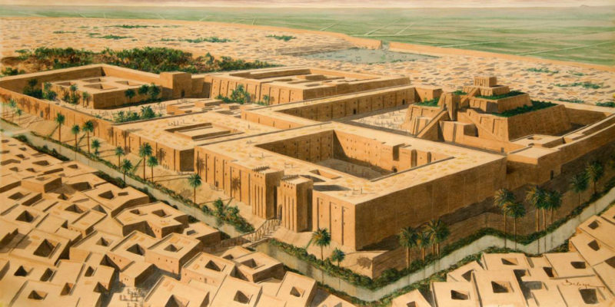
Complex that includes palace, temple and ziggurat

Slide 10
Historical Phases:
4) What are the historical phases of Ancient Mesopotamia?
The first city-states (Sumerians) (3rd Millenium B.C.)
Akkadian Empire (2nd millenium B.C.)
Babylonian Empire (2nd millenium B.C.)
Assyrian Empire (1st millenium B.C.)
Neo-Babylonian Empire (1st millenium B.C.)
Persian Empire (1st millenium B.C.)
Note: It’s not necessary to study the dates.

Slide 11
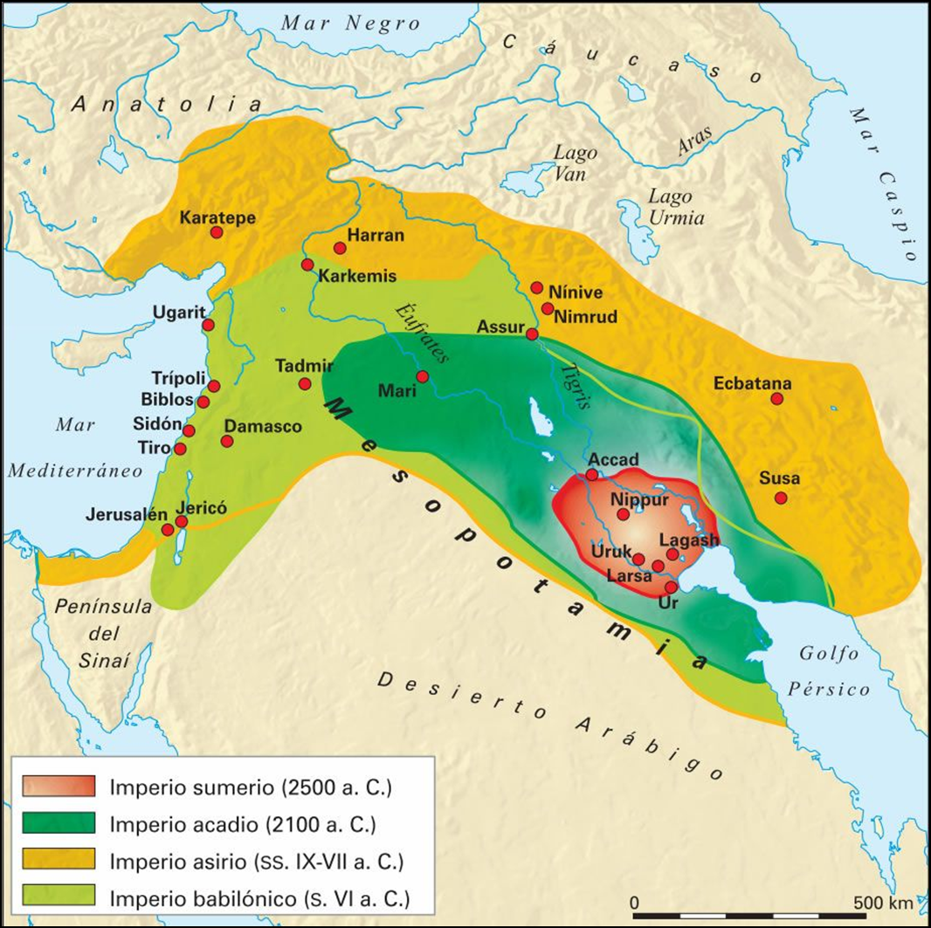
Map of Ancient Mesopotamia

Slide 12
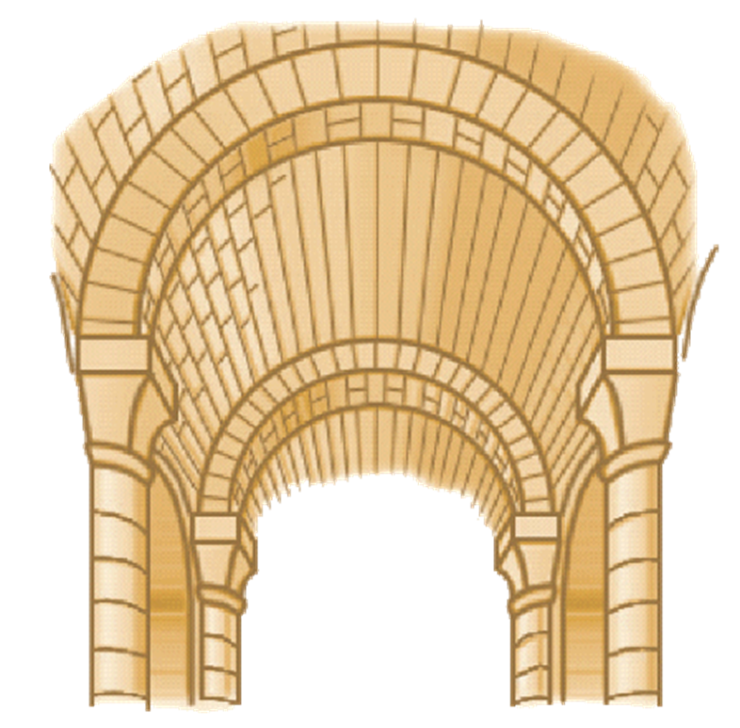
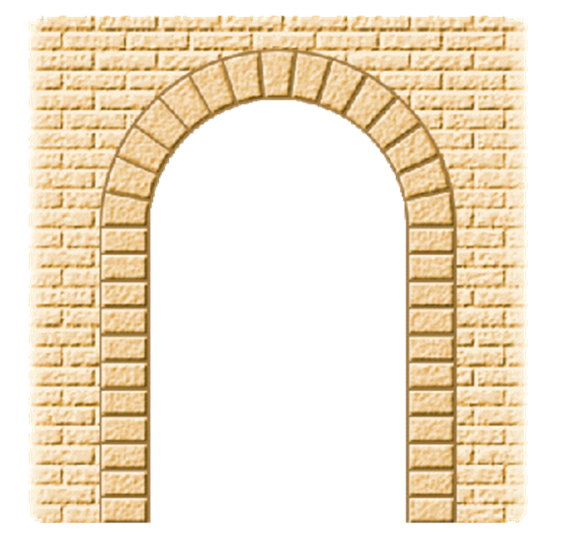
Mesopotamian Art
5) What were the greatest contributions of Mesopotamia to architecture?
The greatest contributions were the arch and the vault (arco y bóveda).

Slide 13
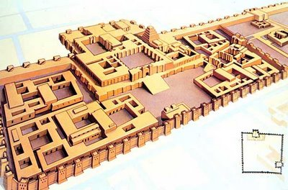
Mesopotamian Art
6) What were the most important buildings of the cities?
The most important buildings were ziggurats and palaces.
Palace of Ancient Mesopotamia

Slide 14
Mesopotamian Art
7) What materials did they use for constructing these buildings?
They used bricks, bitumen (betún) and also glazed ceramics (cerámica vidriada).
Extra information
The oldest bricks were invented in Ancient Mesopotamia in 7500 B.C.
Bitumen was used for protecting the buildings from floods or inundations. (As a waterproof material).
Glazed ceramics were used for decoration.

Slide 15
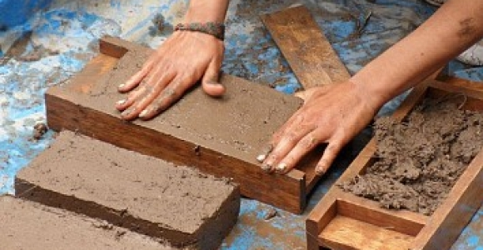
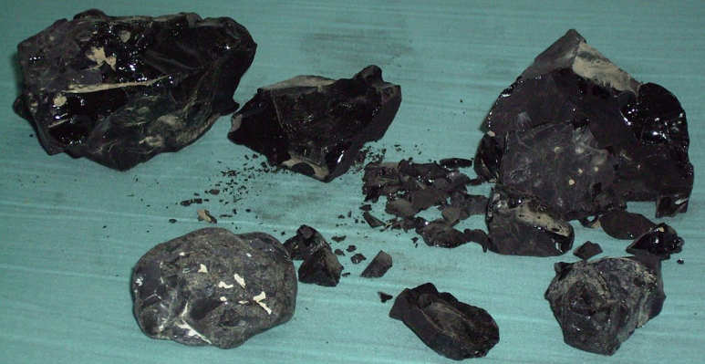
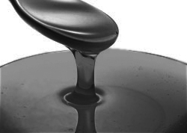
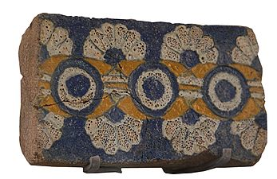
First Bricks
Bitumen
Glazed ceramics

Slide 16
Mesopotamian legacy
8) Tell me some contributions of Ancient Mesopotamia to our civilisation.
Cuneiform writing in Sumer, in 3500 B.C.
The poem of Gilgamesh.
The Flood (El Diluvio Universal de la Biblia)
The Myth of the Tower of Babel
The Hanging Gardens of Babylonia. (One of the seven wonders of the ancient world).
First code laws.
Irrigation Canals
(It continues in the next slide)

Slide 17
Great advances in astronomy.
(Extra Information: the ziggurats were also astronomical observatories).
12 Horoscopes
12 months calendar
Sexagesimal numeral system. (Sistema numérico sexagesimal)
(Extra Information: Nowadays we still use it when we buy eggs –a dozen- and with the 12 months of the calendar and the 12 hours of the day).
In architecture the use of arches, vaults, bricks and ziggurats.

Slide 18
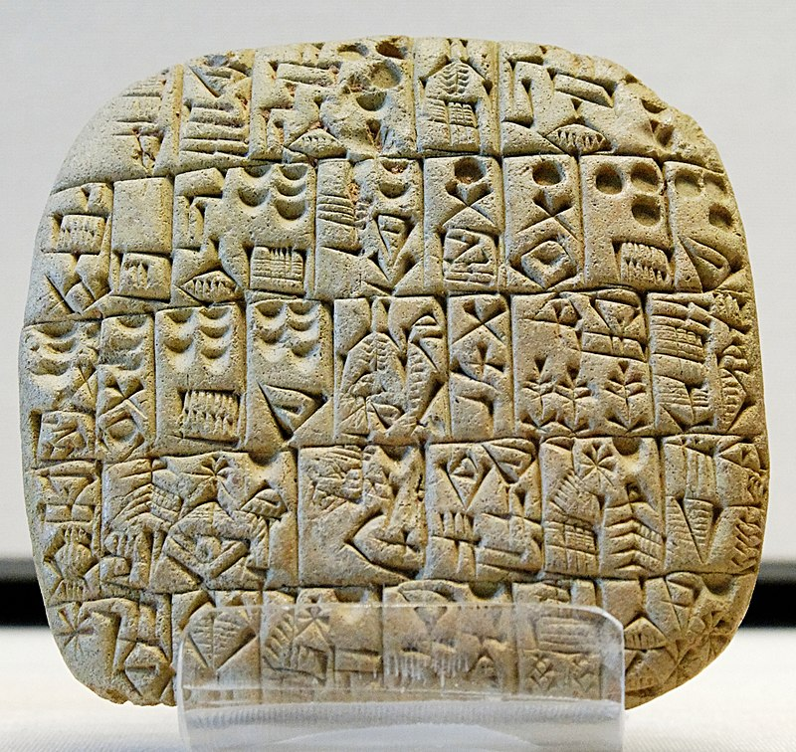
Extra information
Cuneiform writing was the first writing system and it marks the beginning of history.
It was made with a stick (“cuneus”, caña en latín) on wet clay.
Later it was put in the oven and the text was ready.

Slide 19
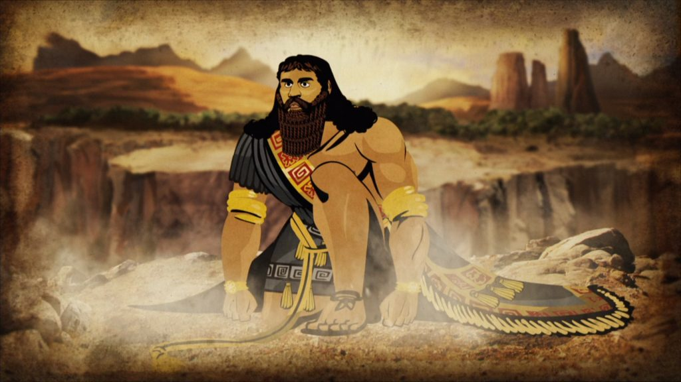
Extra information – The epic poem of Gilgamesh
It is considered the first literary classic made by humanity.

Slide 20
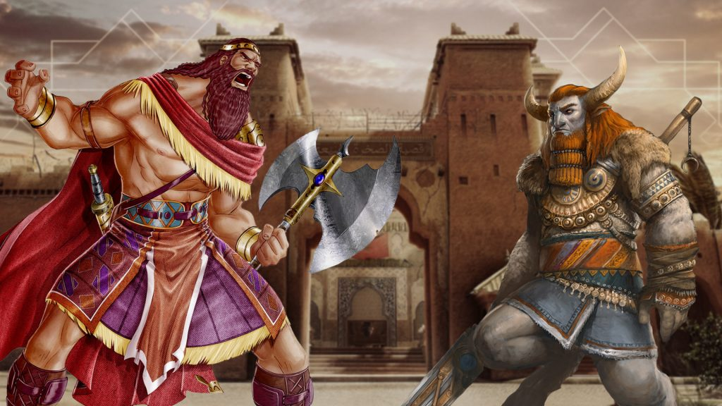
Gilgamesh vs Enkidu

Slide 21
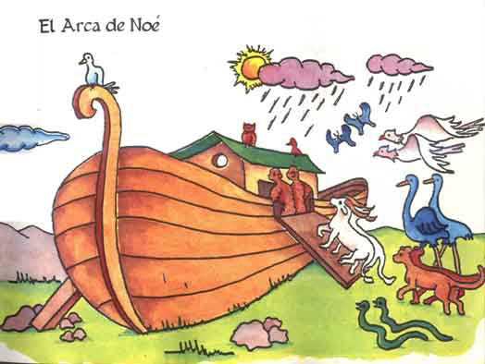
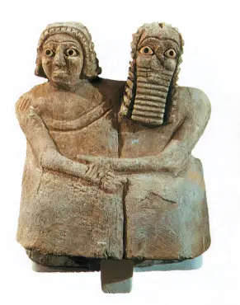
Extra information
The Flood is a myth that appeared in the poem of Gilgamesh, before being mentioned in the Bible.
In this myth Noé was called Utnapishtim.
Utnapishtim and his wife

Slide 22
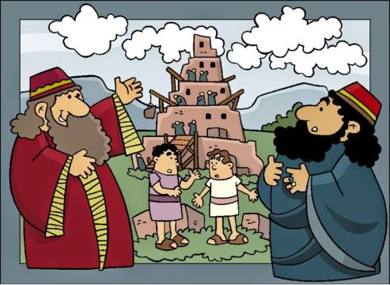
Extra information
In the myth of the tower of Babel all the people that were working in the construction of the tower suffered a punishment from God and started speaking different languages. This is the origin of the different languages.
The tower of Babel is similar to a ziggurat.

Slide 23
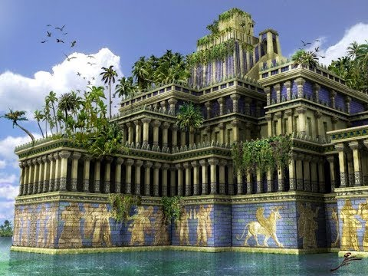
The Hanging Gardens of Babylonia

Slide 24
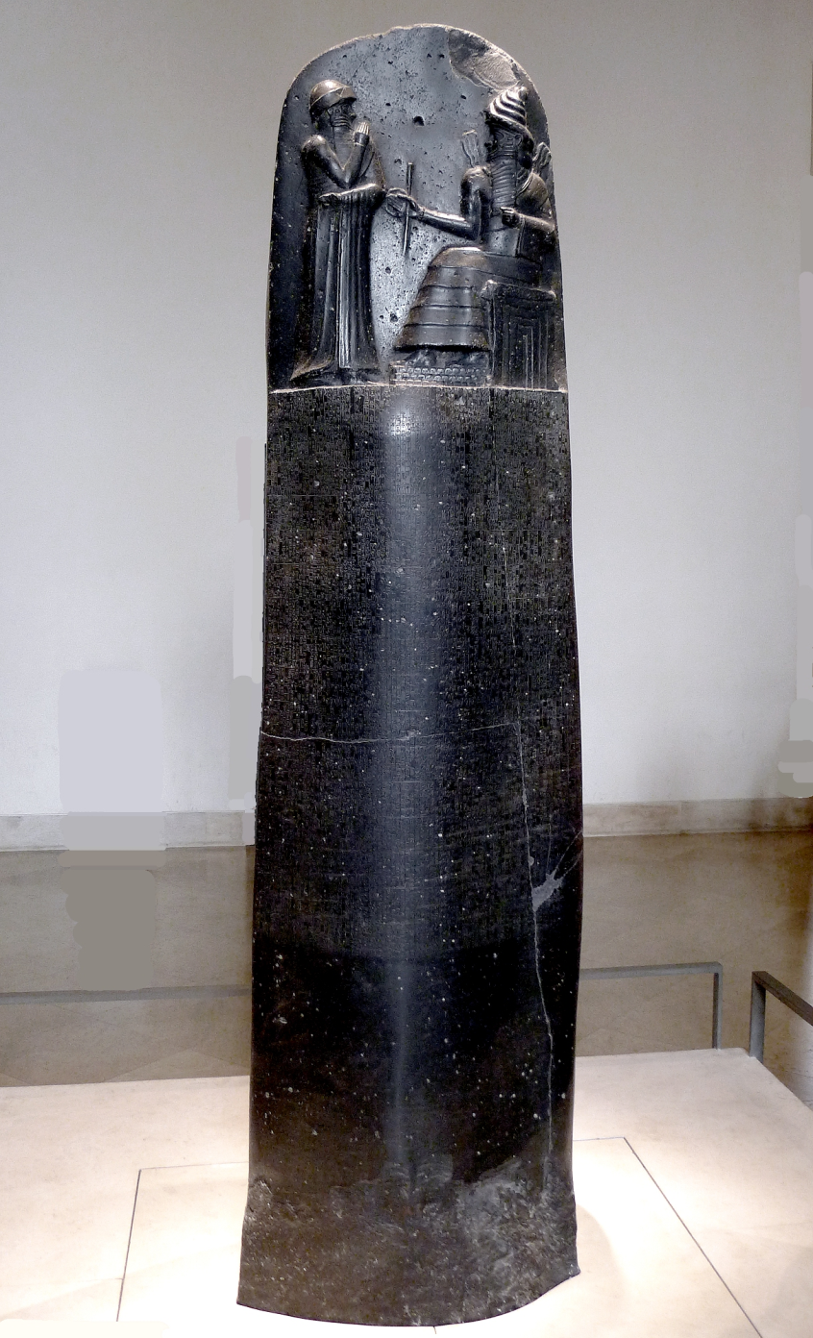
This is the first code of law of history.
As a curiosity here you have some of its laws:
"Si un hombre ha reventado el ojo de un hombre libre, se le reventará un ojo.“
"Si un hijo ha golpeado a su padre se le cortará la mano".
"Si un hombre ha acusado a otro hombre y le ha atribuido un asesinato y éste no ha sido probado en su contra, su acusador será condenado a muerte."
First Code Law of Hammurabi

