Slide 1
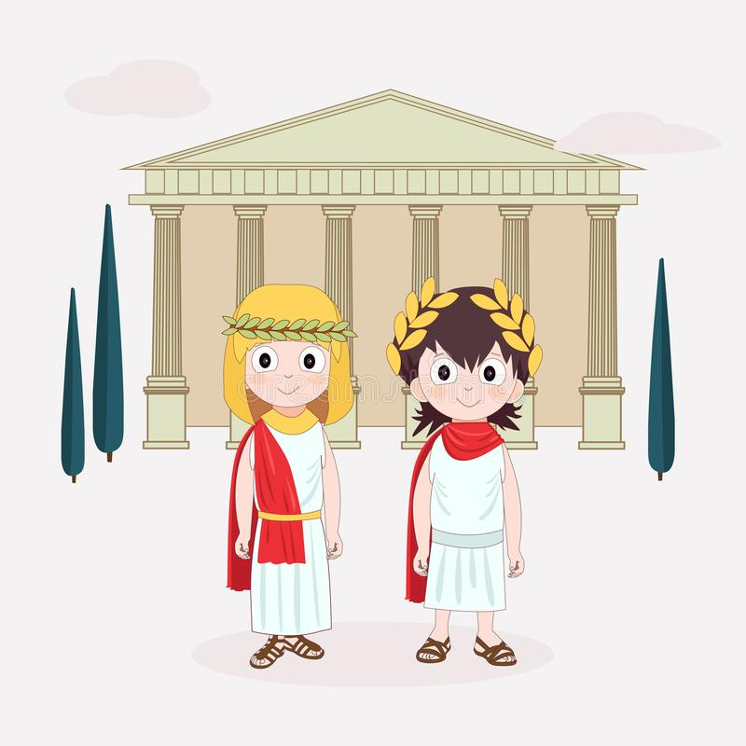
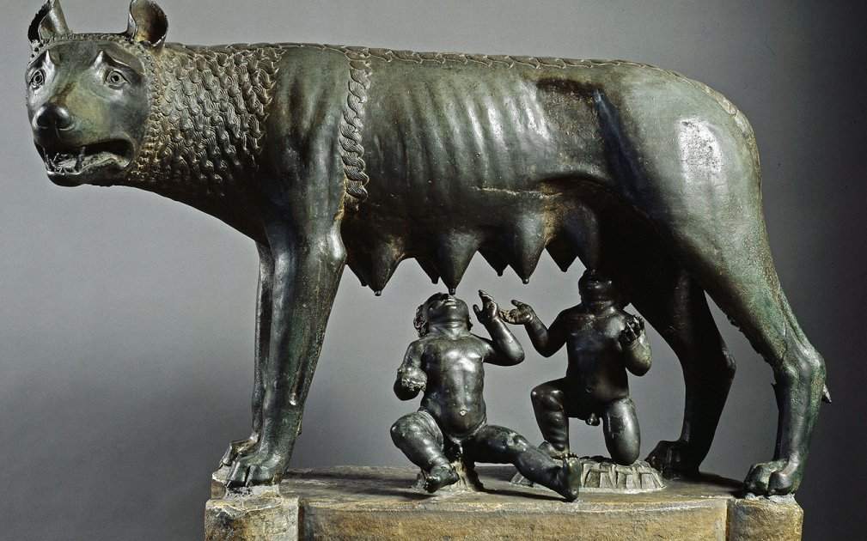
Unit 9: Ancient Rome

Slide 2
Do a time line with the three phases of Ancient Rome.
Monarchy
753 BC
Republic
509 BC
Empire
27 BC 476 AD
Legend about the Foundation of Rome:
The foundation of Rome took place in 753 BC by the twin brothers Romulus and Remus.
Their uncle tried to kill them when they were babies because they could be a menace to their rule.
A she-wolf found them and suckled them and thanks to that they could survive.

Slide 3
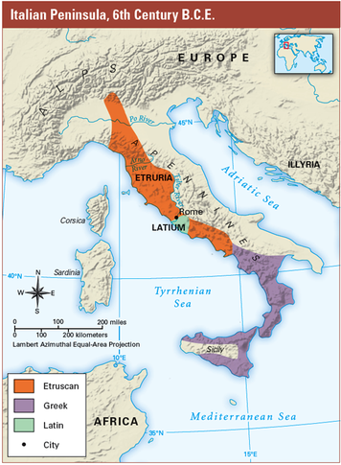
2) What three ethnic groups lived in the Italian Peninsula in the 1st millennium BC and where were they located?
The three ethnic groups were:
The Etruscans that lived in the North,
The Latins that lived in the centre and
The Greeks that lived in the South

Slide 4
Monarchy
3) What was the first political system of Rome and what were its characteristics?
The first political system of Rome was the monarchy.
Its characteristics were that the king ruled with absolute power and that he was given advice by the senate.
4) What was the function of the Senate?
The function of the Senate was to give advice to the king on some matters.

Slide 5
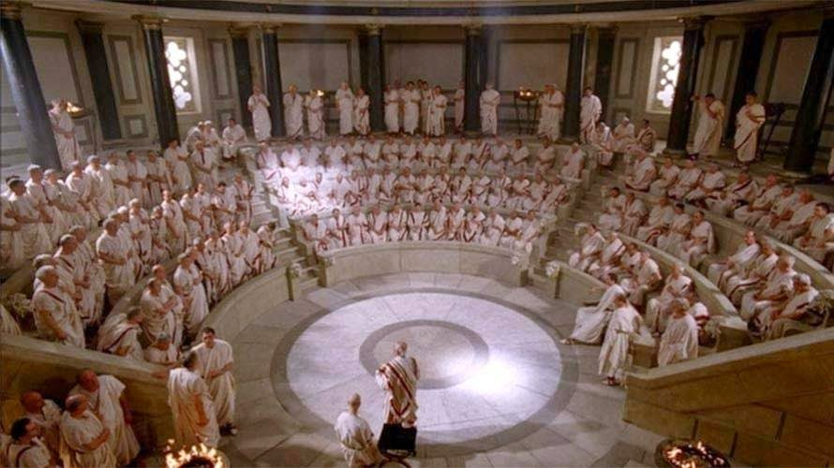
Senate of Rome

Slide 6
5) When was the Republic proclaimed and how did it happen?
In 509 B.C. there was a popular revolt and the last Etruscan king was expelled. After this the Republic was proclaimed.
Extra Information:
There is a story that says that the last Etruscan king Tarquin the Proud (Tarquinio el Soberbio) had abused of a Roman noblewoman, called Lucretia. And because of that the people of Rome rebelled against him and expelled him of Rome.

Slide 7
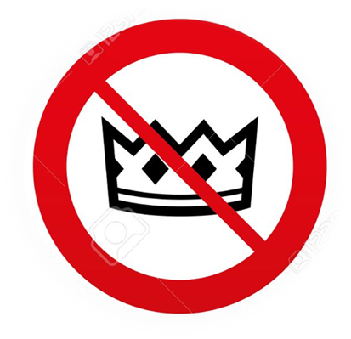
Republic
The Conflict between Patricians and Plebeians
6) What were the patricians?
Patricians were the descendants of aristocratic families that founded Rome. They owned all the land and governed the city.
7) Who were the plebeians?
Plebeians were the majority of the population. They were peasants, artisans and traders. They had no political rights.

Slide 8
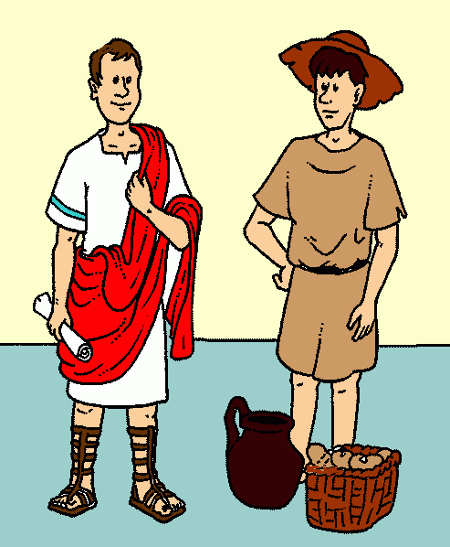
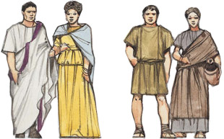
8) Explain the conflict between Patricians and Plebeians.
It was a social and political conflict between patricians and plebeians. It took place during the Republic and lasted more than two centuries. The conflict finished when the plebeians had the same political rights as the patricians.

Slide 9
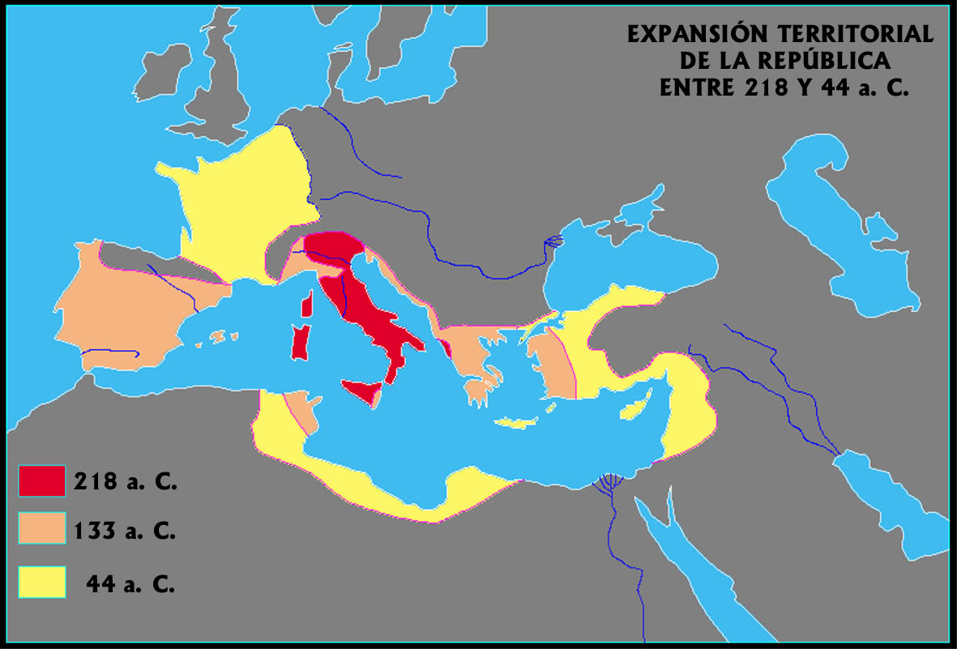
Expansion of Rome

Slide 10
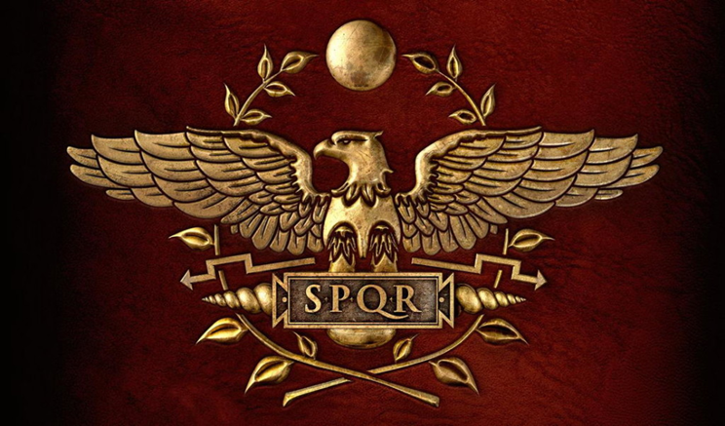
9) Explain the three phases of the conquests of Rome.
The three phases of Rome’s conquests are:
First they conquered the Italian Peninsula.
After the Punic Wars against Carthage they conquered Western Mediterranean.
Finally they conquered Eastern Mediterranean.
‘Senatus Populus Que Romanus’
(Senado y Pueblo Romano)

Slide 11
There are some interesting animated videos about the Punic Wars in my web page.
10) Explain the Punic Wars. (Opponents, historical characters, consequences…)
The Punic Wars were a series of wars that confronted Carthage and Rome, two of the most important powers of the Mediterranean.
Carthage conquered the Iberian Peninsula with their generals Hamilcar Barca, Hasdrubal and Hannibal (Aníbal).
When Hannibal attacked Sagunto (an ally of Rome) the Second Punic War started.
Finally Rome defeated Hannibal and became the major power of the Western Mediterranean.

Slide 12
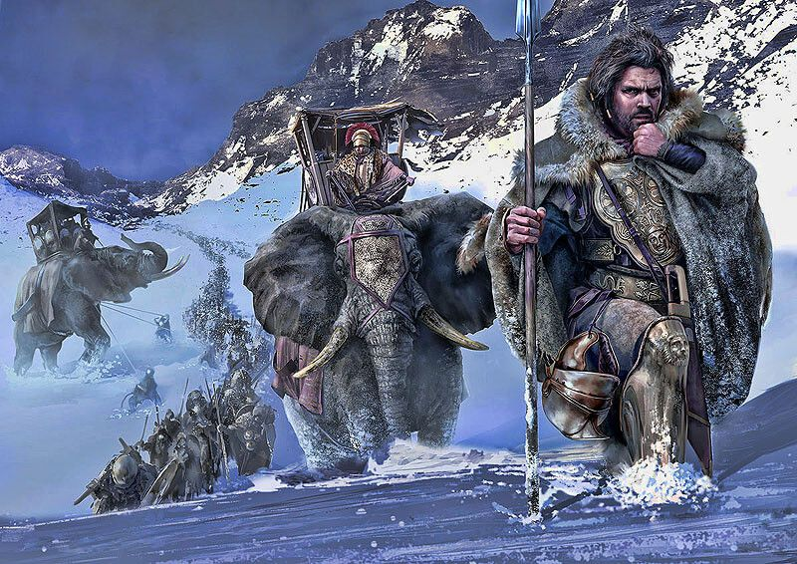
Aníbal cruzando los Alpes. Autor Mariusz Kozik (Fuente: www.arrecaballo.es)

Slide 13
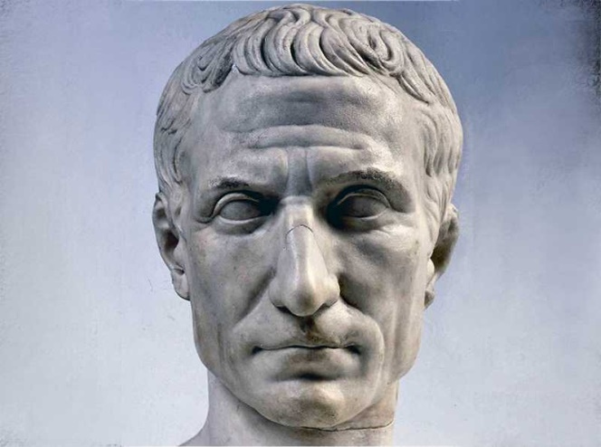
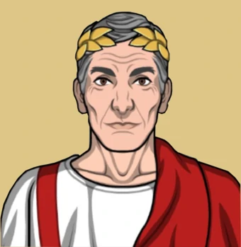
11) Who was Julius Caesar and what happened to him?
Julius Caesar was a dictator of Rome (a type of senator). He tried to establish the Empire but was assassinated by the supporters of the Republic.
Extra Information:
The assassination of Julius Caesar marks the end of the Republic. His nephew and adopted son Octavius Augustus, after having revenged his death, started to accumulate power and finally a new period started, the Empire.

Slide 14
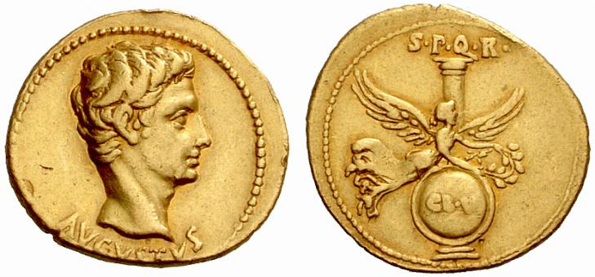
Empire (27 BC – 476 AD)
12) Who was the first Emperor of Rome and what was his relation with Julius Caesar?
The first emperor of Rome was Octavius Augustus and he was the nephew and adopted son of Julius Caesar.
13) What four powers did the Emperor control?
The four powers that the Emperor controlled were political, legislative, military and religious.
Coin of Augustus

Slide 15
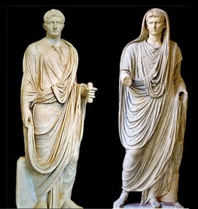
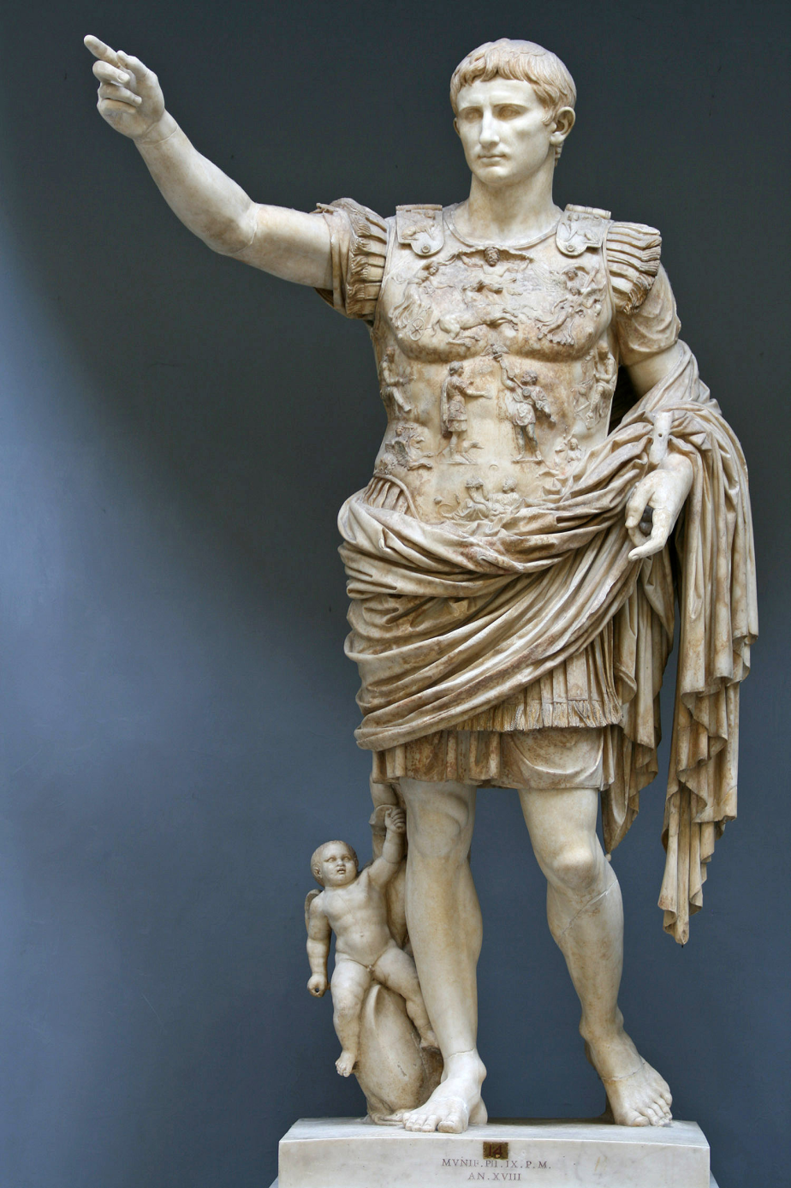
Augustus represented as:
As a Senator (with toga)
As a religious leader
As a military leader

Slide 16
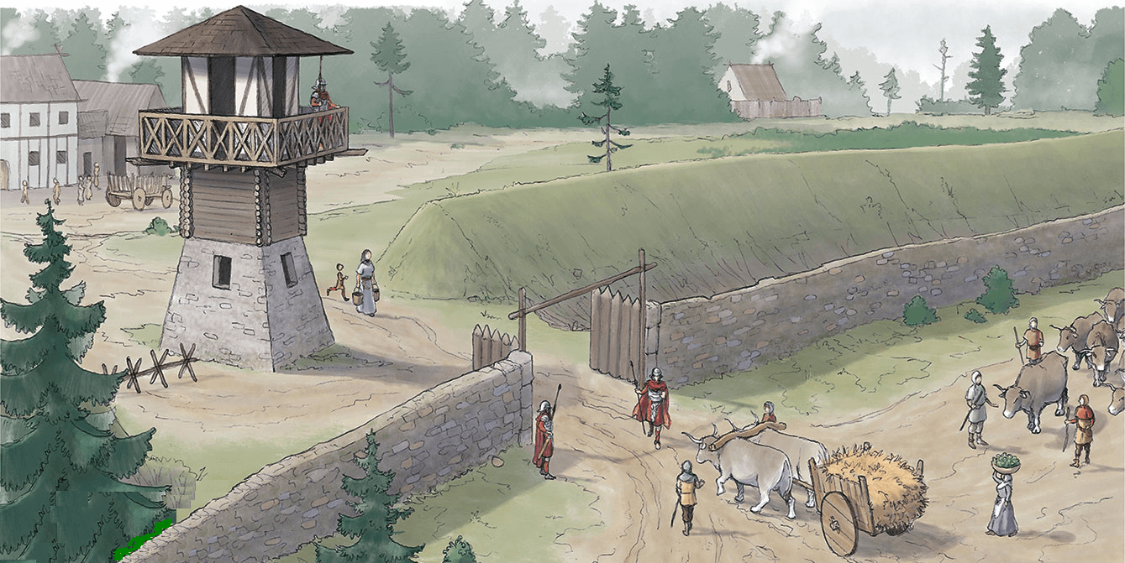
Crisis of the 3rd century
14) What were the causes of the crisis of the 3rd century?
(Give 4 reasons)
The causes of the crisis of the 3rd century were:
An increase in civil wars,
Attacks by Germanic peoples
The end of the conquests
The gradual abandonment of cities.
Limes
(Frontier of the Roman Empire)

Slide 17
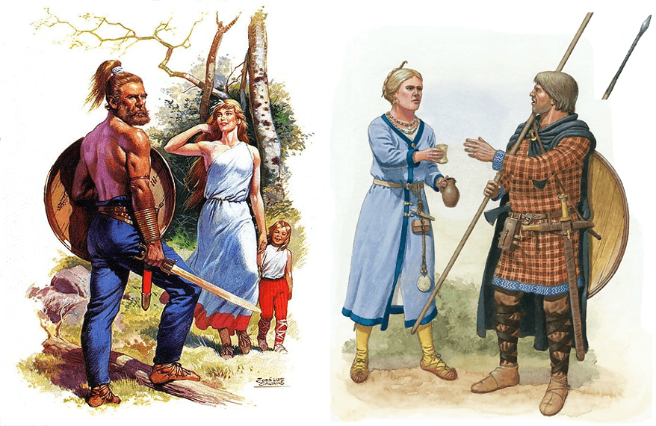
Germanic Peoples

Slide 18
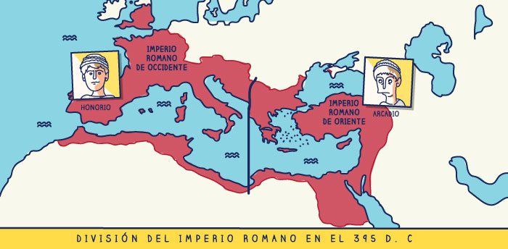
15) What happened in 395 A.D.?
In 395 A.D. Theodosius divided the empire in two: the Western Roman Empire (Rome) and the Eastern Roman Empire (Constantinople).

Slide 19
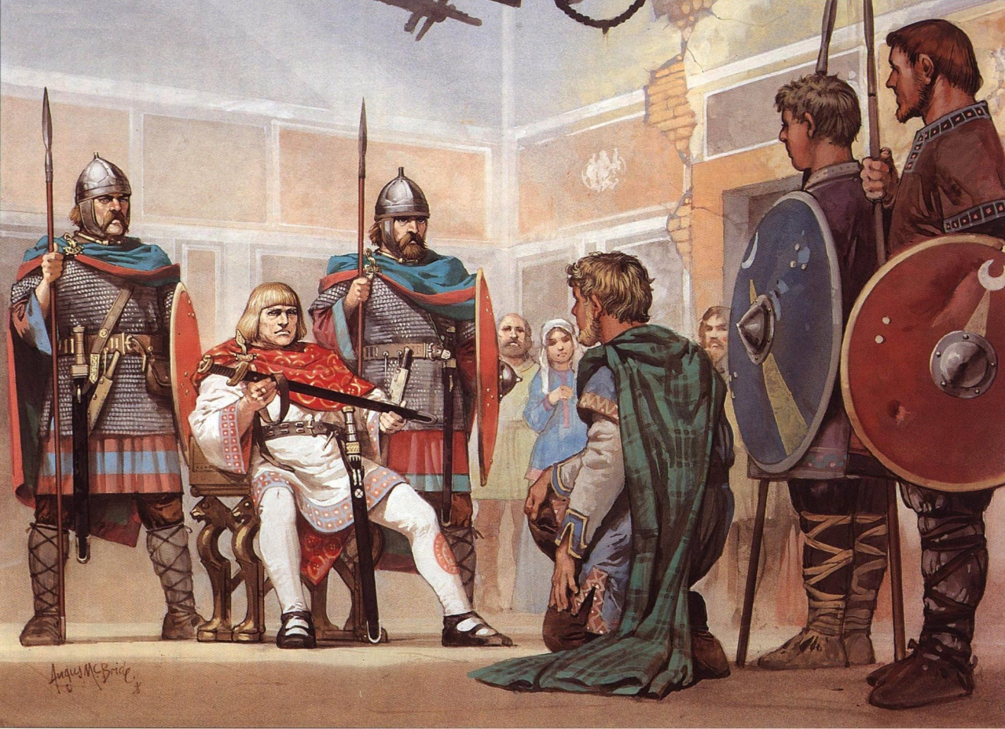
The Fall of the Roman Empire
16) How was the fall of the Roman Empire?
In 476 A.D. a Germanic tribe called the Heruli and their leader Odoacer defeated the last Roman emperor Romulus Augustulus.
Odoacer proclaimed himself king of Italy and sent the Imperial insignia (Imperial symbols) to Constantinople.
Zeno, emperor of the east receiving the imperial insignia of the deposed emperor of the west 476 ad

Slide 20
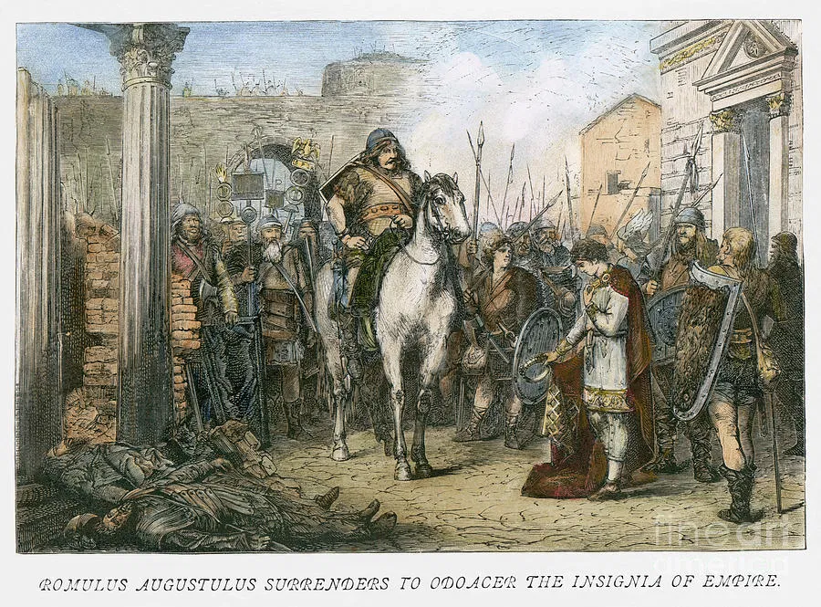

Slide 21
17) Name some typical constructions of any Roman City
Some typical constructions were
Triumphal arches
Roman Baths
Amphitheatre (gladiators)
Circus (races of horses)
Theatres
Aqueducts
Bridges
Commemorative columns
Temples
Basilicas
Forums
Roman Roads

Slide 22
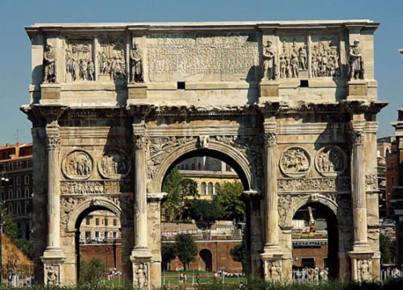
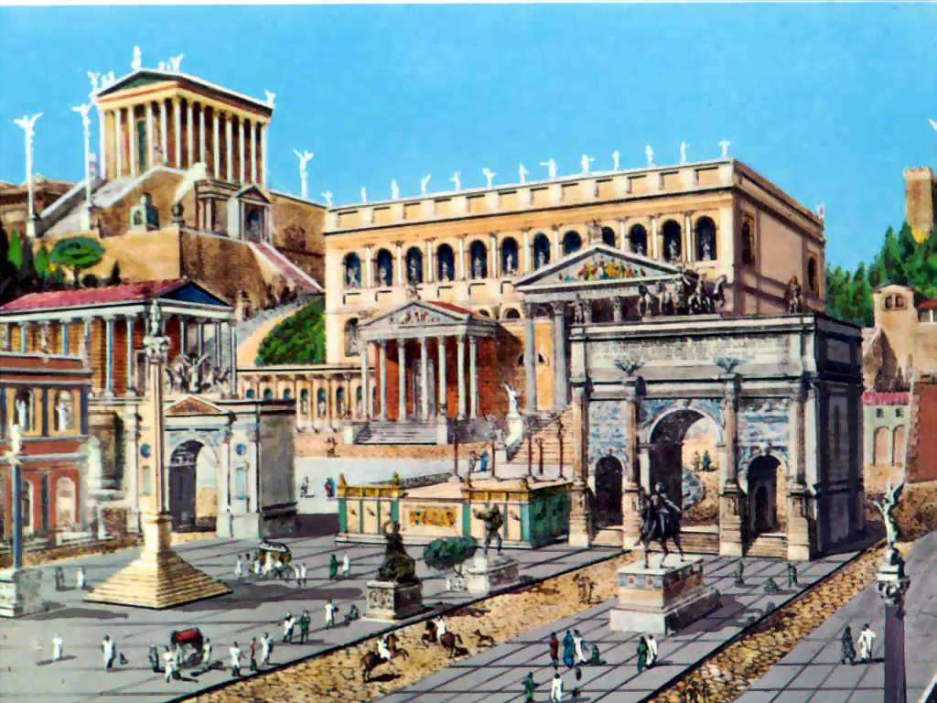
Triumphal Arch of Constantine (Constantino)

Slide 23
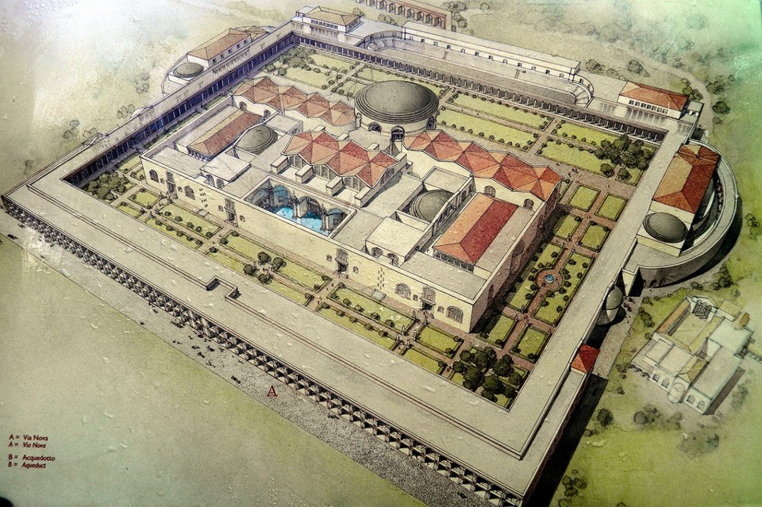
Roman Baths of Caracalla

Slide 24
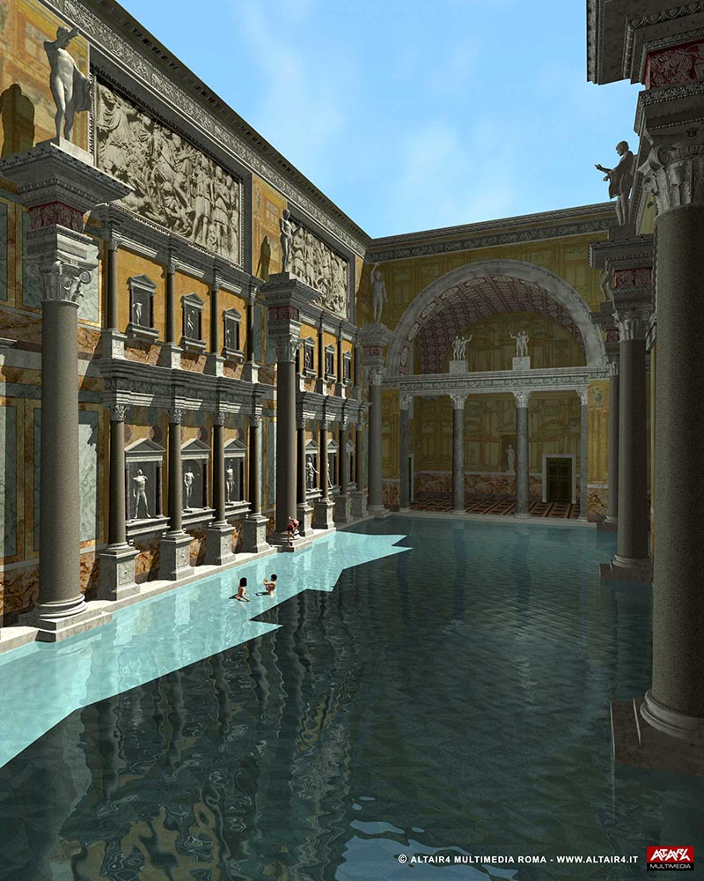
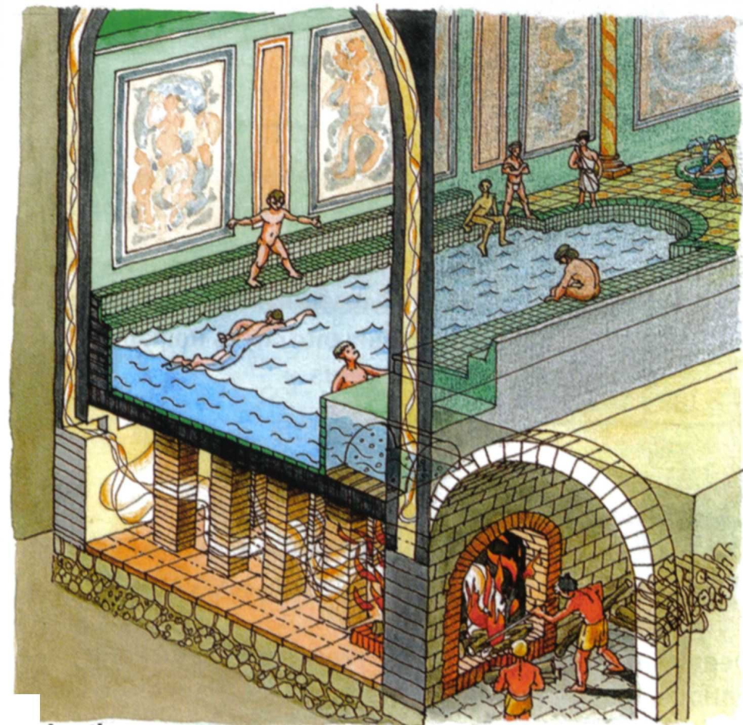
Roman Baths of Caracalla

Slide 25
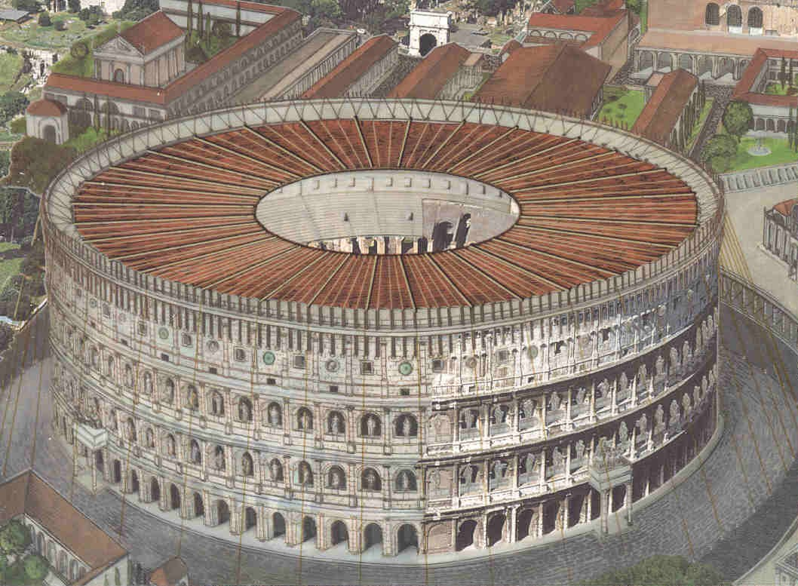
The Coliseum (amphitheatre)

Slide 26
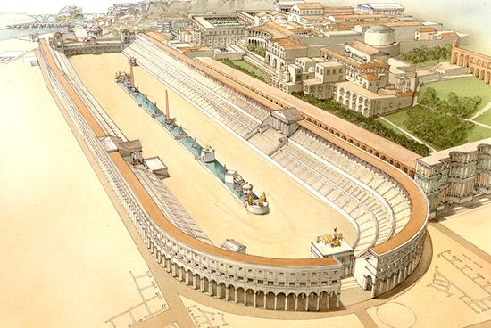
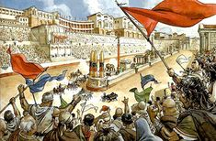
Roman Circus
Circus Massimus

Slide 27
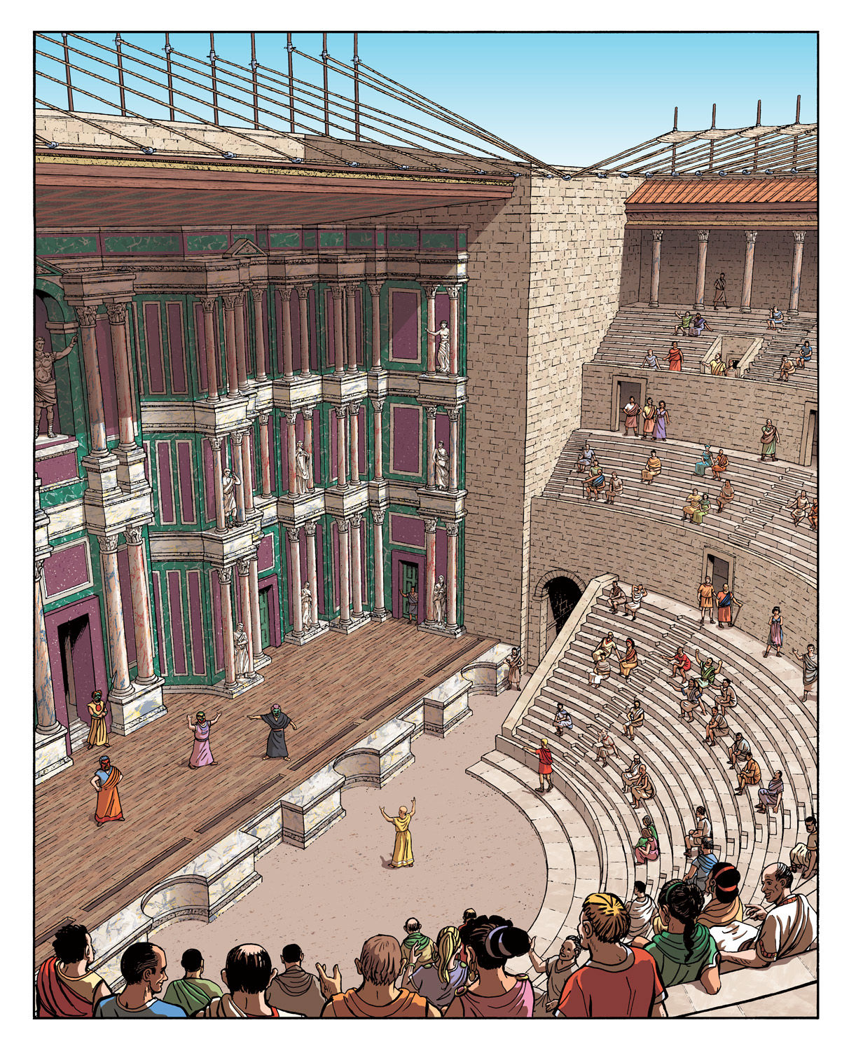
Theatre

Slide 28
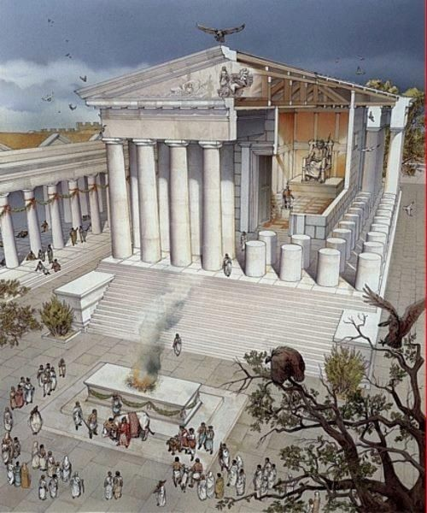
Roman Temple

Slide 29
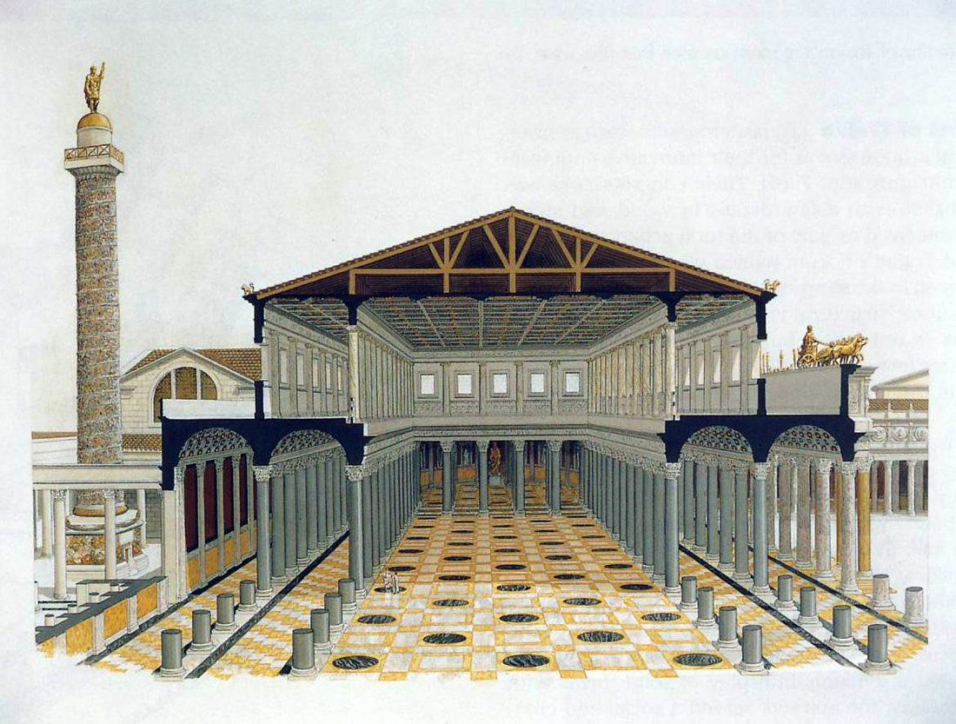
Roman Basilica

Slide 30
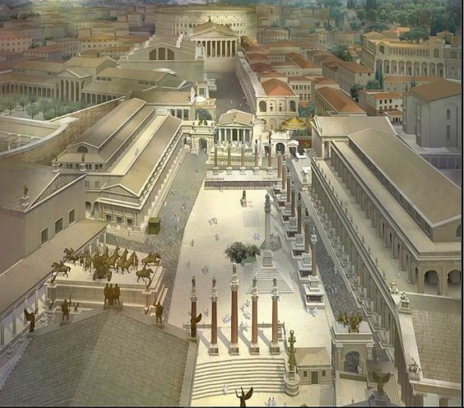
Forum of Rome

Slide 31
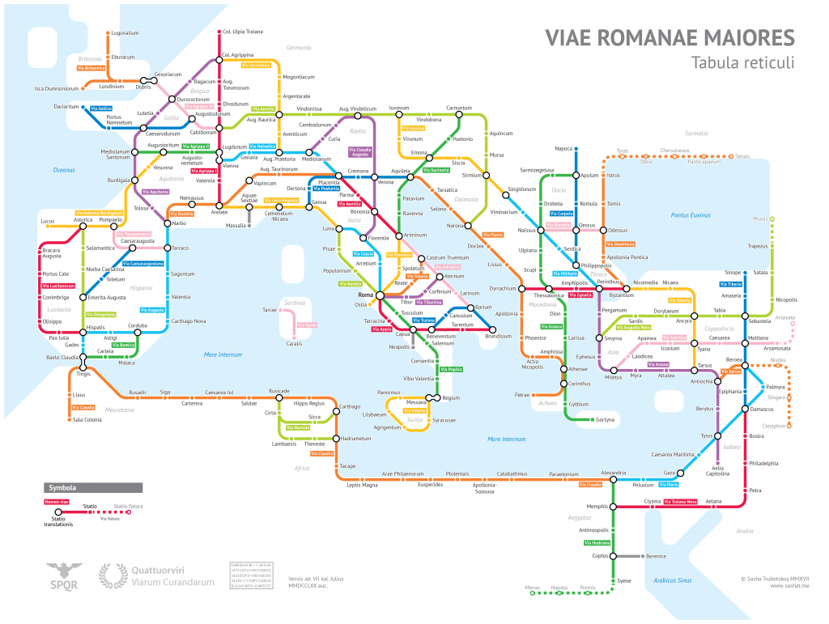
Roman Roads seen as a map of the subway

Slide 32
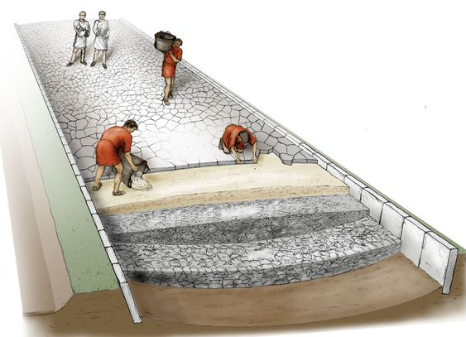
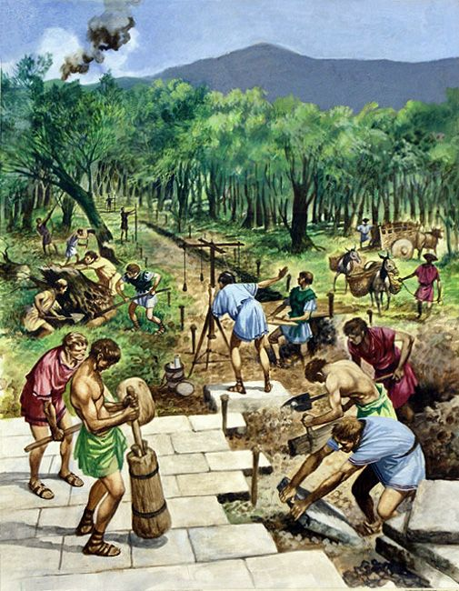
Roman Roads

Slide 33
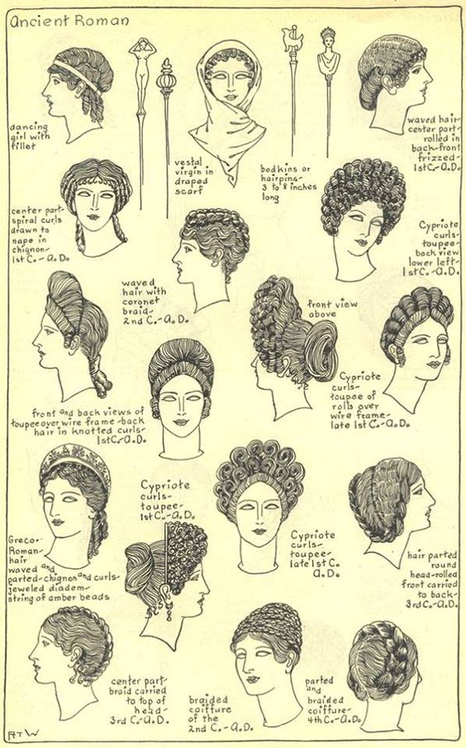
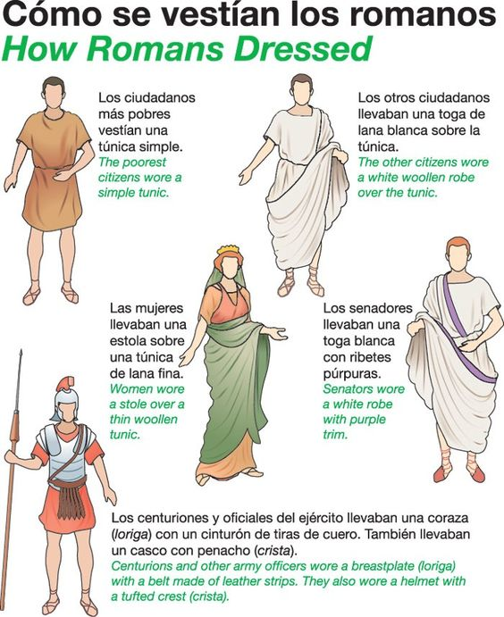

Slide 34
