Slide 1
Unit 6: Prehistory

Slide 2
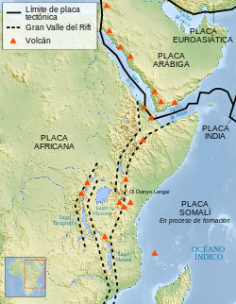
Paleolithic -Human Evolution-
Where did the first hominids come from?
The first hominids came from Africa. They came from the Rift Valley.
2) What is a hominid?
A hominid is a species that looks like a human because he walks on two legs, but he is not a human.

Slide 3
Mention some of the most important changes in the process of Human Evolution.
Standing upright and walking on two legs. This improved vision and freed the hands.
Development of the brain.
The size of the jaws and teeth decreased (because they learned to cook).
Hands: development of the opposable thumb.
Feet: loss of the opposable thumb.
Development of flat forehead and chin (Homo Sapiens Sapiens)

Slide 4
Development of shorter arms.
Harder childbirths (because of the change in the position of the pelvis and because of the bigger size of the babies’ head).
Wider pelvis and hips (because of the bigger size of the babies’ head).
Development of language.

Slide 5
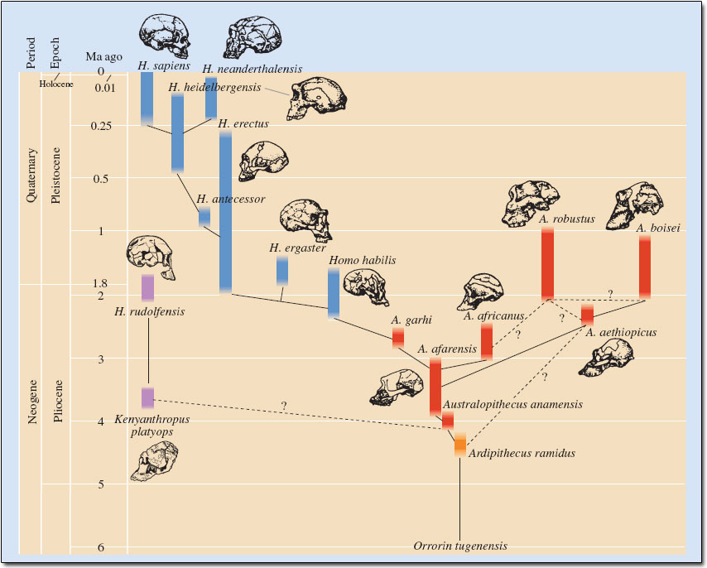

Slide 6
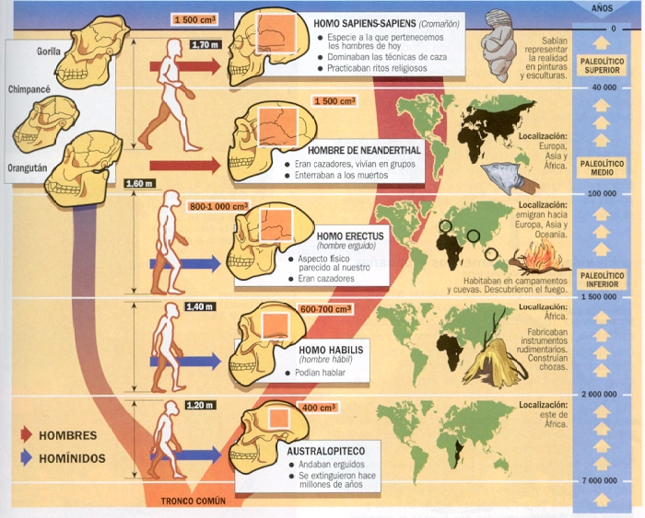

Slide 7
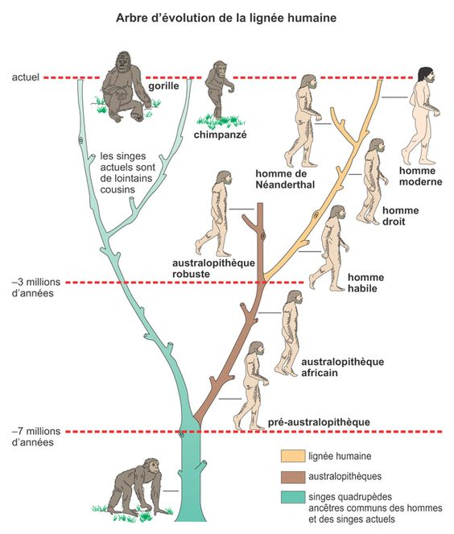

Slide 8
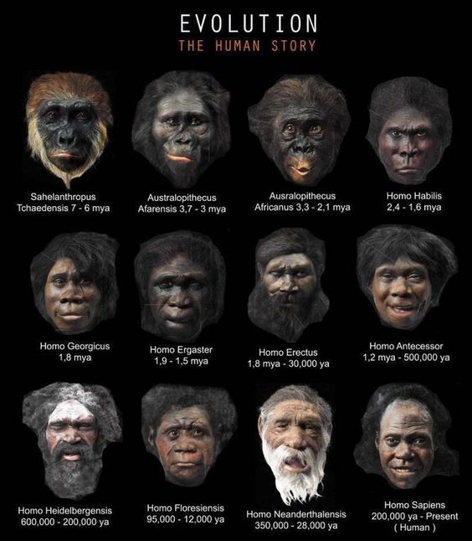

Slide 9
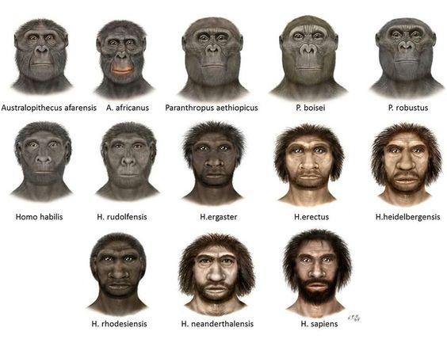

Slide 10
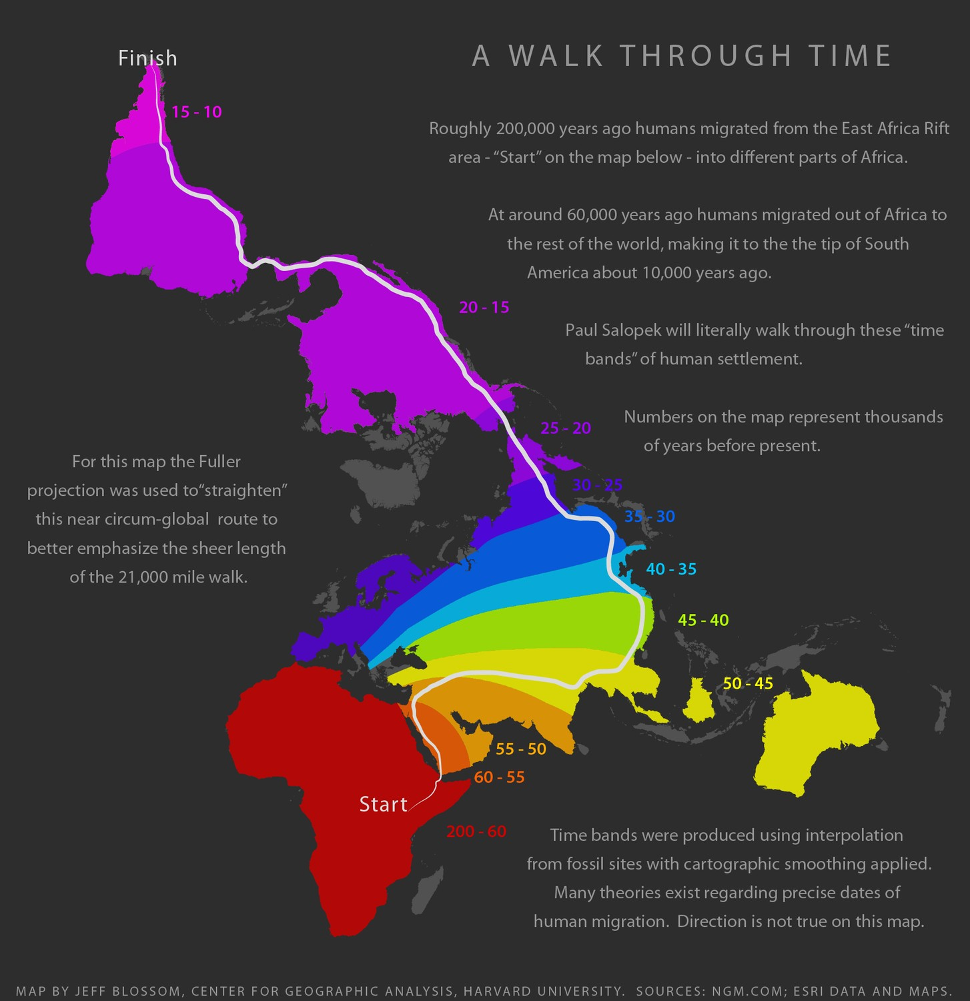

Slide 12
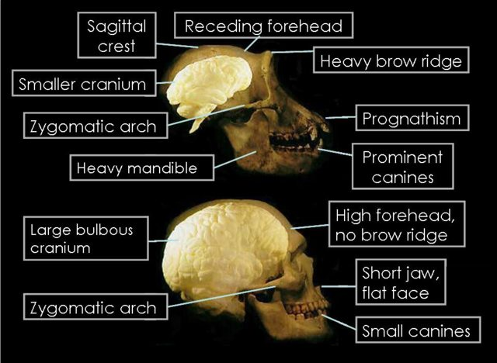

Slide 13
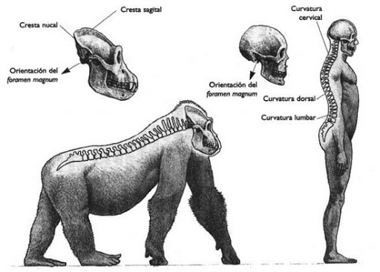

Slide 14
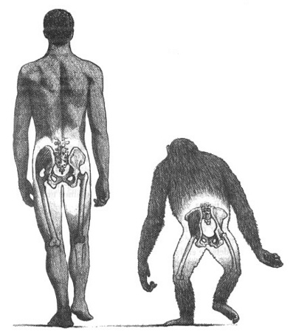
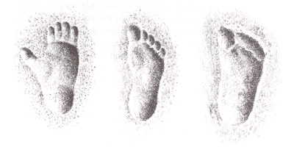

Slide 15
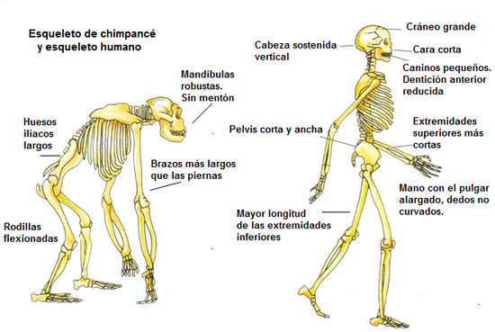

Slide 16
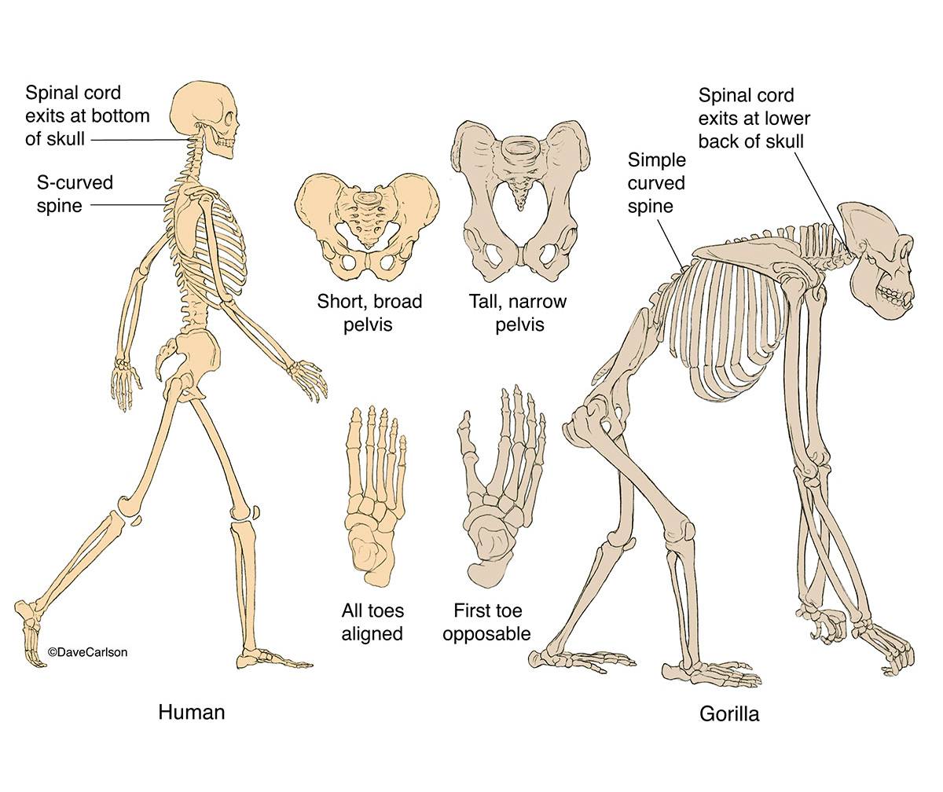

Slide 17
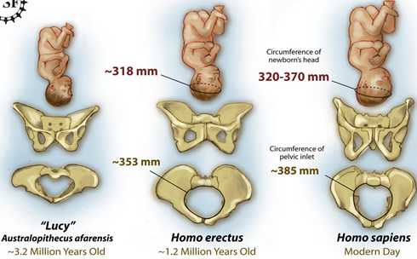

Slide 18
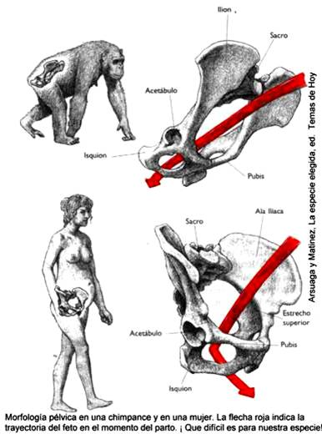

Slide 19
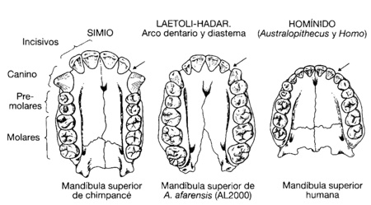

Slide 20
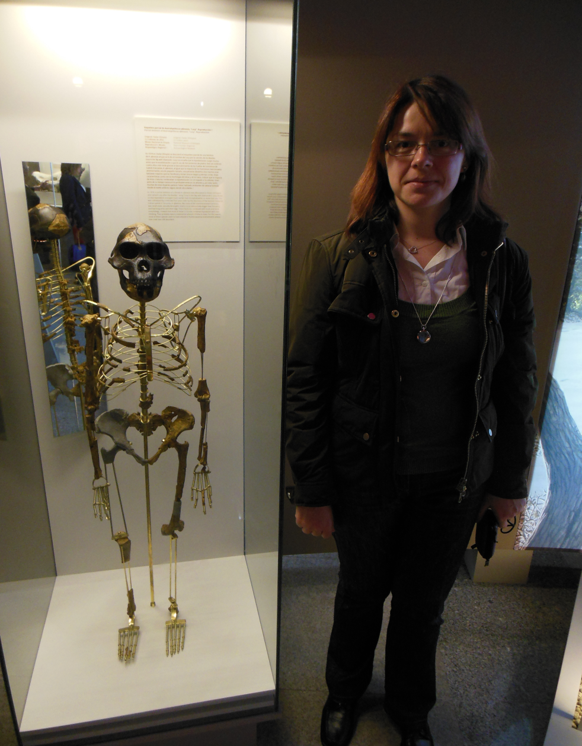
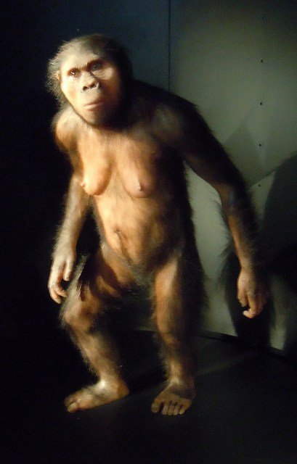
Lucy, Australopithecus Afarensis, (3,2 – 3,5 million years ago)

Slide 21
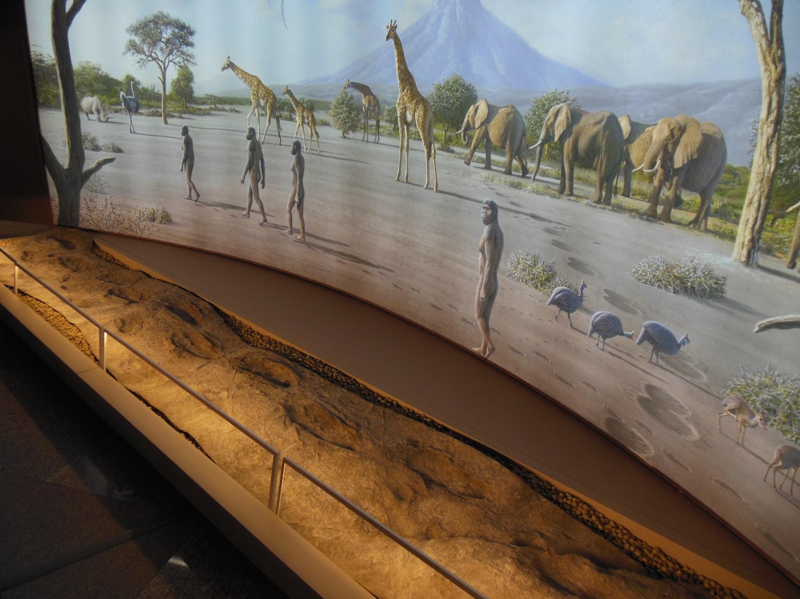
Laetoli footprints, (3,7 million years ago)

Slide 22
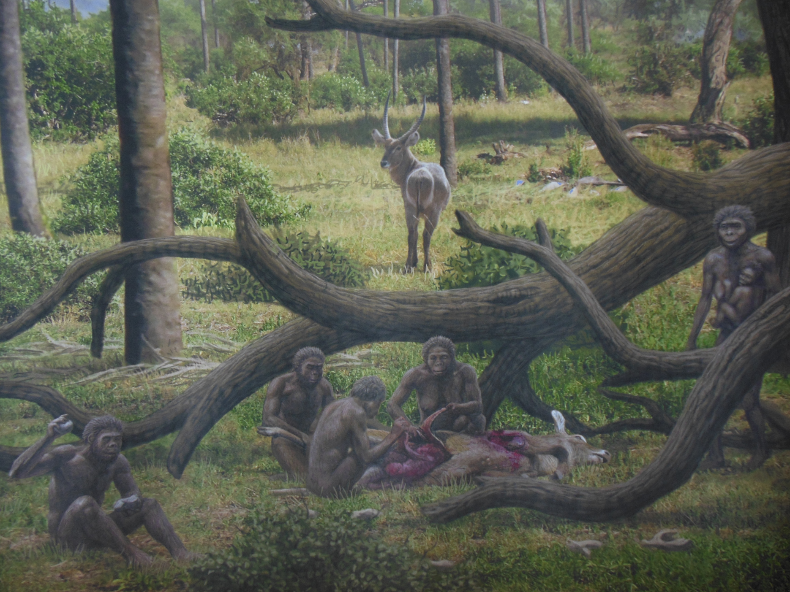
Homo Habilis (2,5 – 1,8 million years)

Slide 23
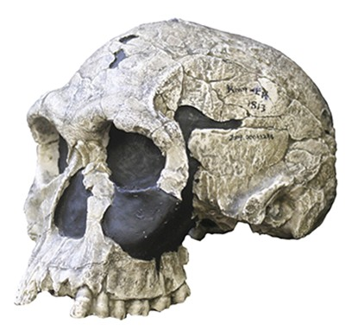
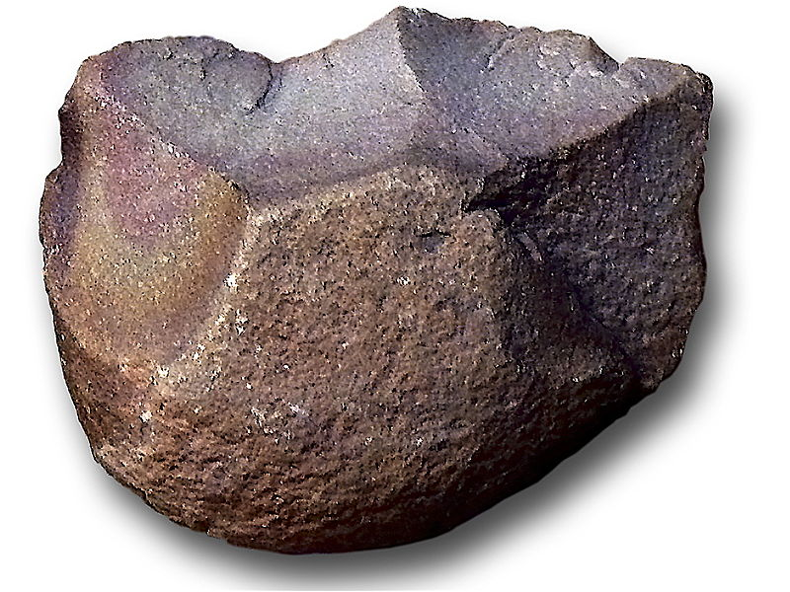
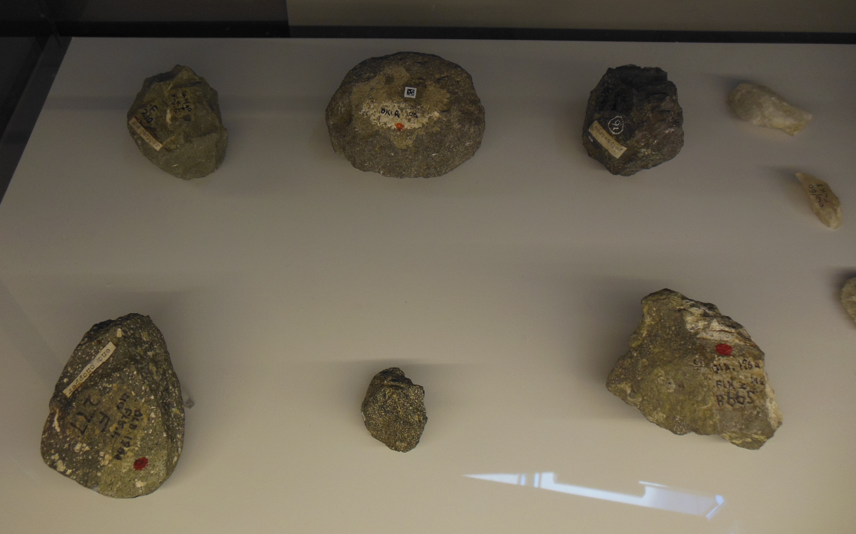
Skull of Homo Habilis
(Brow Ridge – Arco superciliar)
(Receding forehead – Frente huidiza)
Chopping tools – Oldowan choppers (Olduvayense)
(1,8 million years)

Slide 24
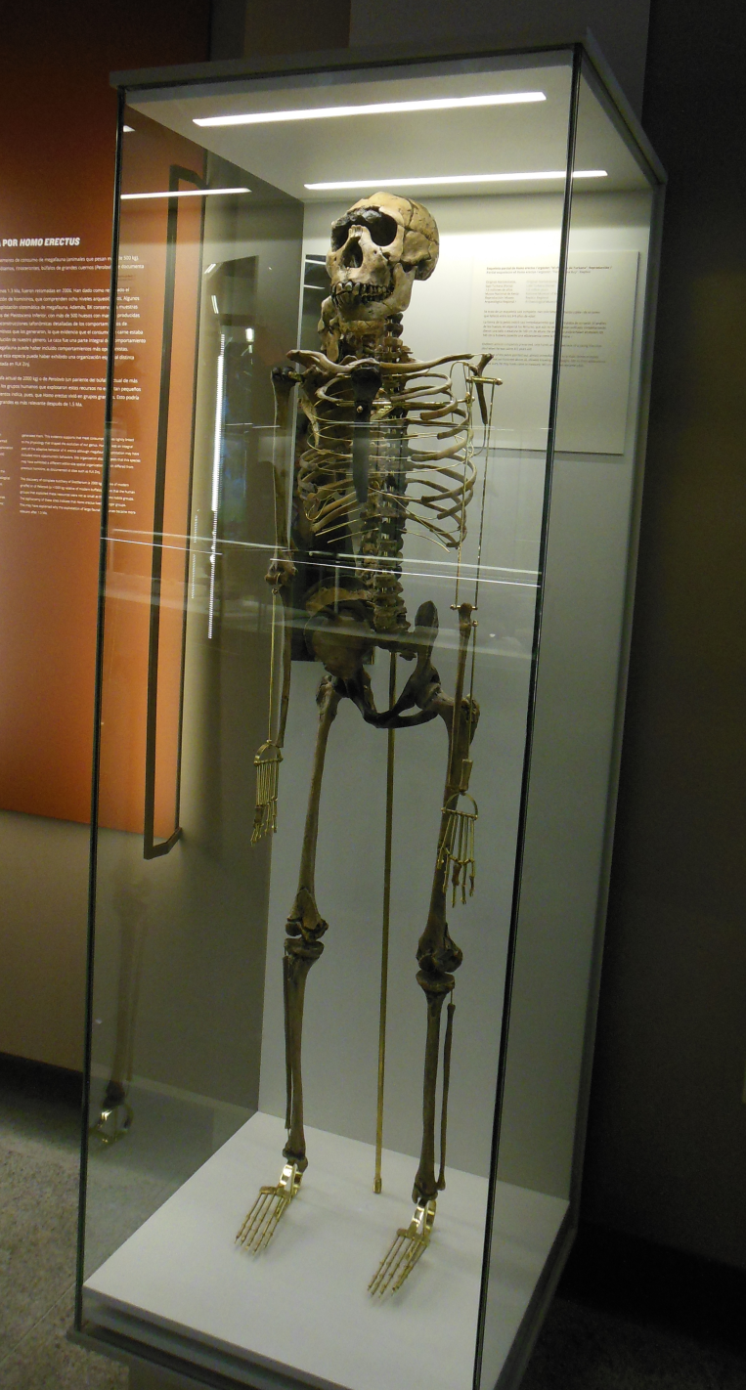
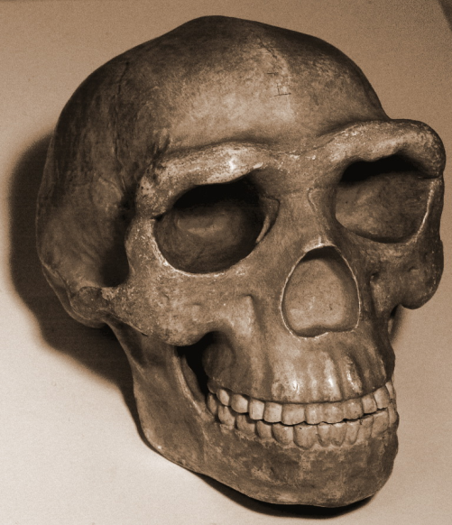
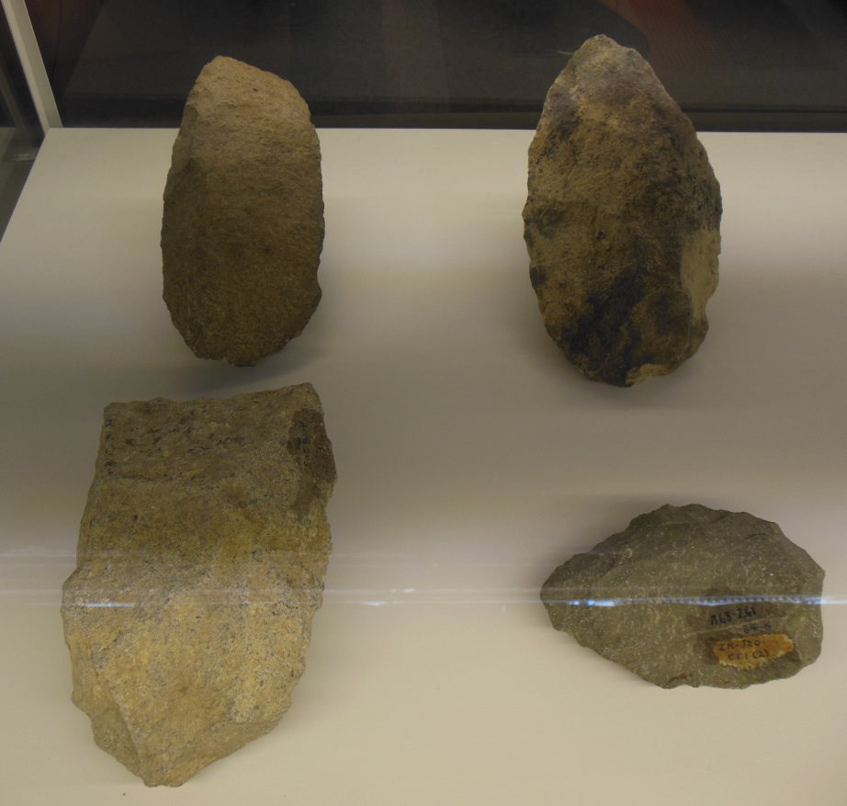
Handaxe, scraper and cleaver
(Bifaz, raedera, hendedor)
Acheulean (Achelense)
(1,5 million years)
Homo Erectus (1,9 – 400.000 years)

Slide 25
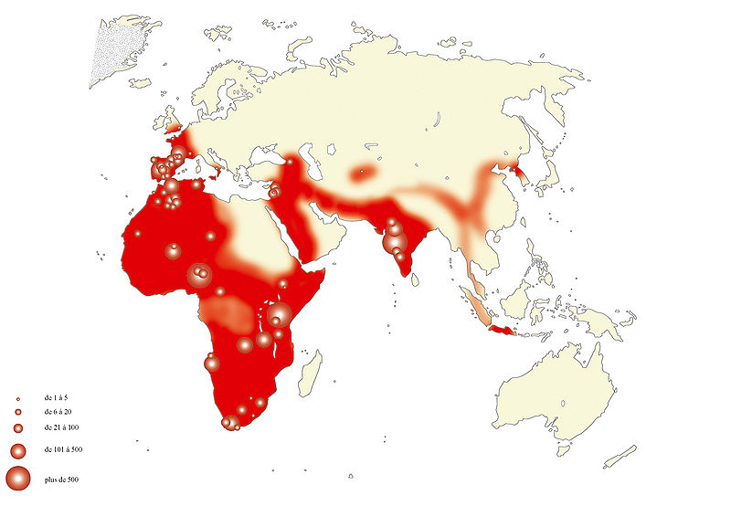
Homo Erectus (1,9 – 400.000 years)
Rests of acheulean tools. (Restos de herramientas achelenses)

Slide 26
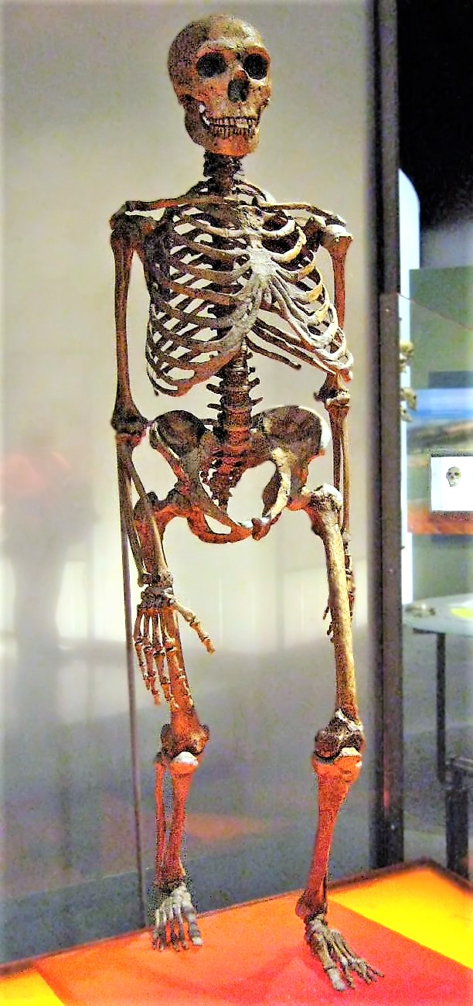
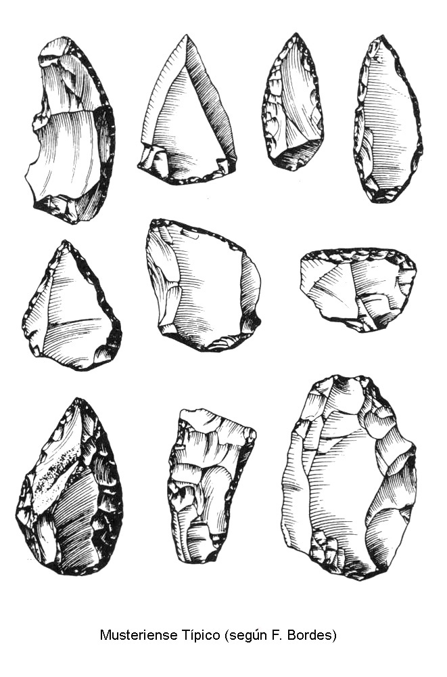
Handaxes, scrapers, burin (buriles), points (puntas), Mousterian (Musteriense) (125.000 years ago)
Homo Sapiens Neanderthalensis (230.000 - 40.000 years)

Slide 27
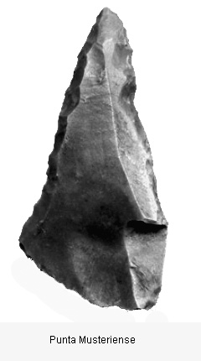
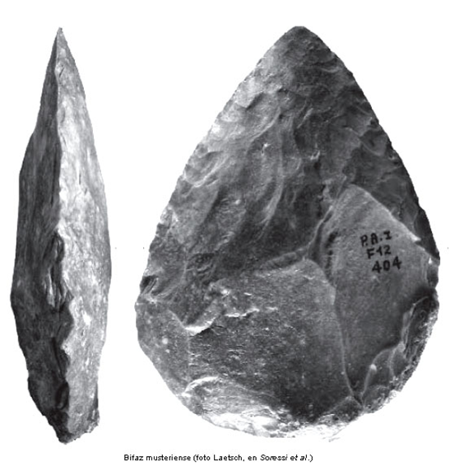
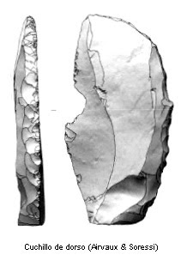

Slide 28
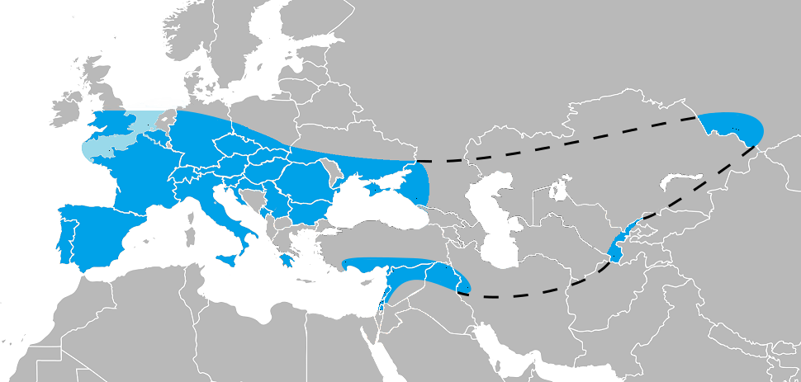
Homo Sapiens Neanderthalensis (230.000 - 40.000 years)

Slide 29
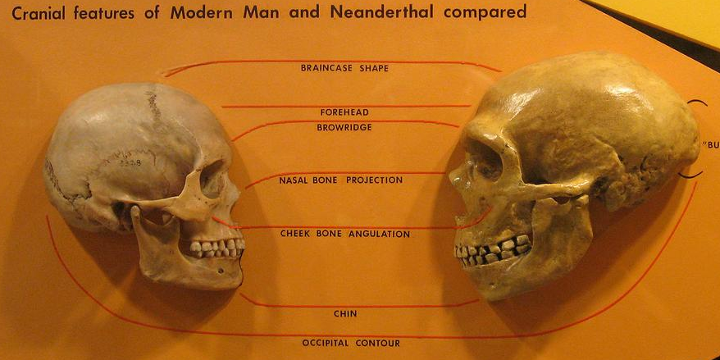
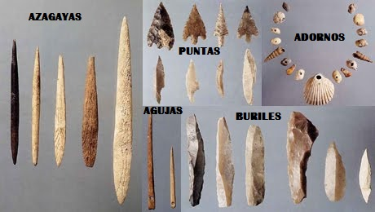
Homo Sapiens Sapiens (130.000 years ago)

Slide 30
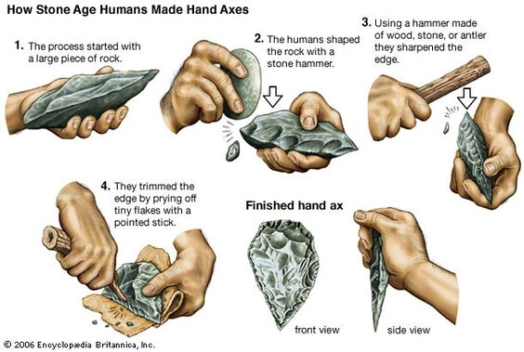
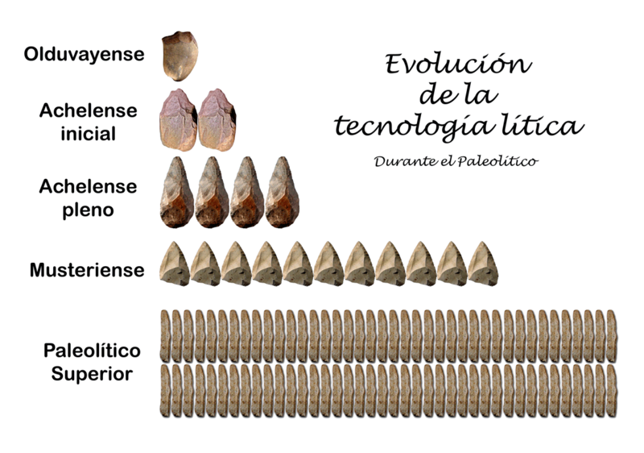
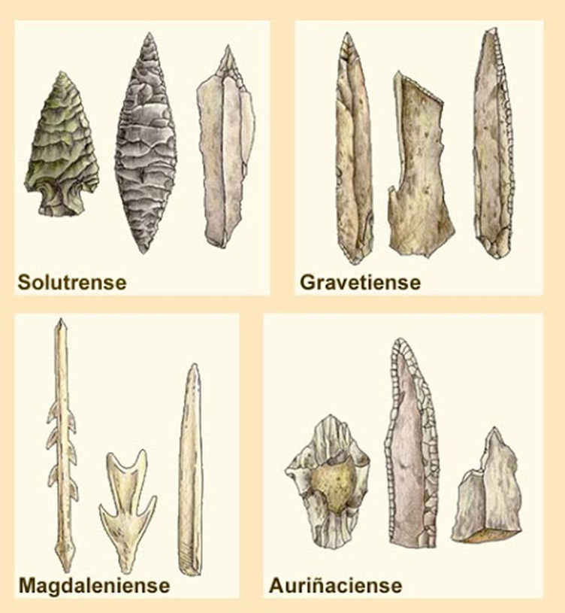
Homo Sapiens Sapiens (130.000 years ago)

